Slide 1

INpowered Discipleship
An Inductive Study of the Book of Acts
Unstoppable Discipleship
Acts 28:1–31

Slide 2
Focal Passages
Scripture Reading Volunteers:
Acts 28:11-16
Acts 28:23-29
Acts 28:30-31

Slide 3

Umshiang Double Decker Root Bridge

Slide 4
Acts 1:8
“But you will receive
when the Holy Spirit has come on you, and you will be My witnesses in Jerusalem, in all Judea and Samaria,
and to the ends of the earth.”
POWER

Slide 5
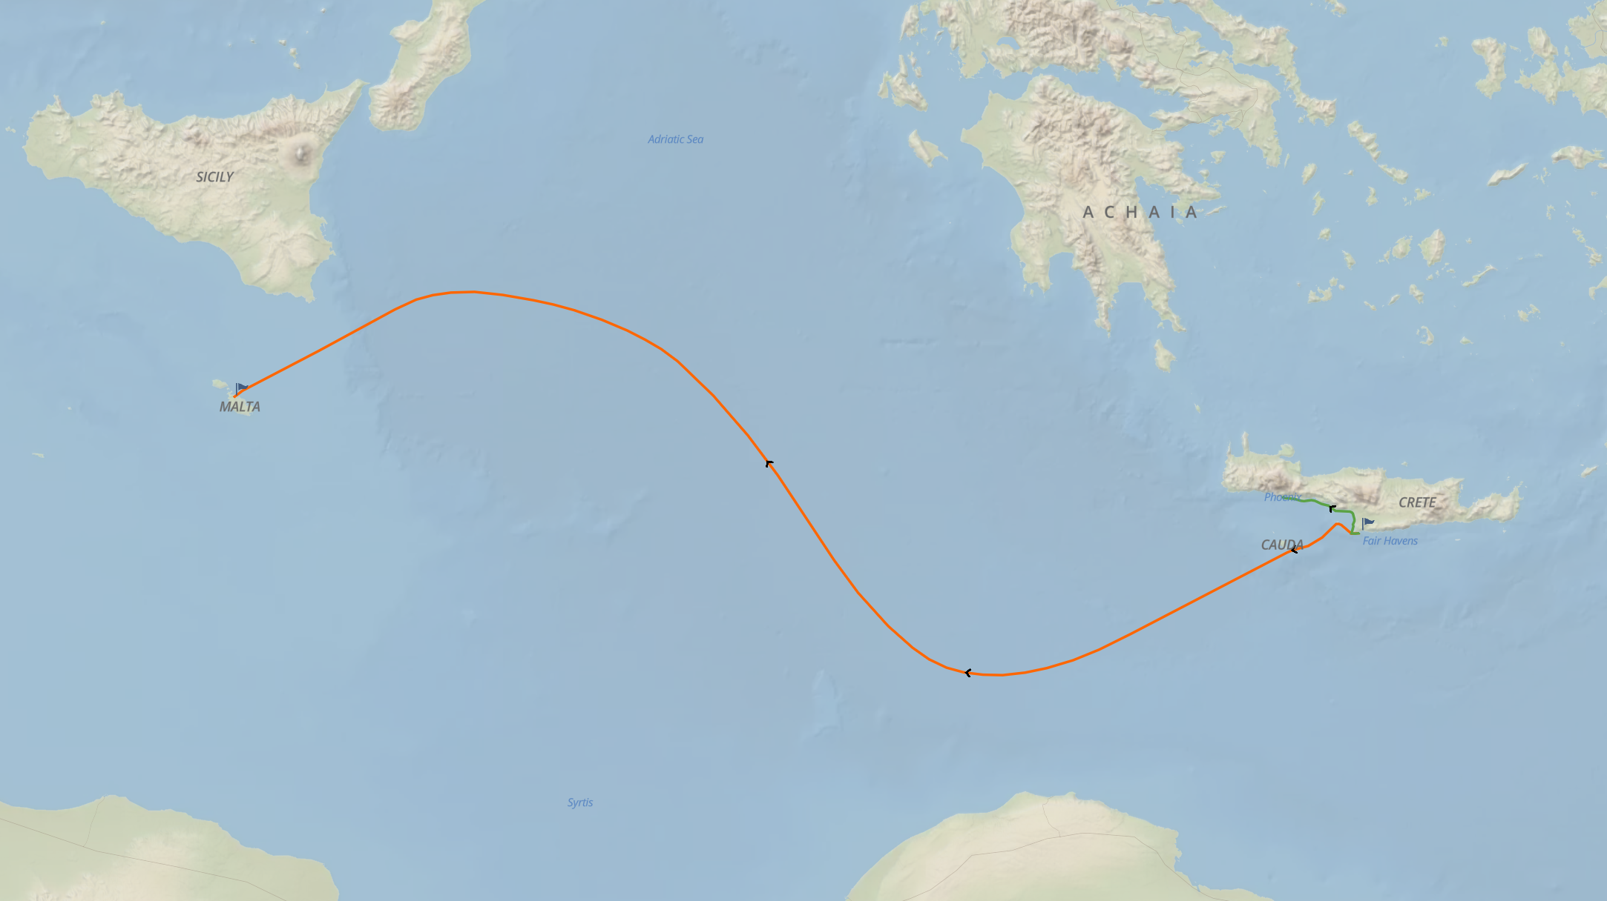
Paul and 275 others were shipwrecked off the coast of Malta.

Slide 6
Ministry
in Malta
Acts 28:1-10
Everyone on board survived the storm and safely reached shore on the island of Malta.
Paul miraculously survived a viper bite, another example of God keeping his promise that Paul would live to testify in Rome.
Paul ministered on the island, healing Publius’ father and many others.
After three months; Paul, his Roman guard, and Luke boarded another ship to Rome.
(Note Luke’s use of “we” in vv. 11-16)
Has anyone here been to Malta?

Slide 7

Rome at Last Acts 28:11-16
¹¹ After three months we set sail in an Alexandrian ship that had wintered at the island, with the Twin Gods as its figurehead. ¹² Putting in at Syracuse, we stayed three days. ¹³ From there, after making a circuit along the coast, we reached Rhegium. After one day a south wind sprang up, and the second day we came to Puteoli. ¹⁴ There we found brothers and sisters and were invited to stay a week with them.
And so we came to Rome. ¹⁵ Now the brothers and sisters from there had heard the news about us and had come to meet us as far as the Forum of Appius and the Three Taverns. When Paul saw them, he thanked God and took courage. ¹⁶ When we entered Rome, Paul was allowed to live by himself with the soldier who guarded him.
© Eric F. Glover 2021
7

Slide 8
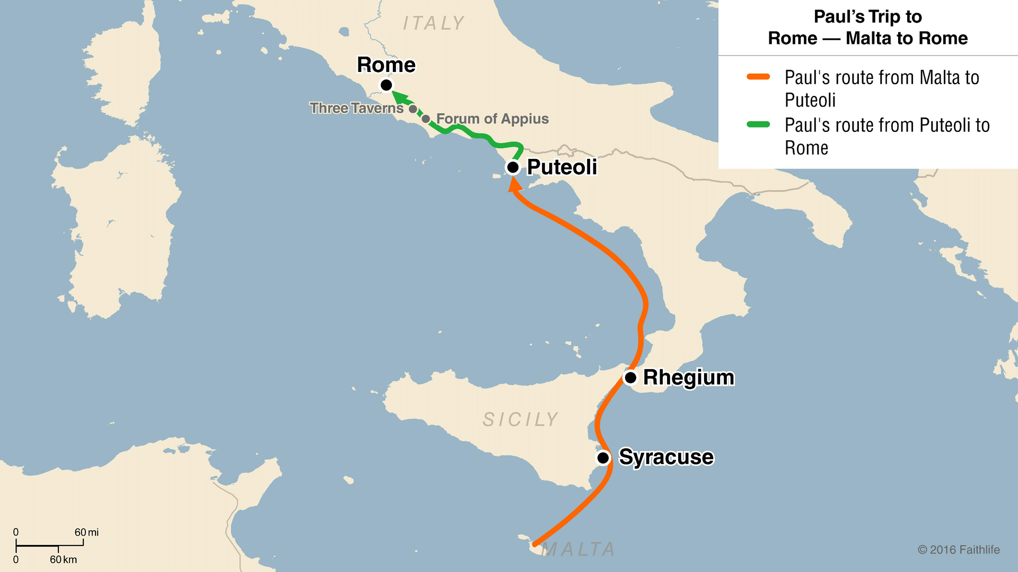
¹⁶When we entered Rome, Paul was allowed to live by himself with the soldier who guarded him.

Slide 9
Encounter
with Jews
Acts 28:17-22
After three days, Paul met with the Jewish leaders in Rome.
He told them the whole story about his trials, the objections of the Jews and his appeal to Caesar.
The Jewish leaders said they had not received any letters about him from Judea, but they were very curious:
²² But we want to hear what your views are, since we know that people everywhere are speaking against this sect.

Slide 10
Bold Witness in Rome Acts 28:23-29
²³ After arranging a day with him, many came to him at his lodging. From dawn to dusk he expounded and testified about the kingdom of God. He tried to persuade them about Jesus from both the Law of Moses and the Prophets. ²⁴ Some were persuaded by what he said, but others did not believe.
²⁵ Disagreeing among themselves, they began to leave after Paul made one statement: “The Holy Spirit was right in saying to your ancestors through the prophet Isaiah ²⁶ when he said,
© Eric F. Glover 2021
10

Slide 11
Bold Witness in Rome Acts 28:23-29
Go to these people and say: You will always be listening, but never understanding; and you will always be looking, but never perceiving. ²⁷ For the hearts of these people have grown callous, their ears are hard of hearing, and they have shut their eyes; otherwise they might see with their eyes and hear with their ears, understand with their heart and turn, and
I would heal them.
²⁸ Therefore, let it be known to you that this salvation of God has been sent to the Gentiles; they will listen.”
© Eric F. Glover 2021
11

Slide 12
Bold
Witness in Rome
Acts 28:23-28
Acts 28:23
From dawn to dusk he expounded and testified about the kingdom of God. He tried to persuade them about Jesus from both the Law of Moses and the Prophets.
How did the Jews respond to Paul?
  Some were persuaded, but others were not and it sparked yet another debate among the Jews (v. 24)
Which statement by Paul got their attention and broke up the debate?

Slide 13

Acts 28:28
Refusing
To Believe
Acts 28:23-28
Therefore, let it be known to you that this salvation of God has been sent to the Gentiles; they will listen.
Isaiah described the Jews as:
  Always listening, never understanding.
  Always looking, never perceiving.
  Calloused hearts and deaf ears.
  Eyes closed
The Jews looked something like this God:

Slide 14

Unstoppable Discipleship Acts 28:30-31
³⁰ Paul stayed two whole years in his own rented house. And he welcomed all who visited him, ³¹ proclaiming the kingdom of God and teaching about the Lord Jesus Christ with all boldness and without hindrance.
³⁰ Paul stayed two whole years in his own rented house. And he welcomed all who visited him, ³¹ proclaiming the kingdom of God and teaching about the Lord Jesus Christ with all boldness and without hindrance.
³⁰ Paul stayed two whole years in his own rented house. And he welcomed all who visited him, ³¹ proclaiming the kingdom of God and teaching about the Lord Jesus Christ with all boldness and without hindrance.
³⁰ Paul stayed two whole years in his own rented house. And he welcomed all who visited him, ³¹ proclaiming the kingdom of God and teaching about the Lord Jesus Christ with all boldness and without hindrance.
While imprisoned in Rome, Paul wrote Ephesians, Philemon, Colossians and Philippians.
The last word of the Book of Acts (akolytos in the Greek) makes an emphatic point!
It’s one word in Greek, UNHINDERED!
© Eric F. Glover 2021
14

Slide 15
IN
IN powered Discipleship
Unstoppable Discipleship
  I love the way Luke ends the Book of Acts. He makes an emphatic point: Paul’s witness was bold and unhindered, despite everything that had happened to him.
  In fact, his witness and testimony was UNSTOPPABLE!
  The impact of his ministry is incalculable; it changed the world in his day, and it’s still changing the world in our day.
  Seas will rise and storms will rage, but the Kingdom of God is UNSTOPPABLE!
POWER
“You will receive when the Holy Spirit has come on you and you will be My witnesses!”

Slide 16

Transformed!
Beginning
Oct 24th
Knowing & Doing God’s Will
An In-depth Study of Paul’s Letter to the Church in Rome

Slide 17
Romans 12:2
Do not be conformed to this age, but be transformed by the renewing of your mind, so that you may discern what is the good, pleasing, and perfect will of God.

