Slide 1

INpowered Discipleship
An Inductive Study of the Book of Acts
Peaceful Discipleship
Acts 27:1–44

Slide 2
Focal Passages
Scripture Reading Volunteers:
Acts 27:19-22
Acts 27:33-38

Slide 3
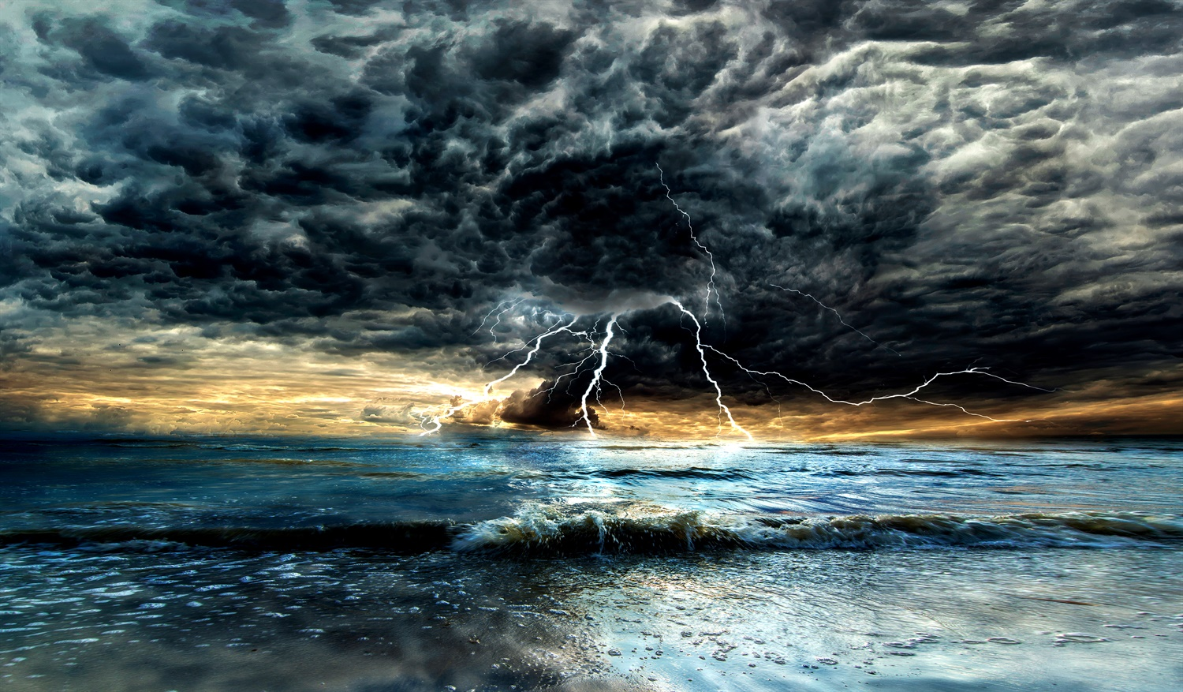
Storm Warning

Slide 4
Acts 1:8
“But you will receive
when the Holy Spirit has come on you, and you will be My witnesses in Jerusalem, in all Judea and Samaria,
and to the ends of the earth.”
POWER

Slide 5
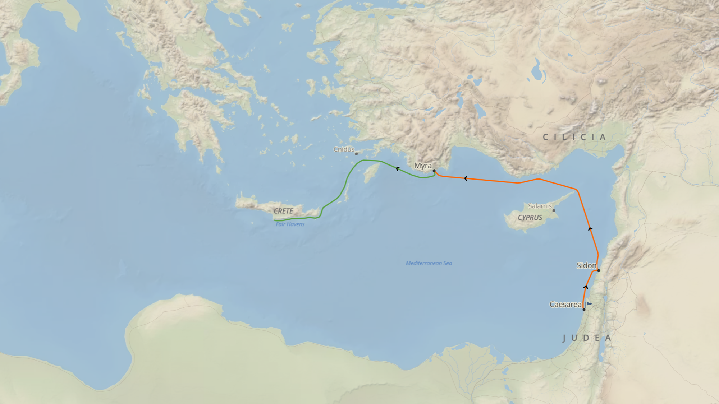
Paul’s Journey to Rome
The voyage had become very dangerous, and Paul warned the Centurion about impending disaster.
Changed ships in Myra.
Sailed north of Cyprus due to strong headwinds.
Sailed slowly for many days with great difficulty.
Much time had passed, and now winter was approaching.

Slide 6
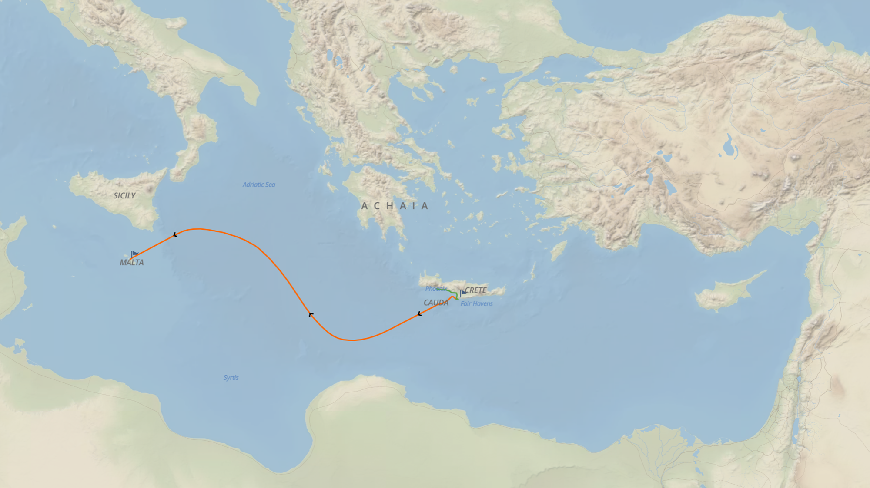
Paul’s Journey to Rome
After three days, the crew
of experienced sailors
lost all hope.
The Captain tried to reach Phoenix, a more suitable winter harbor.
Fair Havens’ harbor was unsuitable for winter.
A strong “northeaster” took them out to sea, where they were severely battered by the storm and jettisoned all cargo.

Slide 7

Paul’s Confident Hope Acts 27:19-22
¹⁹On the third day, they threw the ship’s tackle overboard with their own hands. ²⁰For many days neither sun nor stars appeared, and the severe storm kept raging. Finally all hope was fading that we would be saved.
²¹Since they had been without food for a long time, Paul then stood up among them and said, “You men should have followed my advice not to sail from Crete and sustain this damage and loss. ²²Now I urge you to take courage, because there will be no loss of any of your lives, but only of the ship.
¹⁹On the third day, they threw the ship’s tackle overboard with their own hands. ²⁰For many days neither sun nor stars appeared, and the severe storm kept raging. Finally all hope was fading that we would be saved.
²¹Since they had been without food for a long time, Paul then stood up among them and said, “You men should have followed my advice not to sail from Crete and sustain this damage and loss. ²²Now I urge you to take courage, because there will be no loss of any of your lives, but only of the ship.
© Eric F. Glover 2021
7

Slide 8

Confident
HOPE
Acts 27:19-22
Acts 27:22
Now I urge you to take courage, because there will be no loss of any
of your lives, but only of the ship.
How can Paul be so certain that no one would die after all they had endured on this voyage?
What gave him so much confidence, why would he even think it possible?

Slide 9
Confident
HOPE
Acts 27:19-22
Acts 27:23-24
²³For last night an angel of the God I belong to and serve stood by me ²⁴and said, ‘Don’t be afraid, Paul. It is necessary for you to appear before Caesar. And indeed, God has graciously given
you all those who are sailing with you.’
God always keeps His promises!
Acts 23:11
The following night, the Lord stood by him and said, “Have courage! For as you have testified about me in Jerusalem, so it is necessary for you to testify in Rome.”

Slide 10
Paul’s Reassuring Faith Acts 27:25
²⁵So take courage, men, because I believe God that it will be just the way it was told to me. ²⁶But we have to run aground on some island.”
Paul tells the men they need to stay on the ship to live.
After 14 nights
at sea, and 475 nautical miles traveled, the ship came near land, at long last.
Some of the sailors drop 4 anchors from the stern to keep from running aground in the dark.
Other sailors are nervous and lower the lifeboat, pretending to lay out anchors from the bow.
The sailors cut the ropes and drop the skiff into the sea.
© Eric F. Glover 2021
10

Slide 11

Paul’s Encouraging Prayer Acts 27:33-38
³³When it was about daylight, Paul urged them all to take food, saying, “Today is the fourteenth day that you have been waiting and going without food, having eaten nothing. ³⁴So I urge you to take some food. For this is for your survival, since none of you will lose a hair from your head.” ³⁵After he said these things and had taken some bread, he gave thanks to God in the presence of all of them, and after he broke it, he began to eat. ³⁶They all were encouraged and took food themselves. ³⁷In all there were 276 of us on the ship. ³⁸When they had eaten enough, they began to lighten the ship by throwing the grain overboard into the sea.
³³When it was about daylight, Paul urged them all to take food, saying, “Today is the fourteenth day that you have been waiting and going without food, having eaten nothing. ³⁴So I urge you to take some food. For this is for your survival, since none of you will lose a hair from your head.” ³⁵After he said these things and had taken some bread, he gave thanks to God in the presence of all of them, and after he broke it, he began to eat. ³⁶They all were encouraged and took food themselves. ³⁷In all there were 276 of us on the ship. ³⁸When they had eaten enough, they began to lighten the ship by throwing the grain overboard into the sea.
³³When it was about daylight, Paul urged them all to take food, saying, “Today is the fourteenth day that you have been waiting and going without food, having eaten nothing. ³⁴So I urge you to take some food. For this is for your survival, since none of you will lose a hair from your head.” ³⁵After he said these things and had taken some bread, he gave thanks to God in the presence of all of them, and after he broke it, he began to eat. ³⁶They all were encouraged and took food themselves. ³⁷In all there were 276 of us on the ship. ³⁸When they had eaten enough, they began to lighten the ship by throwing the grain overboard into the sea.
³³When it was about daylight, Paul urged them all to take food, saying, “Today is the fourteenth day that you have been waiting and going without food, having eaten nothing. ³⁴So I urge you to take some food. For this is for your survival, since none of you will lose a hair from your head.” ³⁵After he said these things and had taken some bread, he gave thanks to God in the presence of all of them, and after he broke it, he began to eat. ³⁶They all were encouraged and took food themselves. ³⁷In all there were 276 of us on the ship. ³⁸When they had eaten enough, they began to lighten the ship by throwing the grain overboard into the sea.
How could Paul remain so peaceful and calm amid such turmoil and crisis?
© Eric F. Glover 2021
11

Slide 12
Encouraging
Prayer
Acts 27:33-38
Philippians 4:6-7
⁶Don’t worry about anything, but in everything, through prayer and petition with thanksgiving, present your requests to God. ⁷ And the peace of God, which surpasses all understanding, will guard your
hearts and minds in Christ Jesus.
Luke 8:22-25
Does this situation remind you of any other storm story?
Paul’s prayer of thanksgiving brought encouragement to the men on the ship who had endured much.
It also brought peace to him and all who endured the storm alongside him.
Who brought peace in the middle of
that storm?
Who comforts us?

Slide 13
Peaceful
Discipleship
IN
IN powered Discipleship
  Amid a chaotic and terrifying situation, Paul remained calm and peaceful, trusting God to keep his promise.
  The way he responded to the situation made an indelible mark on all who were with him - they were all healthy, safely ashore and encouraged by Paul.
  Some of us are in the middle of a major storm right now.
  How we respond to the situation will say much about our relationship with God and our faith in Him.
  Don’t worry – present your requests to God and trust Him with the outcome!
  May the peace that surpasses all understanding, guard your hearts and minds in Christ Jesus, as you navigate the storm!

Slide 14
INpowered Discipleship
An Inductive Study of the Book of Acts
Unstoppable Discipleship
Acts 28:1–31

Slide 15

Transformed!
Beginning
Oct 24th
Knowing & Doing God’s Will
An In-depth Study of Paul’s Letter to the Church in Rome

Slide 16
Romans 12:2
Do not be conformed to this age, but be transformed by the renewing of your mind, so that you may discern what is the good, pleasing, and perfect will of God.

