Slide 1
Email
List
Weekly emails with study materials
Distribution list has been updated (174 people on the list now)
Email me at the following address, if you want to be added to the list:
Welcome all new members!
efglover@gmail.com

Slide 2

www.doubtlessliving.com
Hover over Bible Studies and click INpowered Discipleship from the drop-down menu.
Weekly Bible study materials are posted to my blog for easy access and retrieval.
© Eric F. Glover 2021
2

Slide 3

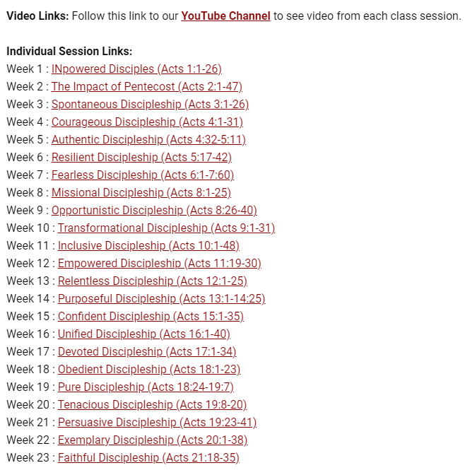
Scroll to the bottom of the page and you will find hotlinks for each week in the series.
© Eric F. Glover 2021
3

Slide 4

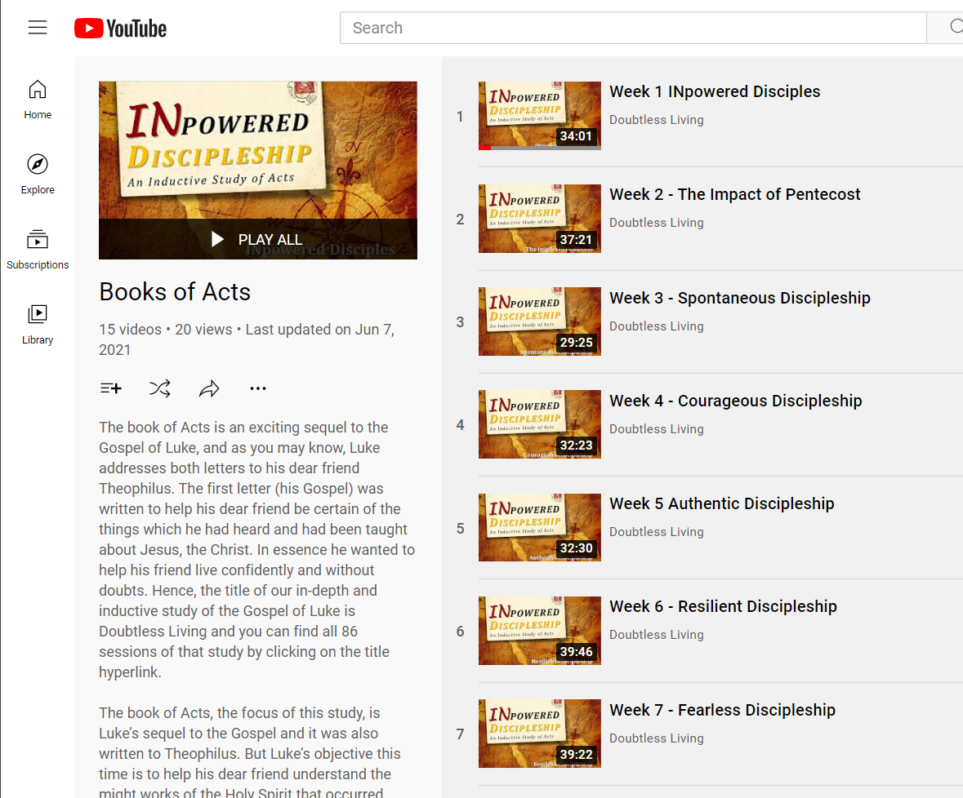

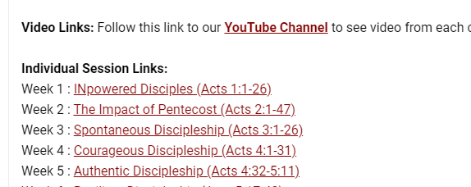

Videos of past Zoom sessions are available on the Doubtless Living YouTube channel as well.
Two ways to get there:
Click Here
https://www.youtube.com/playlist?list=PL-jFPGzfChJ7ASA_jsqndy58VvdpFcx1Z
© Eric F. Glover 2021
4

Slide 5

INpowered Discipleship
An Inductive Study of the Book of Acts
Conscientious Discipleship Acts 22:30 - 23:35

Slide 6
Focal Passages
Scripture Reading Volunteers:
Acts 22:30 – 23:11
Acts 20:18-20
Acts 20:33-35
1 Timothy 1:5, 1:19
Acts 23:31–35

Slide 7
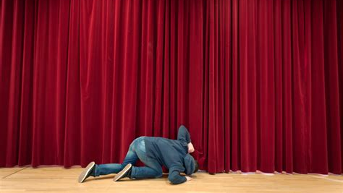
What’s behind the curtain?

Slide 8
Acts 1:8
“But you will receive when the Holy Spirit has come on you, and you will be My witnesses in Jerusalem, in all Judea and Samaria, and to the ends of the earth.”
POWER

Slide 9

Clear Conscience Acts 22:30-23:11
³⁰ The next day, since he wanted to find out exactly why Paul was being accused by the Jews, he released him and instructed the chief priests and all the Sanhedrin to convene. He brought Paul down and placed him before them. ¹ Paul looked straight at the Sanhedrin and said, “Brothers, I have lived my life before God in all good conscience to this day.” ² The high priest Ananias ordered those who were standing next to him to strike him on the mouth. ³ Then Paul said to him, “God is going to strike you, you whitewashed wall! You are sitting there judging me according to the law, and yet in violation of the law are you ordering me to be struck?”
© Eric F. Glover 2021
9

Slide 10
Clear Conscience Acts 22:30-23:11
⁴ Those standing nearby said, “Do you dare revile God’s high priest?”
⁵ “I did not know, brothers, that he was the high priest,” replied Paul. “For it is written, You must not speak evil of a ruler of your people.”, ⁶ When Paul realized that one part of them were Sadducees and the other part were Pharisees, he cried out in the Sanhedrin, “Brothers, I am a Pharisee, a son of Pharisees. I am being judged because of the hope of the resurrection of the dead!” ⁷ When he said this, a dispute broke out between the Pharisees and the Sadducees, and the assembly was divided. ⁸ For the Sadducees say there is no resurrection, and neither angel nor spirit, but the Pharisees affirm them all.
© Eric F. Glover 2021
10

Slide 11
Clear Conscience Acts 22:30-23:11
⁹ The shouting grew loud, and some of the scribes of the Pharisees’ party got up and argued vehemently, “We find nothing evil in this man. What if a spirit or an angel has spoken to him?”,
¹⁰ When the dispute became violent, the commander feared that Paul might be torn apart by them and ordered the troops to go down, take him away from them, and bring him into the barracks. ¹¹ The following night, the Lord stood by him and said, “Have courage! For as you have testified about me in Jerusalem, so it is necessary for you to testify in Rome.”
© Eric F. Glover 2021
11

Slide 12
Paul’s Conscience Acts 23:1
¹Paul looked straight at the Sanhedrin and said, “Brothers, I have lived my life before God in all good conscience to this day.”
Paul opened his defense by declaring he had a clear conscience, a remark similar in tone to how he addressed the Ephesian elders.
Acts 20:18-20
¹⁸When they came to him, he said to them, “You know, from the first day I set foot in Asia, how I was with you the whole time, ¹⁹serving the Lord with all humility, with tears, and during the trials that came to me through the plots of the Jews. ²⁰You know that I did not hesitate to proclaim anything to you that was profitable and to teach you publicly and from house to house.
Acts 20:33-35
³³I have not coveted anyone’s silver or gold or clothing. ³⁴You yourselves know that I worked with my own hands to support myself and those who are with me. ³⁵In every way I’ve shown you that it is necessary to help the weak by laboring like this and to remember the words of the Lord Jesus, because he said, ‘It is more blessed to give than to receive.’”

Slide 13
Paul’s Conscience Acts 23:1
¹Paul looked straight at the Sanhedrin and said, “Brothers, I have lived my life before God in all good conscience to this day.”
Paul would appeal again to conscience in his defense before Felix.
These are the only two occurrences of the word in Acts, but Paul mentions a good conscience twice again in 1 Timothy.
Acts 24:16
I always strive to have a clear conscience toward God and men.

Slide 14
Paul’s Conscience Acts 23:1
1 Timothy 1:5
Now the goal of our instruction is love that comes from a pure heart, a good conscience, and a sincere faith.
1 Timothy 1:19
having faith and a good conscience, which some have rejected and have shipwrecked the faith.
Greek Translation
Syneidesis (syn-ē-da-sis)

Slide 15
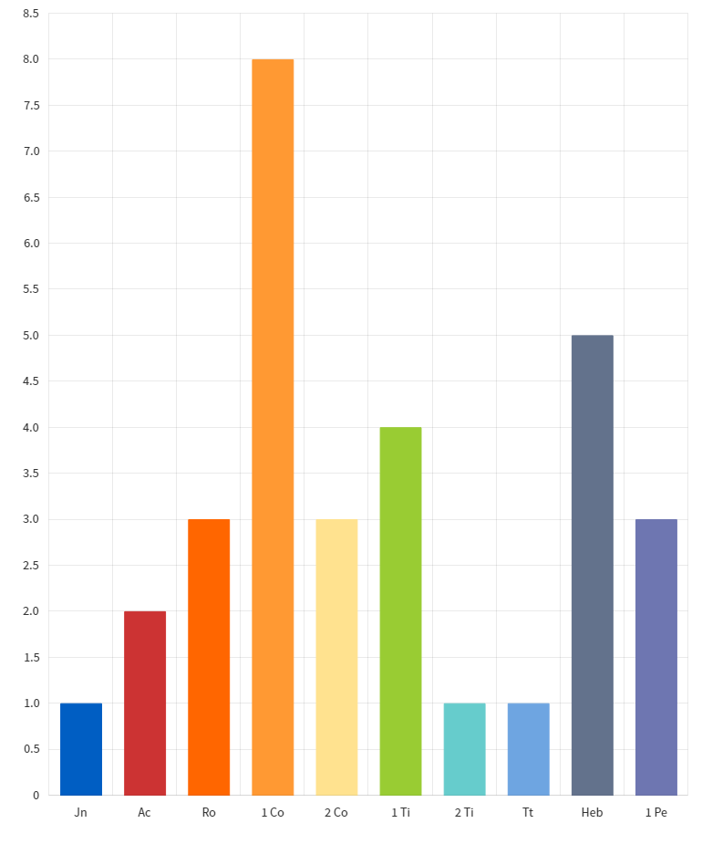
Paul’s Conscience Acts 23:1
Syneidesis (syn-e-da-sis)
Used 30 times in the New Testament
Paul accounts for 20 of the 30 instances
Syneidesis (from the BDAG lexicon)
Consciousness Awareness of information about something.
Moral Consciousness Inward faculty of distinguishing right and wrong.
Conscientiousness Attentive to obligation.
What does this suggest about Paul?

Slide 16
Paul’s Conscience Acts 23:1
So then, what does conscience mean in this context?
What is Paul saying when he says his conscience is clear? Clear of what?
What was Paul saying to the Sanhedrin, and others, when he said he had a clear conscience?
What implications does this have for us?

Slide 17
The rest of the
Story Acts 23:12-35
Some of the Jews formed a conspiracy, took an oath, and plotted to kill Paul the next morning on the way to his trial before the Sanhedrin. (12-15)
Paul’s nephew overheard their scheming and reported it to the Roman commander, foiling their surprise. (16-22)
The Roman commander, not wanting anything to happen to Paul in Jerusalem, sent him to Felix by night with a heavily armed escort. (23-35)
Felix, the Governor of Judea, lived in Caesarea.
God kept his promise and Paul would live to testify in Rome.

Slide 18
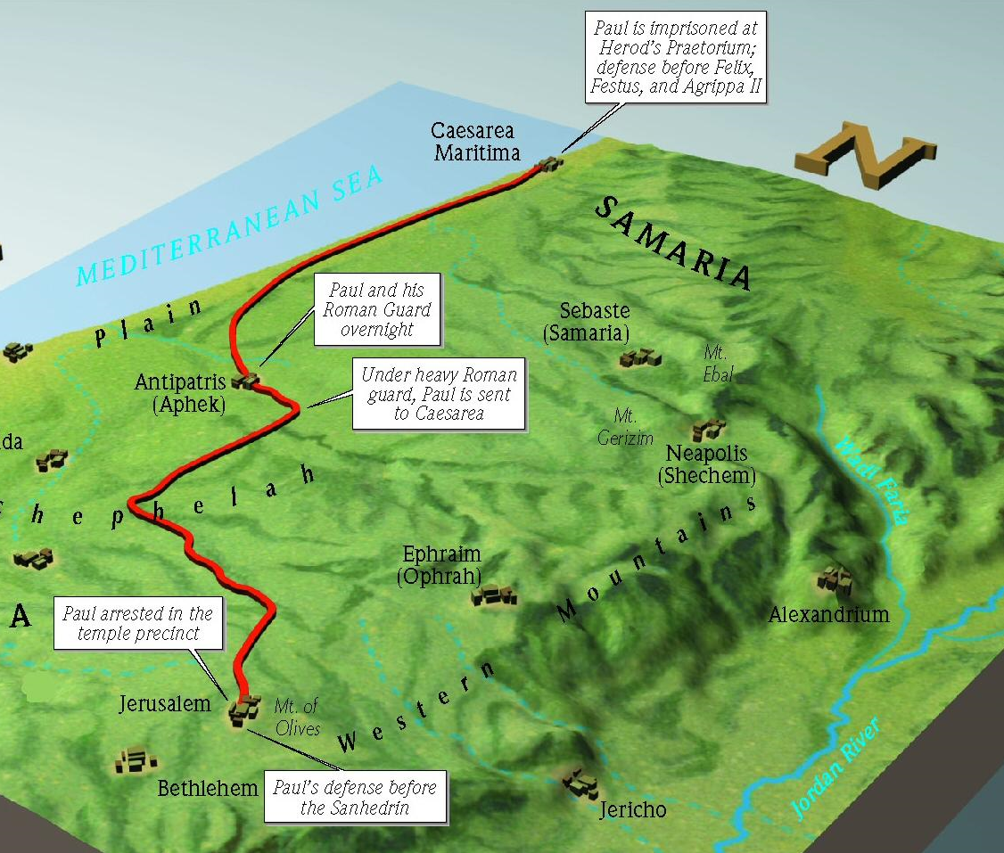
Paul’s Escape Acts 23:31-35
Antipatris, built by Herod the Great, was in Samaria.

Slide 19
Paul’s Deliverance Acts 23:31-35
³¹ So the soldiers took Paul during the night and brought him to Antipatris as they were ordered. ³² The next day, they returned to the barracks, allowing the cavalry to go on with him. ³³ When these men entered Caesarea and delivered the letter to the governor, they also presented Paul to him. ³⁴ After he read it, he asked what province he was from. When he learned he was from Cilicia, ³⁵ he said, “I will give you a hearing whenever your accusers also get here.” He ordered that he be kept under guard in Herod’s palace.
Paul spent 2 years in prison there, ironically, under both Roman custody and protection.
One never knows when our witness might be hindered, like Paul.
© Eric F. Glover 2021
19

Slide 20
IN
IN powered Discipleship
Conscientious Discipleship
The Apostle Paul went to great lengths, at great personal risk, being all things to all people, so that no one could ever say that he didn’t tell them about Jesus.
We may not be called to travel the world as a missionary like Paul, but we are all commanded to “make disciples” by Jesus.
Can you like Paul say, my conscience is clear?
Who within your sphere of influence needs to hear about Jesus?

Slide 21
INpowered Discipleship
An Inductive Study of the Book of Acts
Hopeful Discipleship Acts 24:1-27

