Slide 1

INpowered Discipleship
An Inductive Study of the Book of Acts
Durable Discipleship Acts 21:26 - 22:29

Slide 2
Focal Passages
Scripture Reading Volunteers:
Acts 21:26-30
Acts 21:31-36
Acts 21:37-40

Slide 3
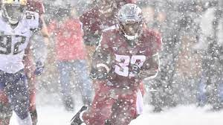
Tough Conditions
What are the worst you’ve ever had to endure?

Slide 4
Acts 1:8
“But you will receive when the Holy Spirit has come on you, and you will be My witnesses in Jerusalem, in all Judea and Samaria, and to the ends of the earth.”
POWER

Slide 5

Trouble in Jerusalem Acts 21:26-30
²⁶So the next day, Paul took the men, having purified himself along with them, and entered the temple, announcing the completion of the purification days when the offering would be made for each of them. ²⁷When the seven days were nearly over, some Jews from the province of Asia saw him in the temple, stirred up the whole crowd, and seized him, ²⁸shouting, “Fellow Israelites, help! This is the man who teaches everyone everywhere against our
© Eric F. Glover 2021
5

Slide 6
Trouble in Jerusalem Acts 21:26-30
people, our law, and this place. What’s more, he also brought Greeks into the temple and has defiled this holy place.” ²⁹For they had previously seen Trophimus the Ephesian in the city with him, and they supposed that Paul had brought him into the temple.
³⁰The whole city was stirred up, and the people rushed together. They seized Paul, dragged him out of the temple, and at once the gates were shut.
© Eric F. Glover 2021
6

Slide 7
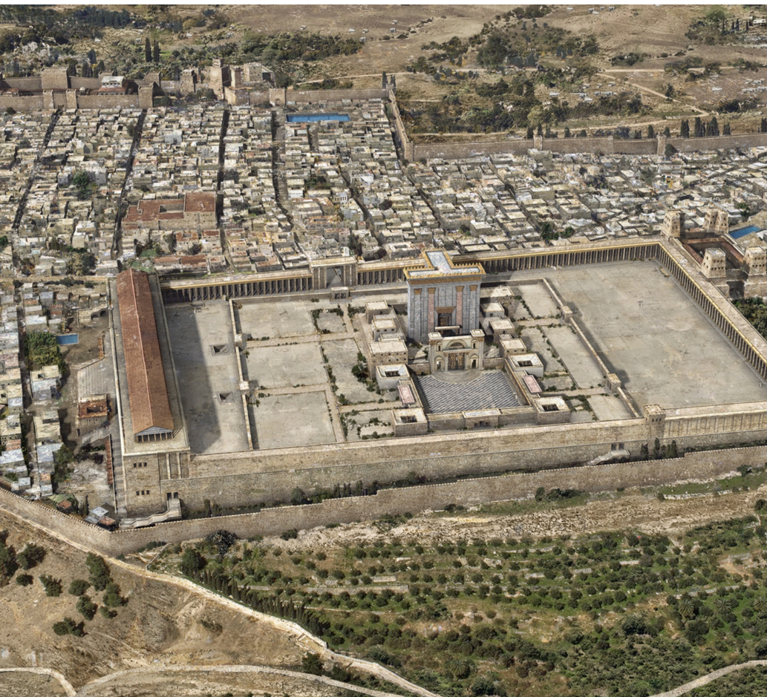
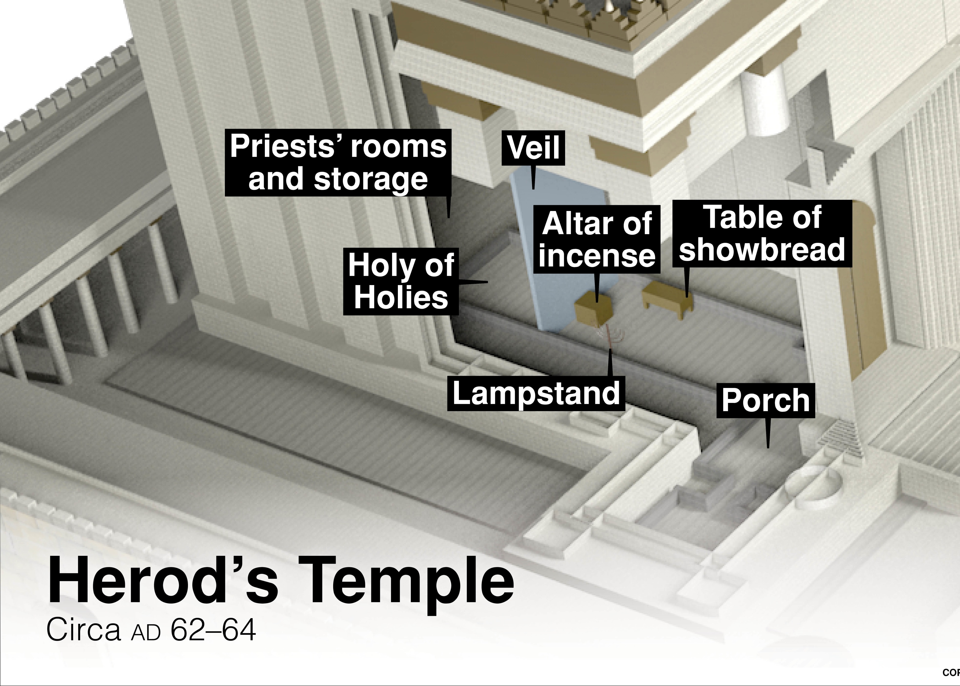
Soreg
Prohibited Gentiles and non-purified Jews from entering the temple.

Slide 8
Noble Gesture Acts 21:26
²⁶So the next day, Paul took the men, having purified himself along with them, and entered the temple, announcing the completion of the purification days when the offering would be made for each of them.
1 Corinthians 9:20, 22
²⁰To the Jews I became like a Jew, to win Jews; to those under the law, like one under the law — though I myself am not under the law — to win those under the law…
^{22…}I have become all things to all people, so that I may by every possible means save some.
Why did Paul go along with the Elders plan?
© Eric F. Glover 2021
8

Slide 9
Predictable Response Acts 21:26-29
²⁷When the seven days were nearly over, some Jews from the province of Asia saw him in the temple, stirred up the whole crowd, and seized him, ²⁸shouting, “Fellow Israelites, help!
²⁷When the seven days were nearly over, some Jews from the province of Asia saw him in the temple, stirred up the whole crowd, and seized him, ²⁸shouting, “Fellow Israelites, help!
Did it work? Were the Jews happy?
Who instigated the trouble in the Temple?
Why is that not surprising?
© Eric F. Glover 2021
9

Slide 10
False Accusation Acts 21:26-29
^{28…}This is the man who teaches everyone everywhere against our people, our law, and this place. What’s more, he also brought Greeks into the temple and has defiled this holy place.” ²⁹For they had previously seen Trophimus the Ephesian in the city with him, and they supposed that Paul had brought him into the temple.
^{28…}This is the man who teaches everyone everywhere against our people, our law, and this place. What’s more, he also brought Greeks into the temple and has defiled this holy place.” ²⁹For they had previously seen Trophimus the Ephesian in the city with him, and they supposed that Paul had brought him into the temple.
^{28…}This is the man who teaches everyone everywhere against our people, our law, and this place. What’s more, he also brought Greeks into the temple and has defiled this holy place.” ²⁹For they had previously seen Trophimus the Ephesian in the city with him, and they supposed that Paul had brought him into the temple.
Acts 16:3 Paul wanted Timothy to go with him; so he took him and circumcised him because of the Jews who were in those places, since they all knew that his father was a Greek.
What accusations did they make about Paul?
Were the accusations true?
© Eric F. Glover 2021
10

Slide 11
Anarchy in Jerusalem Acts 21:31-36
³¹As they were trying to kill him, word went up to the commander of the regiment that all Jerusalem was in chaos. ³²Taking along soldiers and centurions, he immediately ran down to them. Seeing the commander and the soldiers, they stopped beating Paul. ³³Then the commander approached, took him into custody, and ordered him to be bound with two chains. He asked who he was and what he had done. ³⁴Some in the crowd were shouting one
© Eric F. Glover 2021
11

Slide 12
Anarchy in Jerusalem Acts 21:31-36
thing and some another. Since he was not able to get reliable information because of the uproar, he ordered him to be taken into the barracks. ³⁵When Paul got to the steps, he had to be carried by the soldiers because of the violence of the crowd, ³⁶for the mass of people followed, yelling, “Get rid of him!”
© Eric F. Glover 2021
12

Slide 13
Anarchy in Jerusalem Acts 21:27-36
³⁰The whole city was stirred up, and the people rushed together. They seized Paul, dragged him out of the temple, and at once the gates were shut.
³¹As they were trying to kill him, word went up to the commander of the regiment that all Jerusalem was in chaos. ³²Taking along soldiers and centurions, he immediately ran down to them. Seeing the commander and the soldiers, they stopped beating Paul.
³⁰The whole city was stirred up, and the people rushed together. They seized Paul, dragged him out of the temple, and at once the gates were shut.
³¹As they were trying to kill him, word went up to the commander of the regiment that all Jerusalem was in chaos. ³²Taking along soldiers and centurions, he immediately ran down to them. Seeing the commander and the soldiers, they stopped beating Paul.
Six riots Incited by Paul:
Lystra (c. 14)
Philippi (c. 16)
Thessalonica (c. 17)
Berea (c. 17)
Ephesus (c. 19)
Jerusalem (c. 21)
How did the crowd respond to their accusations?
Do you recall any other situations like this in Acts?
© Eric F. Glover 2021
13

Slide 14
Arrested by Romans Acts 21:33-36
³³Then the commander approached, took him into custody, and ordered him to be bound with two chains. He asked who he was and what he had done. ³⁴Some in the crowd were shouting one thing and some another. Since he was not able to get reliable information because of the uproar, he ordered him to be taken into the barracks. ³⁵When Paul got to the steps, he had to be carried by the soldiers because of the violence of the crowd, ³⁶for the mass of people followed, yelling, “Get rid of him!”
Why did the Roman commander intervene in the situation?
Do you see any parallels between how Jesus and Paul were treated in Jerusalem?
© Eric F. Glover 2021
14

Slide 15
Parallels in Suffering
There are several parallels between the sufferings of Christ and the sufferings of the apostle Paul.
Both Jesus and Paul were:
Rejected by their own people, arrested without cause and imprisoned
Unjustly accused and willfully misrepresented by false witnesses
Slapped in the face in court (23:2)
Victims of secret Jewish plots
Condemned by the mob – “Away with him”

Slide 16
Parallels in Suffering
Both were subjected to a series of five trials:
Jesus
Paul
Before Annas
The Crowd
Speaking in Greek, Paul convinced the Roman commander to allow him to speak to the crowd.
The Sanhedrin
The Sanhedrin
Pilate (1)
King Herod Agrippa II
King Herod Antipas
Felix
Pilate (2)
Festus

Slide 17
Paul Defends Himself Acts 21:37-40
³⁷As he was about to be brought into the barracks, Paul said to the commander, “Am I allowed to say something to you?”
He replied, “You know how to speak Greek? ³⁸Aren’t you the Egyptian who started a revolt some time ago and led four thousand men of the Assassins into the wilderness?”
³⁹Paul said, “I am a Jewish man from Tarsus of Cilicia, a citizen of an important city. Now I ask you, let me speak to the people.”
⁴⁰After he had given permission, Paul stood on the steps and motioned with his hand to the people. When there was a great hush, he addressed them in Aramaic:,
³⁷As he was about to be brought into the barracks, Paul said to the commander, “Am I allowed to say something to you?”
He replied, “You know how to speak Greek? ³⁸Aren’t you the Egyptian who started a revolt some time ago and led four thousand men of the Assassins into the wilderness?”
³⁹Paul said, “I am a Jewish man from Tarsus of Cilicia, a citizen of an important city. Now I ask you, let me speak to the people.”
⁴⁰After he had given permission, Paul stood on the steps and motioned with his hand to the people. When there was a great hush, he addressed them in Aramaic:,
Paul, trying to be all things to all people, spoke their native language.
© Eric F. Glover 2021
17

Slide 18
Paul’s Testimony Acts 22:1-29
Paul gave his personal testimony to the crowd in Aramaic, grabbing their attention:
Paul the Pharisee (22:1-5) – Paul established common ground with the audience by telling them of his training and former zealousness for Judaism.
Paul the Believer (22:6-13) – Paul told the crowd about his Damascus road experience.
Paul the witness (22:14-21) – Paul shared the good news with the crowd and told them how God had called him to witness to the Gentiles.
Paul the Prisoner (22:22-29) – the crowd reacted violently to Paul’s message and started to riot again. The Roman’s seized Paul and started to flog him before learning of his Roman citizenship.
What enabled Paul to speak so boldly in the face of a life and death situation?

Slide 19
IN
IN powered Discipleship
Durable Discipleship
Paul endured a great deal of hardship and suffering for the sake of the Gospel, but he never gave up or lost courage.
He tried to address the rioting crowd in Ephesus, but his friends stopped him.
He faced another angry mob in Jerusalem, but this time he stood undaunted before them to speak, even after being brutally beaten.
Jesus commissioned us to “make disciples” and Paul serves as a great example of courage and boldness to us in fulfilling that commission himself.
Let us pray that we will be equally undaunted while enduring trials and challenges for the sake of that call.

Slide 20
INpowered Discipleship
An Inductive Study of the Book of Acts
Vocal Discipleship Acts 22:30 - 23:35

