Slide 1

Transformed!
Knowing & Doing God’s Will
An In-depth Study of Paul’s Letter to the Church in Rome

Slide 2
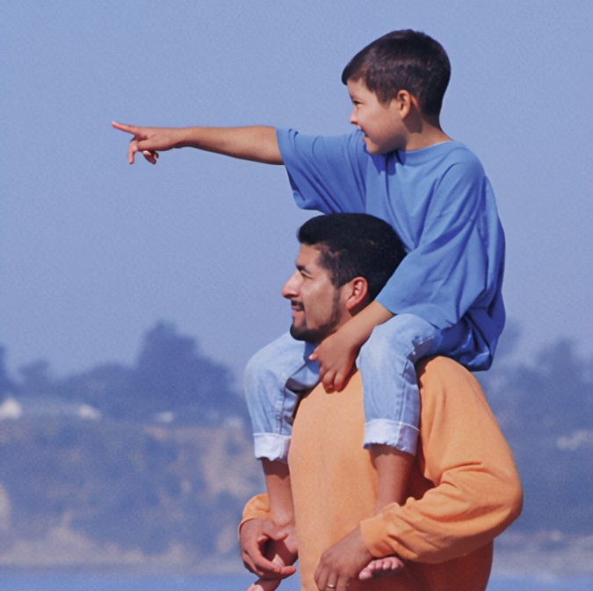
"If only you could see what I see."
A MATTER OF PERSPECTIVE
The Jews had one view of Abraham; Paul gave them a different perspective.

Slide 3
Authentic Faith
Romans 4:1-25

Slide 4
Transformed!
Knowing & Doing God’s Will
Focal Passages for Today:
Romans 4:1-5
Romans 4:9-11
Romans 4:13-16
Romans 4:18-21

Slide 5
Romans 12:2
Do not be conformed to this age, but be transformed by the renewing of your mind, so that you may discern what is the good, pleasing, and perfect will of God.

Slide 6
The Law of FAITH
Romans 3:27-28
²⁷Where, then, is boasting? It is excluded. By what kind of law? By one of works? No, on the contrary, by a law of faith. ²⁸For we conclude that a person is justified by faith apart from the works of the law.
In chapter 3, Paul said emphatically that
no one is righteous, not even one.
He said justification (salvation) comes by faith, not by works.
In chapter 4, Paul proves his point.

Slide 7
Romans 4:1-5
¹What then will we say that Abraham, our forefather according to the flesh, has found? ²If Abraham was justified by works, he has something to boast about—but not before God. ³For what does the Scripture say? Abraham believed God, and it was credited to him for righteousness. ⁴Now to the one who works, pay is not credited as a gift, but as something owed. ⁵But to the one who does not work, but believes on him who justifies the ungodly, his faith is credited for righteousness.

Slide 8
Abraham:
The forefather of all who have faith, Jews and Gentiles alike.

Slide 9
Romans 4:9-11
⁹Is this blessing only for the circumcised, then? Or is it also for the uncircumcised? For we say, Faith was credited to Abraham for righteousness. ¹⁰In what way, then, was it credited—while he was circumcised, or uncircumcised? It was not while he was circumcised, but uncircumcised. ¹¹And he received the sign of circumcision as a seal of the righteousness that he had by faith, while still uncircumcised. This was to make him the father of all who believe but are not circumcised, so that righteousness may be credited to them also.

Slide 10
Abraham’s Timeline
Abram Called
Gen. 11
Covenant Made
Gen. 12
Abraham Believed God
Gen. 15:6
Abraham
Circumcised
Gen 17
Isaac
Born
Gen. 21
Ismael Born
86
70
75
75
99
100
Genesis 12:1-3
¹Go from your land, your relatives, and your father’s house to the land that I will show you. ²I will make you into a great nation, I will bless you, I will make your name great, and you will be a blessing. ³I will bless those who bless you, I will curse anyone who treats you with contempt, and all the peoples on earth will be blessed through you.
Abraham believed God 14-years Before Circumcision
Abraham believed God 25-years Before Isaac was born
Reaffirmed in Gen. 15 & 17

Slide 11
Romans 4:9-11
It was Abraham’s faith in God that saved him.
⁹Is this blessing only for the circumcised, then? Or is it also for the uncircumcised? For we say, Faith was credited to Abraham for righteousness. ¹⁰In what way, then, was it credited—while he was circumcised, or uncircumcised? It was not while he was circumcised, but uncircumcised. ¹¹And he received the sign of circumcision as a seal of the righteousness that he had by faith, while still uncircumcised. This was to make him the father of all who believe but are not circumcised, so that righteousness may be credited to them also.
Before Circumcision

Slide 12
Faith
The Key to Unlocking
God’s Promise

Slide 13
Romans 4:13-16
¹³For the promise to Abraham or to his descendants that he would inherit the world was not through the law, but through the righteousness that comes by faith. ¹⁴If those who are of the law are heirs, faith is made empty and the promise nullified, ¹⁵because the law produces wrath. And where there is no law, there is no transgression.
¹⁶This is why the promise is by faith, so that it may be according to grace, to guarantee it to all the descendants—not only to the one who is of the law but also to the one who is of Abraham’s faith. He is the father of us all.
Who’s righteousness?
How is it obtained?

Slide 14
Romans 4:13-16
¹³For the promise to Abraham or to his descendants that he would inherit the world was not through the law, but through the righteousness that comes by faith. ¹⁴If those who are of the law are heirs, faith is made empty and the promise nullified, ¹⁵because the law produces wrath. And where there is no law, there is no transgression.
¹⁶This is why the promise is by faith, so that it may be according to grace, to guarantee it to all the descendants—not only to the one who is of the law but also to the one who is of Abraham’s faith. He is the father of us all.

Slide 15
Ephesians 2:8-9
⁸For you are saved by grace through faith,
and this is not from yourselves; it is God’s gift —
⁹not from works, so that no one can boast.

Slide 16
Authentic Faith
What Kind of Faith Did Abraham Demonstrate?
Authentic faith finds fulfillment in action!

Slide 17
Romans 4:18-21
¹⁸He believed, hoping against hope, so that he became the father of many nations, according to what had been spoken: So will your descendants be. ¹⁹He did not weaken in faith when he considered his own body to be already dead (since he was about a hundred years old) and also the deadness of Sarah’s womb. ²⁰He did not waver in unbelief at God’s promise but was strengthened in his faith and gave glory to God, ²¹because he was fully convinced that what God had promised, he was also able to do.

Slide 18
Romans 4:22-25
²²Therefore, it was credited to him for righteousness.
²³Now it was credited to him was not written for Abraham alone, ²⁴but also for us. It will be credited to us who believe in him who raised Jesus our Lord from the dead. ²⁵He was delivered up for our trespasses and raised for our justification.

Slide 19
Transformed!
Knowing & Doing God’s Will
Abraham is the father of the fully persuaded!
He walked by faith, not by sight, and he trusted God to fulfill His promise.
So it is with us! There is nothing we can do to earn our salvation. There no one righteous, not even one.
But praise be to God, He is faithful and He keeps His promises.
It is a gift, have you accepted it?
If you confess with your mouth, “Jesus is Lord,” and believe in your heart that God raised him from the dead,
you will be saved.

