Slide 1

Transformed!
Knowing & Doing God’s Will
An In-depth Study of Paul’s Letter to the Church in Rome

Slide 2
Not Even One
Romans 3:1-31

Slide 3
Transformed! Knowing & Doing God’s Will
Focal Passages for Today’s Study:
Romans 3:9-12
Romans 3:21-24
Romans 3:25-26
Romans 3:27-31

Slide 4
Romans 12:2
Do not be conformed to this age, but be transformed by the renewing of your mind, so that you may discern what is the good, pleasing, and perfect will of God.

Slide 5
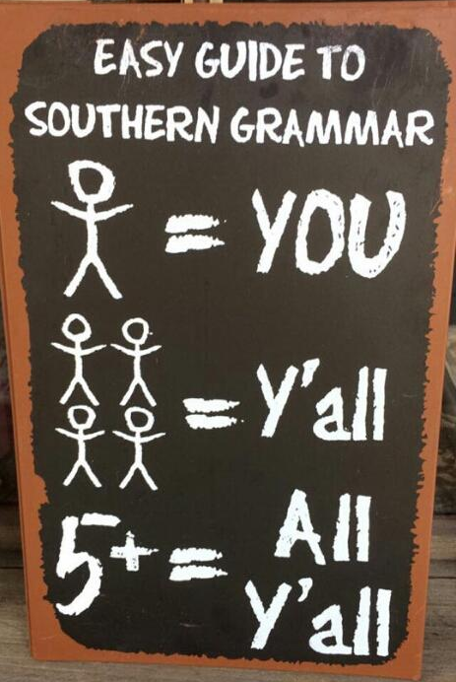

y’all
Speak southern?

Slide 6
The Apostle Paul must have been a Southerner!

Slide 7


Romans 3:9-12
⁹What then? Are we any better off? Not at all! For we have already charged that both Jews and Greeks are all under sin, ¹⁰as it is written:
There is no one righteous, not even one.
¹¹There is no one who understands;
there is no one who seeks God.
¹²All have turned away;
all alike have become worthless.
There is no one who does what is good,
not even one.
Who is righteous?
All y’all are guilty!

Slide 8
Romans 3:9-12
⁹What then? Are we any better off? Not at all! For we have already charged that both Jews and Greeks are all under sin, ¹⁰as it is written:
There is no one righteous, not even one.
¹¹There is no one who understands;
there is no one who seeks God.
¹²All have turned away;
all alike have become worthless.
There is no one who does what is good,
not even one.
Why?

Slide 9
Romans 3:9-12
⁹What then? Are we any better off? Not at all! For we have already charged that both Jews and Greeks are all under sin, ¹⁰as it is written:
There is no one righteous, not even one.
¹¹There is no one who understands;
there is no one who seeks God.
¹²All have turned away;
all alike have become worthless.
There is no one who does what is good,
not even one.
So what?

Slide 10
So, how can Christianity be described as “Good News" when it teaches that all people are guilty before God?

Slide 11
Romans 3:21-24
What is the cost/price of justification with God?
What justifies us in God’s sight?
How does a person obtain righteousness?
What new righteousness has been made known?
²¹But now, apart from the law, the righteousness of God has been revealed, attested by the Law and the Prophets. ²²The righteousness of God is through faith in Jesus Christ, to all who believe, since there is no distinction. ²³For all have sinned and fall short of the glory of God; ²⁴they are justified freely by his grace through the redemption that is in Christ Jesus.

Slide 12
Romans 3:25-26
²⁵God presented him as the mercy seat, by his blood, through faith, to demonstrate his righteousness, because in his restraint God passed over the sins previously committed. ²⁶God presented him to demonstrate his righteousness at the present time, so that he would be just and justify the one who has faith in Jesus.
What did God do to provide a means of justification and forgiveness for every person?

Slide 13
Romans 8:3-4
³For what the law could not do since it was weakened by the flesh, God did. He condemned sin in the flesh by sending his own Son in the likeness of sinful flesh as a sin offering, ⁴in order that the law’s requirement would be fulfilled in us who do not walk according to the flesh but according to the Spirit.

Slide 14
Romans 3:27-31
What justifies a person in God’s sight?
²⁷Where, then, is boasting? It is excluded. By what kind of law?, By one of works? No, on the contrary, by a law of faith. ²⁸For we conclude that a person is justified by faith apart from the works of the law. ²⁹Or is God the God of Jews only? Is he not the God of Gentiles too? Yes, of Gentiles too, ³⁰since there is one God who will justify the circumcised by faith and the uncircumcised through faith. ³¹Do we then nullify the law through faith? Absolutely not! On the contrary, we uphold the law.

Slide 15
Transformed! Knowing & Doing God’s Will
The bad news: All y’all are guilty!
The Good News: God provided a way for us to be justified in His sight.
While we were yet sinners, Christ died for our sins. God did for us what we cannot do for ourselves.
The righteousness of God is offered freely to all who believe and have faith in Christ Jesus as their Savior.
So, what is your standing before God?
Have y’all been justified?

