Slide 1

Transformed!
Knowing & Doing God’s Will
An In-depth Study of Paul’s Letter to the Church in Rome

Slide 2
salvation
By Faith Alone or by Faith + Works?

Slide 3
Transformed! Knowing & Doing God’s Will
Focal Passages for Today’s Study:
James 2:14-26

Slide 4


Slide 5
Romans 12:2
Do not be conformed to this age, but be transformed by the renewing of your mind, so that you may discern what is the good, pleasing, and perfect will of God.

Slide 6
Faith Alone or Faith+Works?
This very important question arose last week but we were unable to adequately discuss it due to time constraints.
It is perhaps the most important question in Christian theology, so we will take time today to discuss it further.
But this question is not new, it was one of the key issues that gave rise to the Protestant Reformation.

Slide 7
The Five Solas
By Grace alone, through Faith alone, in Christ alone, according to Scripture alone, for God’s glory alone.
The five solas are five Latin phrases popularized during the Protestant Reformation that emphasized the distinctions between the early Reformers and the Roman Catholic Church.
Sola scriptura (Scripture alone): emphasizes the Bible alone as the sole source of authority for Christians, rather than the words of the Pope. (2 Peter 1:20-21, 2 Timothy 3:16-17)
Sola gratia (Grace alone): emphasizes grace as the reason for our salvation, which comes from what God has done rather than what we do. (Ephesians 2:8-9)
Sola fide (Faith alone): emphasizes that salvation is a free gift to all who accept it by faith. Salvation is not based on human effort or good deeds. (John 3:16, Ephesians 2:8-9)
Solo Christo (Christ alone): Salvation comes through Christ alone rather than through priests as intermediaries. (Hebrews 4:15)
Soli Deo gloria (to the glory of God alone): Only God receives glory for our salvation. (1 Corinthians 10:31)

Slide 8
What Do Baptists Believe?
SALVATION
Salvation involves the redemption of the whole man, and is offered freely to all who accept Jesus Christ as Lord and Saviour, who by His own blood obtained eternal redemption for the believer. In its broadest sense salvation includes regeneration, justification, sanctification, and glorification. There is no salvation apart from personal faith in Jesus Christ as Lord.
Baptist Faith and Message https://bfm.sbc.net/bfm2000/

Slide 9
Regeneration
“Unless one is born again he cannot see the kingdom of God.” (John 3:3)
2 Corinthians 5:17
Therefore, if anyone is in Christ, he is a new creation; the old has passed away, and see, the new has come!
Also see: John 3:3-7, Romans 6:4-7, Ephesians 4:24, Colossians 3:9

Slide 10
Sanctification
Set apart for special use; becoming more personally dedicated to God; becoming more devoted
Romans 6:22-23
But now, since you have been set free from sin and have become enslaved to God, you have your fruit, which results in sanctification — and the outcome is eternal life! For the wages of sin is death, but the gift of God is eternal life in Christ Jesus our Lord.
Philippians 1:6
I am sure of this, that he who started a good work in you will carry it on to completion until the day of Christ Jesus.

Slide 11
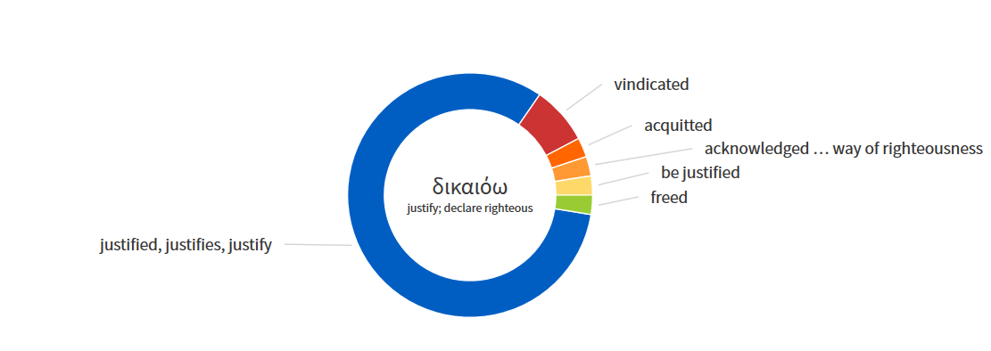
Justified (Gk: dikaioō)
To be or become judicially vindicated as having complied with the requirements of the Law of God.
Used 39 Times in the Greek New Testament
Luke 3
James 3
Paul 33

Slide 12
Justification by Faith
Romans 3:22-24: The righteousness of God is through faith in Jesus Christ to all who believe, since there is no distinction. For all have sinned and fall short of the glory of God; they are justified freely by his grace through the redemption that is in Christ Jesus.
Romans 3:28: For we conclude that a person is justified by faith apart from the works of the law.
Romans 5:1: Therefore, since we have been justified by faith, we have peace with God through our Lord Jesus Christ.
Galatians 3:24: The law, then, was our guardian until Christ, so that we could be justified by faith.
Ephesians 2:8-9: For you are saved by grace through faith, and this is not from yourselves; it is God’s gift — not from works, so that no one can boast.
Paul’s view is crystal clear across all his writings. According to Paul, justification is by faith alone, apart from works.
© Eric F. Glover 2021
12

Slide 13



Justification by Faith+Works?
But what about James 2:24?
James 2:24
“You see that a person is justified by works and not by faith alone.”
Does James contradict Paul?
The book of James was written first, is Paul correcting James?

Slide 14
How then do we resolve this apparent conflict?
© Eric F. Glover 2021
14

Slide 15
All Scripture is God Breathed
SCRIPTURE
The Holy Bible was written by men divinely inspired and is God’s revelation of Himself to man. It is a perfect treasure of divine instruction. It has God for its author, salvation for its end, and truth, without any mixture of error, for its matter. Therefore, all Scripture is totally true and trustworthy…
Baptist Faith and Message https://bfm.sbc.net/bfm2000/

Slide 16
Understanding the context of James is critical!
© Eric F. Glover 2021
16

Slide 17
James 2:14-26
¹⁴What good is it, my brothers and sisters, if someone claims to have faith but does not have works? Can such faith save him?
¹⁵If a brother or sister is without clothes and lacks daily food ¹⁶and one of you says to them, “Go in peace, stay warm, and be well fed,” but you don’t give them what the body needs, what good is it? ¹⁷In the same way faith, if it does not have works, is dead by itself.
¹⁸But someone will say, “You have faith, and I have works.” Show me your faith without works, and I will show you faith by my works. ¹⁹You believe that God is one. Good! Even the demons believe—and they shudder.

Slide 18
James 2:14-26
²⁰Senseless person! Are you willing to learn that faith without works is useless? ²¹Wasn’t Abraham our father justified by works in offering Isaac his son on the altar? ²²You see that faith was active together with his works, and by works, faith was made complete, ²³and the Scripture was fulfilled that says, Abraham believed God, and it was credited to him as righteousness, and he was called God’s friend. ²⁴You see that a person is justified by works and not by faith alone. ²⁵In the same way, wasn’t Rahab the prostitute also justified by works in receiving the messengers and sending them out by a different route? ²⁶For just as the body without the spirit is dead, so also faith without works is dead.

Slide 19
James 2:14-26
Who are the “subjects” of James dissertation?
¹⁴What good is it, my brothers and sisters, if someone claims to have faith but does not have works? Can such faith save him?
¹⁵If a brother or sister is without clothes and lacks daily food ¹⁶and one of you says to them, “Go in peace, stay warm, and be well fed,” but you don’t give them what the body needs, what good is it? ¹⁷In the same way faith, if it does not have works, is dead by itself.
¹⁸But someone will say, “You have faith, and I have works.” Show me your faith without works, and I will show you faith by my works. ¹⁹You believe that God is one. Good! Even the demons believe—and they shudder.
Counterfeit Faith
False faith. All talk, no walk.

Slide 20
James 2:14-26
²⁰Senseless person! Are you willing to learn that faith without works is useless? ²¹Wasn’t Abraham our father justified by works in offering Isaac his son on the altar? ²²You see that faith was active together with his works, and by works, faith was made complete, ²³and the Scripture was fulfilled that says, Abraham believed God, and it was credited to him as righteousness, and he was called God’s friend. ²⁴You see that a person is justified by works and not by faith alone. ²⁵In the same way, wasn’t Rahab the prostitute also justified by works in receiving the messengers and sending them out by a different route? ²⁶For just as the body without the spirit is dead, so also faith without works is dead.
Perfected, finished, accomplished, proven.
It is not true faith.

Slide 21
Faith Without Works is Dead
James’ goal is to refute the belief that a person can have faith without producing any good works.
His argument is that works are the evidence of true faith – authentic faith finds fulfillment in action.
Faith and deeds are as essential to each other as the body and the spirit.
© Eric F. Glover 2021
21

Slide 22
Faith Evidenced by Works
“It appears certain that James is speaking of the manifestation, not of the imputation of righteousness, as if he had said, Those who are justified by faith prove their justification by obedience and good works, not by a bare and imaginary semblance of faith. In one word, he is not discussing the mode of justification, but requiring that the justification of all believers shall be operative. And as Paul contends that men are justified without the aid of works, so James will not allow any to be regarded as Justified who are destitute of good works.”
John Calvin Institutes of the Christian Religion 3:17:12 (Henry Beveridge, Grand Rapids: Eerdmans, 1966 reprint, 2: 115)
© Eric F. Glover 2021
22

Slide 23

Living Faith
"We are saved by faith alone, but the faith that saves is never alone.“
Martin Luther
“Faith is a living, restless thing. It cannot be inoperative. We are not saved by works; but if there be no works, there must be something amiss with faith.”
Martin Luther (as quoted by Roland Bainton in his biography of Luther, Here I Stand, VIII 361).
© Eric F. Glover 2021
23

Slide 24
Jesus Said it Best
¹⁶You’ll recognize them by their fruit. Are grapes gathered from thornbushes or figs from thistles? ¹⁷In the same way, every good tree produces good fruit, but a bad tree produces bad fruit. ¹⁸A good tree can’t produce bad fruit; neither can a bad tree produce good fruit. ¹⁹Every tree that doesn’t produce good fruit is cut down and thrown into the fire. ²⁰So you’ll recognize them by their fruit.”
Matt. 7:16-20

Slide 25
No Dropouts
Romans 8:30
And those he predestined, he also called; and those he called, he also justified; and those he justified, he also glorified.
Also see: John 10:28, John 3:15-16, Romans 8:38-39, Ephesians 4:30, Jude 24

Slide 26
Transformed! Knowing & Doing God’s Will
Justification by faith is an essential Christian doctrine and it is central to Paul’s teaching in the Book of Romans.
Understanding this basic tenet of our faith is crucial to understanding the overall message of Romans.
Salvation by grace through faith does not give us license to sin nor does it give us a free pass on works.
Works are important, just not salvific. As Paul says later in Romans; “Each of us will give an account of himself to God.” (Romans 14:12)
Faith without works is like a song you can't sing. It's about as useless as a screen door on a submarine.
Rich Mullins

