Slide 1
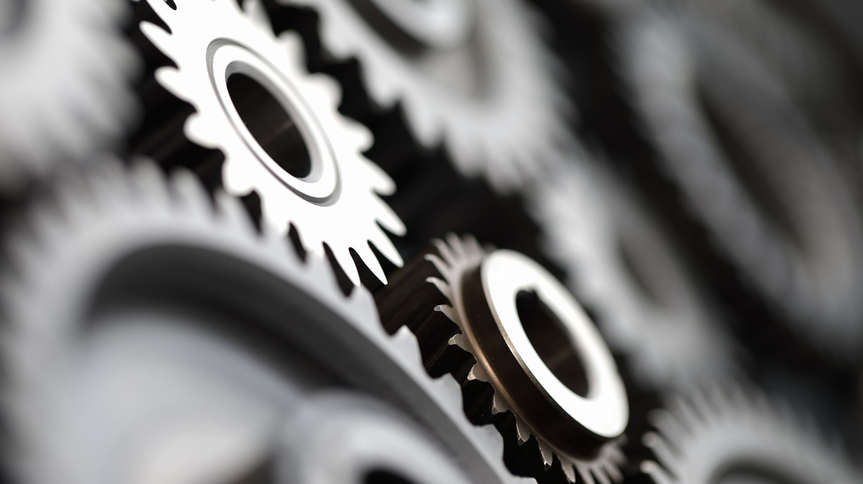
Transformed!
Knowing & Doing God’s Will
An In-depth Study of Paul’s Letter to the Church in Rome

Slide 2
God’s Righteous Judgment
Romans 2:1-16

Slide 3
Transformed! Knowing & Doing God’s Will
Focal Passages for Today’s Study:
Romans 2:1-5
Romans 2:6-13

Slide 4

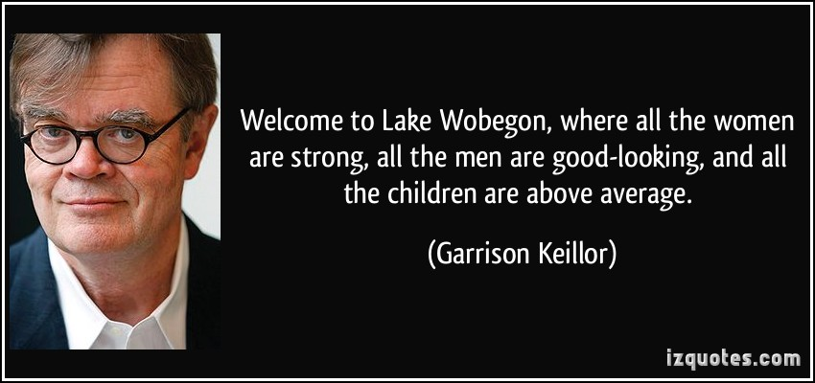
The Lake Wobegon Effect

Slide 5
“The Pharisee is always present in each one of us” Dr. Franz Leenhardt (1902-1990)

Slide 6
Romans 12:2
Do not be conformed to this age, but be transformed by the renewing of your mind, so that you may discern what is the good, pleasing, and perfect will of God.

Slide 7
Condemnation of Sinfulness Romans 1:24-32
²⁹ They are filled with all unrighteousness, evil, greed, and wickedness.
SPECIFIC TYPES OF WICKEDNESS
Envy | Slander | Disobedient to Parents
Murder | God-hater | Senseless
Quarrels | Arrogant | Untrustworthy
Deceit | Proud | Unloving
Malice | Boastful | Unmerciful
Gossip | Inventors of evil
What were the Jews in Rome thinking when Paul indicted Gentiles for their wickedness?
³² Although they know God’s just sentence—that those who practice such things deserve to die,—they not only do them, but even applaud, others who practice them.

Slide 8
Romans 2:1-5
¹Therefore, every one of you, who judges is without excuse. For when you judge another, you condemn yourself, since you, the judge, do the same things. ²Now we know that God’s judgment on those who do such things is based on the truth. ³Do you think—anyone of you who judges those who do such things yet do the same—that you will escape God’s judgment? ⁴Or do you despise the riches of his kindness, restraint, and patience, not recognizing that God’s kindness is intended to lead you to repentance? ⁵Because of your hardened and unrepentant heart you are storing up wrath for yourself in the day of wrath, when God’s righteous judgment is revealed.
What’s it there for?

Slide 9
Romans 1:18-20
For God’s wrath is revealed from heaven against all godlessness and unrighteousness of people who by their unrighteousness suppress the truth, since what can be known about God is evident among them, because God has shown it to them… as a result, people are without excuse.

Slide 10
Romans 2:1-5
¹Therefore, every one of you, who judges is without excuse. For when you judge another, you condemn yourself, since you, the judge, do the same things. ²Now we know that God’s judgment on those who do such things is based on the truth. ³Do you think—anyone of you who judges those who do such things yet do the same—that you will escape God’s judgment? ⁴Or do you despise the riches of his kindness, restraint, and patience, not recognizing that God’s kindness is intended to lead you to repentance? ⁵Because of your hardened and unrepentant heart you are storing up wrath for yourself in the day of wrath, when God’s righteous judgment is revealed.
Judge not, lest you be judged. Jews and Gentiles alike.
CAUSE
EFFECT

Slide 11
Romans 2:1-5
¹Therefore, every one of you, who judges is without excuse. For when you judge another, you condemn yourself, since you, the judge, do the same things. ²Now we know that God’s judgment on those who do such things is based on the truth. ³Do you think—anyone of you who judges those who do such things yet do the same—that you will escape God’s judgment? ⁴Or do you despise the riches of his kindness, restraint, and patience, not recognizing that God’s kindness is intended to lead you to repentance? ⁵Because of your hardened and unrepentant heart you are storing up wrath for yourself in the day of wrath, when God’s righteous judgment is revealed.
“Paul’s point is that we are all involved in a solidarity of sin that embraces the whole human race.”
Leon Morris
Jews are no better than Gentiles, we are all sinners in need of a Savior.

Slide 12
Romans 2:6-13
⁶He will repay each one according to his works: ⁷eternal life to those who by persistence in doing good seek glory, honor, and immortality; ⁸but wrath and anger to those who are self-seeking and disobey the truth while obeying unrighteousness. ⁹There will be affliction and distress for every human being who does evil, first to the Jew, and also to the Greek; ¹⁰but glory, honor, and peace for everyone who does what is good, first to the Jew, and also to the Greek. ¹¹For there is no favoritism with God.
¹²For all who sin without the law will also perish without the law, and all who sin under the law will be judged by the law. ¹³For the hearers of the law are not righteous before God, but the doers of the law will be justified.
There is no favoritism with God, all of us are worthy of judgment.

Slide 13
Judgment by Works? Romans 2:6-8
He will repay each one according to his works:
eternal life to those who by persistence in doing good seek glory, honor, and immortality;
but wrath and anger to those who are self-seeking and disobey the truth while obeying unrighteousness.
How should we interpret this passage?
Wait a minute, this sounds a lot like works-based salvation…

Slide 14
Day of Wrath Romans 2:5
⁵Because of your hardened and unrepentant heart you are storing up wrath for yourself in the day of wrath, when God’s righteous judgment is revealed.
Take a closer look at verse 5, what does Paul tell the Jews about judgment day?
What is the day of wrath?
When will God’s righteous judgment be revealed?

Slide 15
The Great White Throne Judgment
Revelation 20:11-15
¹¹Then I saw a great white throne and one seated on it. Earth and heaven fled from his presence, and no place was found for them. ¹²I also saw the dead, the great and the small, standing before the throne, and books were opened. Another book was opened, which is the book of life, and the dead were judged according to their works by what was written in the books. ¹³Then the sea gave up the dead that were in it, and death and Hades gave up the dead that were in them; each one was judged according to their works. ¹⁴Death and Hades were thrown into the lake of fire. This is the second death, the lake of fire. ¹⁵And anyone whose name was not found written in the book of life was thrown into the lake of fire.
Unbelievers will be judged at the Great White Throne

Slide 16
The Judgment seat of Christ
Believers will be judged at the Judgment Seat of Christ
2 Corinthians 5:10
¹⁰For we must all appear before the judgment seat of Christ, so that each may be repaid for what he has done in the body, whether good or evil.
Romans 14:10-12
¹⁰But you, why do you judge your brother or sister? Or you, why do you despise your brother or sister? For we will all stand before the judgment seat of God. ¹¹For it is written, As I live, says the Lord, every knee will bow to me, and every tongue will give praise to God. ¹²So then, each of us will give an account of himself to God.

Slide 17
The Way We Live Matters
Matthew 16:27
For the Son of Man is going to come with his angels in the glory of his Father, and then he will reward each according to what he has done.
“Our deeds are not the basis of our salvation; they are the evidence of our salvation.” John Piper
Revelation 22:12
“Look, I am coming soon, and my reward is with me to repay each person according to his work.

Slide 18
1 Corinthians 3:8-9
⁸Now he who plants and he who waters are one, and each will receive his own reward according to his own labor. ⁹For we are God’s coworkers.
The subjective criterion for salvation is faith alone, with nothing added (Eph. 2:8-9).
But the objective reality of that salvation is manifested in the subsequent godly works that the Holy Spirit leads and empowers believers to perform.

Slide 19
Transformed! Knowing & Doing God’s Will
True believers are transformed by the power of the indwelling Holy Spirit and persist in doing good.
A person’s actions form an infallible index to their character and give credence to their confession of faith.
All believers will stand before Jesus one day and will be judged for their works (deeds).
While judgment is by works, salvation is by grace, through faith (Eph 2:8-9).
“You will know them by their fruits.”
Matt. 7:16

