Slide 1
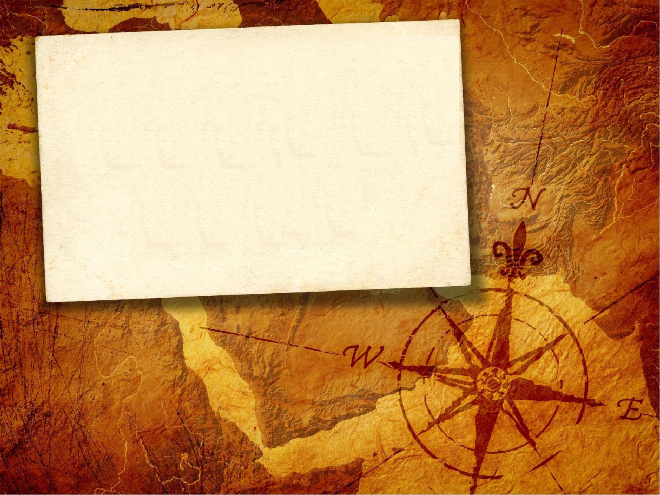

INpowered
Discipleship
An Inductive Study of Acts
Opportunistic Discipleship
Acts 8:26-40

Slide 2


Slide 3

Acts 1:8
power
“But you will receive
when the Holy Spirit has come on you, and you will be My witnesses in Jerusalem, in all Judea and Samaria, and to the ends of the earth.”

Slide 4

Opportunistic Discipleship Acts 8:26-40
²⁶ An angel of the Lord spoke to Philip: “Get up and go south to the road that goes down from Jerusalem to Gaza.” (This is the desert road.) ²⁷ So he got up and went.
Philip, one of the seven deacons, is often referred to as the Evangelist.
Philip the Evangelist is not the same person as Philip the Apostle.
He was the first Christian missionary, preaching the Gospel first to the Samaritans as we saw last week.
God had another assignment for Philip, and He sent an angel
to deliver the message.

Slide 5
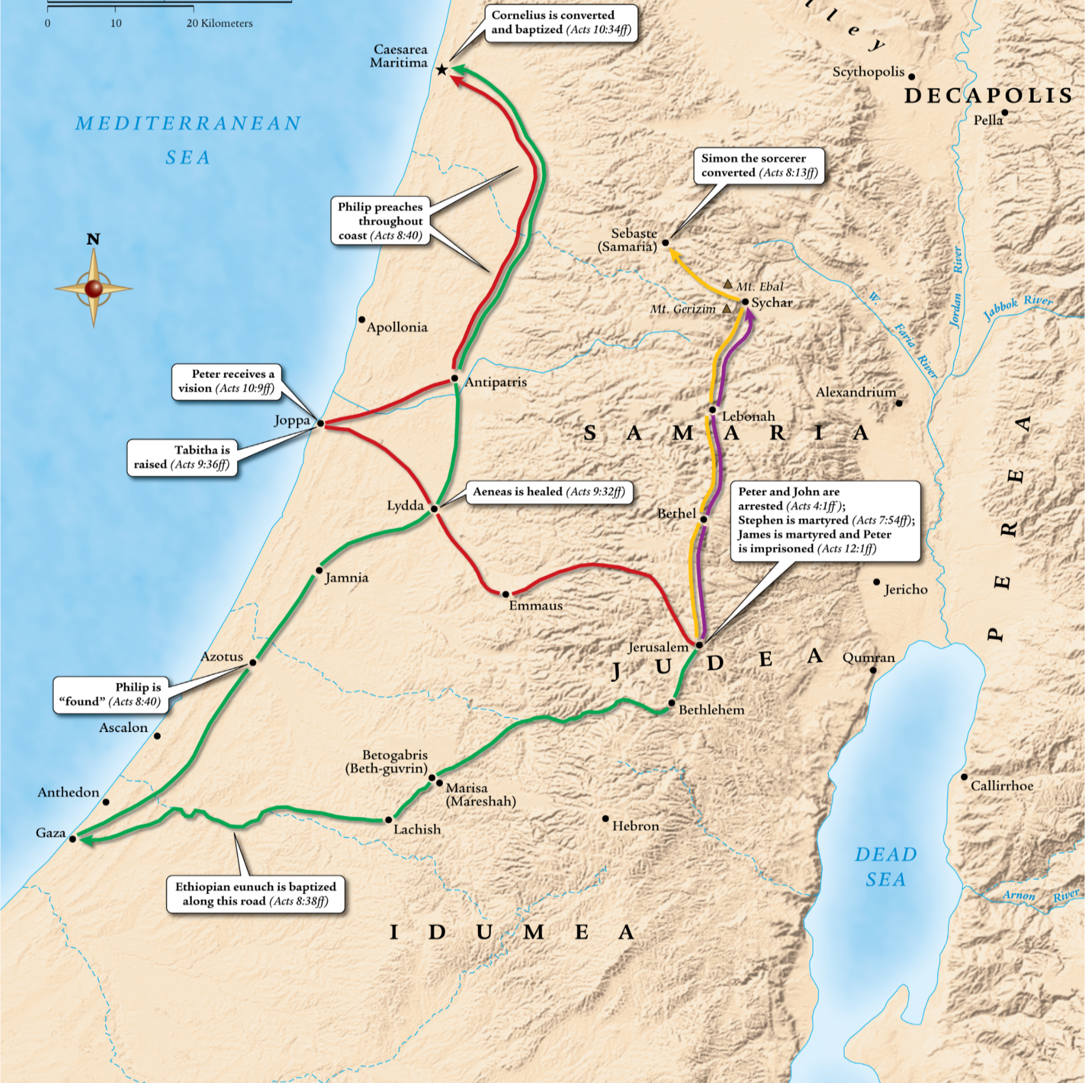
Philip the Evangelist’s
Missionary Travels
Persecution ramped up after Stephen’s death and Philip fled to Samaria where he preached the Gospel.
God had other plans for Philip once the church had been planted in Samaria.
An angel directed Philip to travel south from Jerusalem toward Gaza.
A divine appointment awaited him.

Slide 6
Opportunistic Discipleship Acts 8:26-40
^{27…}There was an Ethiopian man, a eunuch and high official of Candace, queen of the Ethiopians, who was in charge of her entire treasury. He had come to worship in Jerusalem ²⁸ and was sitting in his chariot on his way home, reading the prophet Isaiah aloud.
Philip encountered an Ethiopian man on the road from Jerusalem to Gaza.
Ethiopia is to the south of Egypt and is known as Cush in the earlier books of the OT. Today, the area is known as the Sudan.
The journey to Jerusalem would have taken five months each way by chariot.
Ethiopia was considered “the ends of the earth” to Romans and Jews of that day.

Slide 7
Opportunistic Discipleship Acts 8:26-40
²⁹ The Spirit told Philip, “Go and join that chariot.”
³⁰ When Philip ran up to it, he heard him reading the prophet Isaiah, and said, “Do you understand what you’re reading?”
³¹ “How can I,” he said, “unless someone guides me?” So he invited Philip to come up and sit with him.
Philip, sensitive to the leading of the Holy Spirit, boldly approached the chariot of the high ranking official
and engaged him in conversation.
Philip’s obedience to the prompting of the Holy Spirit opened a door of opportunity to an entirely new group.
As an Ethiopian, the eunuch is probably black, and so the gospel is expanding to a new ethnic group.
The Spirit didn’t give Philip explicit instructions, He simply said go and join.

Slide 8
Opportunistic Discipleship Acts 8:26-40
³² Now the Scripture passage he was reading was this: He was led like a sheep to the slaughter, and as a lamb is silent before its shearer, so he does not open his mouth. ³³ In his humiliation justice was denied him. Who will describe his generation? For his life is taken from the earth.
The quotation from Isaiah 53:7–8 was perplexing to the eunuch.
Welcoming the opportunity to have Philip explain the passage, he invited the evangelist into his chariot.

Slide 9
Opportunistic Discipleship Acts 8:26-40
³⁴ The eunuch said to Philip, “I ask you, who is the prophet saying this about—himself or someone else?” ³⁵ Philip proceeded to tell him the good news about Jesus, beginning with that Scripture.
The Ethiopian knew the passage described an individual, but was it Isaiah or someone else?
Philip seized the opportunity to present the good news about Jesus from Isaiah 53.

Slide 10
Opportunistic Discipleship Acts 8:26-40
³⁶ As they were traveling down the road, they came to some water. The eunuch said, “Look, there’s water. What would keep me from being baptized?” ³⁸ So he ordered the chariot to stop, and both Philip and the eunuch went down into the water, and he baptized him.
How the eunuch knows about baptism is not made clear.
Perhaps Philip explained it to him, or he heard about it in Jerusalem.
Either way, his willingness to receive baptism means that he is responsive
to the gospel.
All the barriers are down, and so a God-fearing, black, eunuch, Gentile is baptized.

Slide 11
Opportunistic Discipleship Acts 8:26-40
³⁹ When they came up out of the water, the Spirit of the Lord carried Philip away, and the eunuch did not see him any longer but went on his way rejoicing. ⁴⁰ Philip appeared in Azotus, and he was traveling and preaching the gospel in all the towns until he came to Caesarea.
With the baptism complete, so is Philip's mission. And so, the Spirit carries him away.
He shows up again in Azotus (aka Ashdod) and preaches from town to town all the way up to Caesarea.
The eunuch continues his journey homeward, rejoicing all the way.

Slide 12
IN powered Discipleship
Acts 8 is full of contrasts:
  There is work in the north (Samaria) and the south (Gaza);
  A magician and a government figure hear the Good News,
  God-fearers from Africa and Samaritans alike respond.
God is mightily at work with a wide array of people.
He is empowering and using His disciples to spread the Good News, just as He promised in Acts 1:8.
Like Philip, let us be faithfully obedient, sensitive to hearts prepared by God and ready to cross cultural lines with the Good News at a moment’s notice.
To whom is the Spirit calling you to engage with
the Gospel?
Who is your “Ethiopian Eunuch?”

Slide 13
INpowered
Discipleship
An Inductive Study of Acts
Transformational Discipleship
Acts 9:1-31

