Slide 1

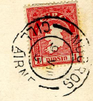
INpowered
Discipleship
An Inductive Study of Acts
Fearless Discipleship
Acts 6:1 – 7:60

Slide 2


Slide 3

Acts 1:8
power
“But you will receive
when the Holy Spirit has come on you, and you
will be My witnesses in Jerusalem, in all Judea
and Samaria, and to the ends of the earth.”

Slide 4
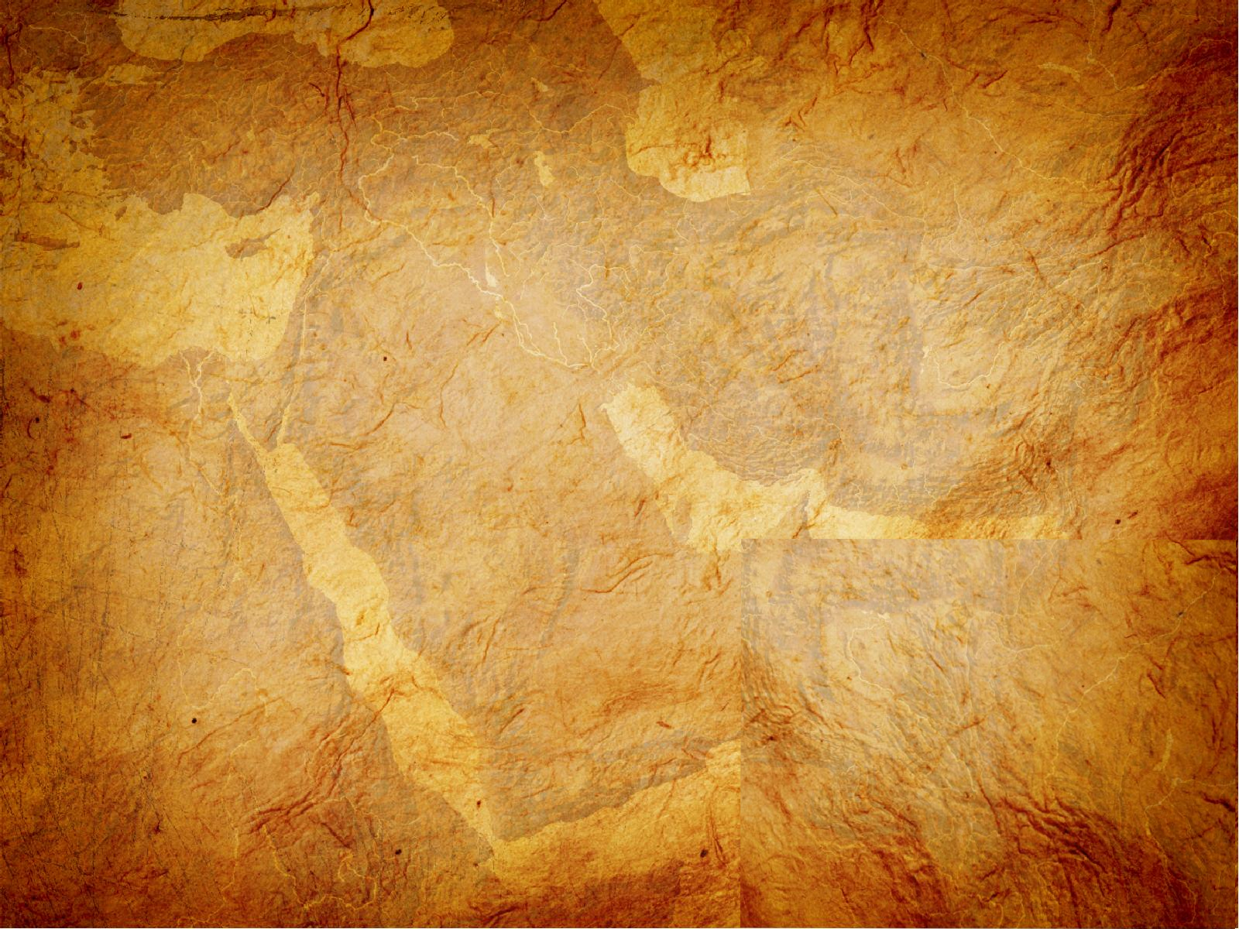
Focused Discipleship Acts 6:1-7
¹In those days, as the disciples were increasing in number, there arose a complaint by the Hellenistic Jews against the Hebraic Jews that their widows were being overlooked in the daily distribution. ²The Twelve summoned the whole company of the disciples and said, “It would not be right for us to give up preaching the word of God to wait on tables. ³Brothers and sisters, select from among you seven men of good reputation, full of the Spirit and wisdom, whom we can appoint to this duty. ⁴But we will devote ourselves to prayer and to the ministry of the word.” ⁵This proposal pleased the whole company. So they chose Stephen, a man full of faith and the Holy Spirit, and Philip, Prochorus, Nicanor, Timon, Parmenas, and Nicolaus, a convert from Antioch. ⁶They had them stand before the apostles, who prayed and laid their hands on them.
⁷So the word of God spread, the disciples in Jerusalem increased greatly in number, and a large group of priests became obedient to the faith.

Slide 5
Focused Discipleship Acts 6:1-7
³Brothers and sisters, select from among you seven men of good reputation, full of the Spirit and wisdom, whom we can appoint to this duty. ⁴But we will devote ourselves to prayer and to the ministry of the word.”
How would you describe the Apostles response to the complaint?
God has uniquely gifted all of us to serve differently.
No one can do everything, nor
should they try.
The Gospel advances quickest when we
work together collaboratively.

Slide 6
Focused Discipleship Acts 6:1-7
⁷So the word of God spread, the disciples in Jerusalem increased greatly in number, and a large group of priests became obedient to the faith.
This collaborative ministry model produced big results:
The Word of God spread
The church grew greatly in Jerusalem
A large group of priests embraced the Truth
Which of the three results were of the greatest concern to the Jewish leadership?

Slide 7
Fearless Discipleship Acts 6:8-10
⁸Now Stephen, full of grace and power, was performing great wonders and signs among the people. ⁹Opposition arose, however, from some members of the Freedmen’s Synagogue, composed of both Cyrenians and Alexandrians, and some from Cilicia and Asia, and they began to argue with Stephen. ¹⁰But they were unable to stand up against his wisdom and the Spirit by whom he was speaking.
Who was Stephen?
  One of the seven deacons appointed
  by the Apostles.
  A Greek-speaking, Hellenistic Jew.
  The first layman to perform signs and wonders.
  The first martyr of the church.

Slide 8
Fearless Discipleship Acts 6:8-10
⁸Now Stephen, full of grace and power, was performing great wonders and signs among the people. ⁹Opposition arose, however, from some members of the Freedmen’s Synagogue, composed of both Cyrenians and Alexandrians, and some from Cilicia and Asia, and they began to argue with Stephen. ¹⁰But they were unable to stand up against his wisdom and the Spirit by whom he was speaking.
He was full of grace and power, just as Jesus promised.
  “For I will give you such words and a wisdom that none of your adversaries will be able to resist or contradict.” (Luke 21:15)
  “But you will receive power when the Holy Spirit has come on you, and you will be my witnesses in Jerusalem, in all Judea and Samaria, and to the ends of the earth.” (Acts 1:8)

Slide 9
Falsely Accused Acts 6:11-15
¹¹Then they secretly persuaded some men to say, “We heard him speaking blasphemous words against Moses and God.” ¹²They stirred up the people, the elders, and the scribes; so they came, seized him, and took him to the Sanhedrin. ¹³They also presented false witnesses who said, “This man never stops speaking against this holy place and the law. ¹⁴For we heard him say that this Jesus of Nazareth will destroy this place and change the customs that Moses handed down to us.” ¹⁵And all who were sitting in the Sanhedrin looked intently at him and saw that his face was like the face of an angel.

Slide 10
Falsely Accused Acts 6:8-15
¹⁵And all who were sitting in the Sanhedrin looked intently at him and saw that his face was like the face of an angel.
How would you describe the mood of the Sanhedrin?
How would you describe Stephen’s countenance?
How could Stephen be
so calm under the circumstance?
Do you see any parallels between Stephen’s trial before the Sanhedrin and Jesus’ trial?

Slide 11
Fearless Rebuttal Acts 7:1-53
¹ Are these things true?” the high priest asked.
² “Brothers and fathers,” he replied, “listen:
The “prosecutors” finish and the judges yield the floor to Stephen.
Stephen became the first non-apostle to defend the faith.
His purpose was not to recite history but to establish that he is not guilty of blasphemy.
However, his accusers were because they had rejected the Messiah and he makes that abundantly clear in his response.

Slide 12
Fearless Rebuttal Acts 7:1-53
Stephen’s Defense:
  The Promise to Abraham (7:2-8)
  The Deliverance through Joseph (7:9-16)
  The Deliverance through Moses (7:17-34)
  The Apostasy of Israel (7:35-50)
  The Rejection of the Messiah (7:51-53)
Stephen turned the tables on the Sanhedrin.
He boldly accused them instead of rejecting God and His Messiah.
Stephen’s rebuttal builds to a crescendo and his closing argument takes their breath away!

Slide 13
Bold Proclamation Acts 7:50-53
⁵¹ “You stiff-necked people with uncircumcised hearts and ears! You are always resisting the Holy Spirit. As your ancestors did, you do also. ⁵² Which of the prophets did your ancestors not persecute? They even killed those who foretold the coming of the Righteous One, whose betrayers and murderers you have now become. ⁵³ You received the law under the direction of angels and yet have not kept it.”
Stephen, filled with the Spirit, boldly challenged the Sanhedrin, accusing them of resisting God, killing His prophets and murdering the Messiah.

Slide 14
Faithful Servant Acts 7:54-60
⁵⁴ When they heard these things, they were enraged and gnashed their teeth at him. ⁵⁵ Stephen, full of the Holy Spirit, gazed into heaven. He saw the glory of God, and Jesus standing at the right hand of God. ⁵⁶ He said, “Look, I see the heavens opened and the Son of Man standing at the right hand of God!”
⁵⁷ They yelled at the top of their voices, covered their ears, and together rushed against him. ⁵⁸ They dragged him out of the city and began to stone him. And the witnesses laid their garments at the feet of a young man named Saul. ⁵⁹ While they were stoning Stephen, he called out, “Lord Jesus, receive my spirit!” ⁶⁰ He knelt down and cried out with a loud voice, “Lord, do not hold this sin against them!” And after saying this, he fell asleep.

Slide 15
IN powered Discipleship
Stephen was much like Jesus, in life and in death.
  Jesus was filled with the Spirit, so was Stephen.
  Jesus was full of grace, so was Stephen.
  Jesus boldly confronted religious leaders, so did Stephen.
  Jesus was convicted by lying witnesses, so was Stephen.
  Jesus had a mock trial, so did Stephen.
  Jesus was executed though innocent, so was Stephen.
  Both were accused of blasphemy.
  Both died outside the city and were buried by sympathizers.
  Both prayed for the salvation of their executioners.
Stephen was a fearless disciple of Jesus and his mark on the
church in indelible.
What will be your legacy?

Slide 16
INpowered
Discipleship
An Inductive Study of Acts
Missional Discipleship
Acts 8:1-40

