Slide 1


INpowered
Discipleship
An Inductive Study of Acts
Courageous Discipleship Acts 4:1-31

Slide 2
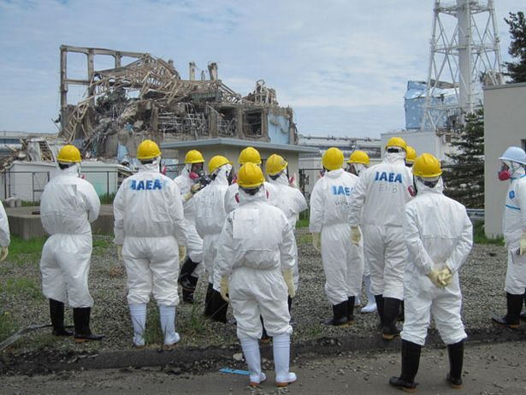
How do you measure courage?
Skilled Veterans Corps Fukushima Nuclear Reactor

Slide 3

Acts 1:8
power
“But you will receive when the Holy Spirit has come on you, and you will be My witnesses in Jerusalem, in all Judea and Samaria, and to the ends of the earth.”

Slide 4
Courageous Proclamation Acts 4:1-7
¹While they were speaking to the people, the priests, the captain of the temple police, and the Sadducees confronted them, ²because they were annoyed that they were teaching the people and proclaiming in Jesus the resurrection of the dead. ³So they seized them and took them into custody until the next day since it was already evening. ⁴But many of those who heard the message believed, and the number of the men came to about five thousand.
⁵The next day, their rulers, elders, and scribes assembled in Jerusalem ⁶with Annas the high priest, Caiaphas, John, Alexander, and all the members of the high-priestly family. ⁷After they had Peter and John stand before them, they began to question them: “By what power or in what name have you done this?”

Slide 5

Courageous Proclamation Acts 4:1-7
Where were Peter and John when this scene happened and what were they doing?
What essential character trait did Peter and John demonstrate in this situation? Why is that noteworthy?
How did the religious leaders react to their teaching and preaching?
How did the crowd respond to their bold teaching and preaching?
What question did the religious leaders ask Peter and John after they arrested them?

Slide 6
Courageous Witnessing Acts 4:8-12
⁸Then Peter was filled with the Holy Spirit and said to them, “Rulers of the people and elders:, ⁹If we are being examined today about a good deed done to a disabled man, by what means he was healed, ¹⁰let it be known to all of you and to all the people of Israel, that by the name of Jesus Christ of Nazareth, whom you crucified and whom God raised from the dead—by him this man is standing here before you healthy. ¹¹This Jesus is the stone rejected by you builders, which has become the cornerstone.,
¹²There is salvation in no one else, for there is no other name under heaven given to people by which we must be saved.”

Slide 7
Courageous Witnessing Acts 4:8-12
What gave Peter the courage to speak?
How did Peter answer their question about his authority?
What bold statement did Peter make in his conclusion?
Why did it take courage for Peter to say these things?

Slide 8
Courageous Commitment Acts 4:13-22
13 When they observed the boldness of Peter and John and realized that they were uneducated and untrained men, they were amazed and recognized that they had been with Jesus. 14 And since they saw the man who had been healed standing with them, they had nothing to say in opposition. 15 After they ordered them to leave the Sanhedrin, they conferred among themselves, 16 saying, “What should we do with these men? For an obvious sign has been done through them, clear to everyone living in Jerusalem, and we cannot deny it. 17 But so that this does not spread any further among the people, let’s threaten them against speaking to anyone in this name again.” 18 So they called for them and ordered them not to speak or teach at all in the name of Jesus.
19 Peter and John answered them, “Whether it’s right in the sight of God for us to listen to you rather than to God, you decide; 20 for we are unable to stop speaking about what we have seen and heard.”
21 After threatening them further, they released them. They found no way to punish them because the people were all giving glory to God over what had been done. 22 For this sign of healing had been performed on a man over forty years old.

Slide 9
Courageous Commitment Acts 4:13-22
What amazed the religious leaders about Peter and John?
What did the leaders recognize about them?
What did the leaders do to them?
How did Peter and John respond to their threats?

Slide 10
Courageous Prayer Acts 4:23-31
²³After they were released, they went to their own people and reported everything the chief priests and the elders had said to them. ²⁴When they heard this, they raised their voices together to God and said, “Master, you are the one who made the heaven, the earth, and the sea, and everything in them. ²⁵You said through the Holy Spirit, by the mouth of our father David your servant: Why do the Gentiles rage and the peoples plot futile things? ²⁶The kings of the earth take their stand and the rulers assemble together against the Lord and against his Messiah.
²⁷“For, in fact, in this city both Herod and Pontius Pilate, with the Gentiles and the people of Israel, assembled together against your holy servant Jesus, whom you anointed, ²⁸to do whatever your hand and your will had predestined to take place. ²⁹And now, Lord, consider their threats, and grant that your servants may speak your word with all boldness, ³⁰while you stretch out your hand for healing, and signs and wonders are performed through the name of your holy servant Jesus.” ³¹When they had prayed, the place where they were assembled was shaken, and they were all filled with the Holy Spirit and began to speak the word of God boldly.

Slide 11
Courageous Prayer Acts 4:23-31
What did Peter and John do when they were released?
What request did they make of God in their prayer?
How did God respond to their prayer?
Why did God answer their prayer?

Slide 12
Courageous Discipleship
Proclaim
Witness
Commit
Pray
Speak out for the Lord with courage whenever you have an opportunity!
Anticipate resistance but stick to your convictions.
Pray for the courage and boldness to be fearless in the face of opposition.

Slide 13
INpowered
Discipleship
An Inductive Study of Acts
Authentic Discipleship Acts 4:32-5:11

