Slide 1

INpowered Discipleship
An Inductive Study of the Book of Acts
Faithful Discipleship
Acts 21:18-25

Slide 2
Focal Passages
Scripture Reading Volunteers:
Acts 21:1-9
Acts 21:10-16
Acts 21:17-25

Slide 3
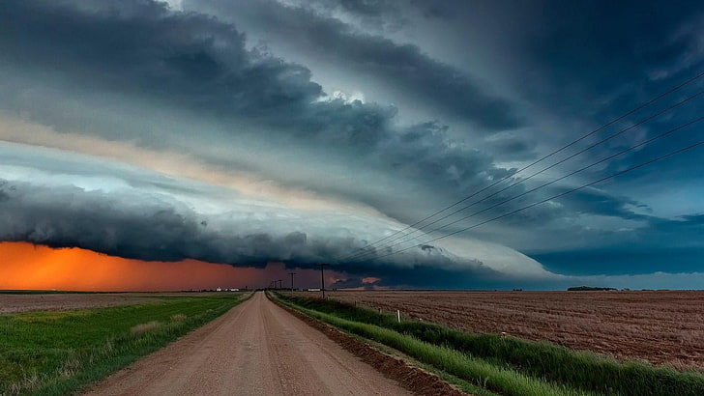
What do you see?

Slide 4
Acts 1:8
“But you will receive
when the Holy Spirit has come on you, and you will be My witnesses in Jerusalem, in all Judea and Samaria,
and to the ends of the earth.”
POWER

Slide 5
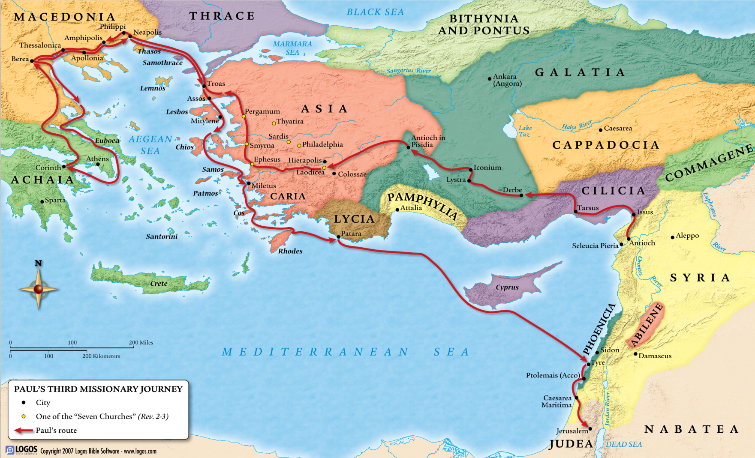
Paul’s 3rd
Missionary
Journey
53-57 AD
1
When we last saw Paul, he was in Miletus encouraging and saying farewell to the Ephesian Elders.
Paul was anxious to get to Jerusalem for Pentecost. He had been away for nearly 3 years and had much to share.
2

Slide 6

Journey to Jerusalem Acts 21:1-16
¹After we tore ourselves away from them, we set sail straight for Cos, the next day to Rhodes, and from there to Patara. ²Finding a ship crossing over to Phoenicia, we boarded and set sail. ³After we sighted Cyprus, passing to the south of it, we sailed on to Syria and arrived at Tyre, since the ship was to unload its cargo there. ⁴We sought out the disciples and stayed there seven days. Through the Spirit they told Paul not to go to Jerusalem. ⁵When our time had come to an end, we left to continue our journey, while all of them, with their wives and children, accompanied us out of the city. After kneeling down on the beach to pray, ⁶we said farewell to one another and boarded the ship, and they returned home.
⁷When we completed our voyage from Tyre, we reached Ptolemais, where we greeted the brothers and sisters and stayed with them for a day. ⁸The next day we left and came to Caesarea, where we entered the house of Philip the evangelist, who was one of the Seven, and stayed with him. ⁹This man had four virgin daughters who prophesied.
© Eric F. Glover 2021
6

Slide 7
Journey to Jerusalem Acts 21:1-16
¹⁰After we had been there for several days, a prophet named Agabus came down from Judea. ¹¹He came to us, took Paul’s belt, tied his own feet and hands, and said, “This is what the Holy Spirit says: ‘In this way the Jews in Jerusalem will bind the man who owns this belt and deliver him over to the Gentiles.’” ¹²When we heard this, both we and the local people pleaded with him not to go up to Jerusalem.
¹³Then Paul replied, “What are you doing, weeping and breaking my heart? For I am ready not only to be bound but also to die in Jerusalem for the name of the Lord Jesus.”
¹⁴Since he would not be persuaded, we said no more except, “The Lord’s will be done.”
Conflict over the Gentile Mission
¹⁵After this we got ready and went up to Jerusalem. ¹⁶Some of the disciples from Caesarea also went with us and brought us to Mnason of Cyprus, an early disciple, with whom we were to stay.
© Eric F. Glover 2021
7

Slide 8
Warning
About Jerusalem
Acts 21:3-12
Paul had been warned not to go to Jerusalem; many times, by lots of people, in multiple locations.
  “³…we sailed on to Syria and arrived at Tyre, since the ship was to unload its cargo there. ⁴We sought out the disciples and stayed there seven days. Through the Spirit they told Paul not to go to Jerusalem.” (vv. 3-4)
  “⁸The next day we left and came to Caesarea, where we entered the house of Philip the evangelist, who was one of the Seven, and stayed with him. ⁹This man had four virgin daughters who prophesied.” (vv. 8-9)
  “¹⁰After we had been there for several days, a prophet named Agabus came down from Judea. ¹¹He came to us, took Paul’s belt, tied his own feet and hands, and said, “This is what the Holy Spirit says: ‘In this way the Jews in Jerusalem will bind the man who owns this belt and deliver him over to the Gentiles.’” (vv. 10-11)
  “¹²When we heard this, both we and the local people pleaded with him not to go up to Jerusalem.” (v. 12)
Paul had been warned not to go to Jerusalem; many times, by lots of people, in multiple locations.
  “³…we sailed on to Syria and arrived at Tyre, since the ship was to unload its cargo there. ⁴We sought out the disciples and stayed there seven days. Through the Spirit they told Paul not to go to Jerusalem.” (vv. 3-4)
  “⁸The next day we left and came to Caesarea, where we entered the house of Philip the evangelist, who was one of the Seven, and stayed with him. ⁹This man had four virgin daughters who prophesied.” (vv. 8-9)
  “¹⁰After we had been there for several days, a prophet named Agabus came down from Judea. ¹¹He came to us, took Paul’s belt, tied his own feet and hands, and said, “This is what the Holy Spirit says: ‘In this way the Jews in Jerusalem will bind the man who owns this belt and deliver him over to the Gentiles.’” (vv. 10-11)
  “¹²When we heard this, both we and the local people pleaded with him not to go up to Jerusalem.” (v. 12)
What were they concerned about?
Did they have cause for concern?
How did Paul respond?

Slide 9
Faithful
Discipleship
Acts 21:13-14
¹³Then Paul replied, “What are you doing, weeping and breaking my heart? For I am ready not only to be bound but also to die in Jerusalem for the name of the Lord Jesus.”
¹⁴Since he would not be persuaded, we said no more except, “The Lord’s will be done.”
Was this just bluster, or was Paul sincere?
How did Luke and the Caesarean disciples respond?
2 Corinthians 11:24-29
²⁴Five times I received the forty lashes minus one from the Jews. ²⁵Three times I was beaten with rods. Once I received a stoning. Three times I was shipwrecked. I have spent a night and a day in the open sea. ²⁶On frequent journeys, I faced dangers from rivers, dangers from robbers, dangers from my own people, dangers from Gentiles, dangers in the city, dangers in the wilderness, dangers at sea, and dangers among false brothers; ²⁷toil and hardship, many sleepless nights, hunger and thirst, often without food, cold, and without clothing. ²⁸Not to mention other things, there is the daily pressure on me: my concern for all the churches. ²⁹Who is weak, and I am not weak?

Slide 10
Faithful
Discipleship
Acts 21:13-14
¹³Then Paul replied, “What are you doing, weeping and breaking my heart? For I am ready not only to be bound but also to die in Jerusalem for the name of the Lord Jesus.”
¹⁴Since he would not be persuaded, we said no more except, “The Lord’s will be done.”
After traveling for weeks, Paul and his traveling companions were on the doorstep of Jerusalem.
Why was Paul so insistent upon visiting Jerusalem, why didn’t he just go back to his home base in Antioch?

Slide 11
Faithful
Discipleship
Acts 21:13-14
Paul’s main reason for going to Jerusalem was to deliver offerings from the Gentile churches.
  “After an absence of several years, I came to Jerusalem to bring my people gifts for the poor and to present offerings.”
  (Acts 24:17)
  “¹Now about the collection for God's people: Do what I told the Galatian churches to do. ²On the first day of every week, each one of you should set aside a sum of money in keeping with his income, saving it up, so that when I come no collections will have to be made. ³Then, when I arrive, I will give letters of introduction to the men you approve and send them with your gift to Jerusalem. ⁴If it seems advisable for me to go also, they will accompany me.”
  (1 Corinthians 16:1-4)
  “²⁵Now, however, I am on my way to Jerusalem in the service of the saints there. ²⁶For Macedonia and Achaia were pleased to make a contribution for the poor among the saints in Jerusalem. ²⁷They were pleased to do it, and indeed they owe it to them. For if the Gentiles have shared in the Jews' spiritual blessings, they owe it to the Jews to share with them their material blessings.”
  (Romans 15:25-27)
Because he carried offerings and testimony with him!
So, just imagine how Paul must have felt by the time he reached Jerusalem?

Slide 12
Arrival in Jerusalem Acts 21:17-25
¹⁷When we reached Jerusalem, the brothers and sisters welcomed us warmly. ¹⁸The following day Paul went in with us to James, and all the elders were present. ¹⁹After greeting them, he reported in detail what God had done among the Gentiles through his ministry.
²⁰When they heard it, they glorified God and said, “You see, brother, how many thousands of Jews there are who have believed, and they are all zealous for the law. ²¹But they have been informed about you — that you are teaching all the Jews who are among the Gentiles to abandon Moses, telling them not to circumcise their children or to live according to our customs. ²²So what is to be done? They will certainly hear that you’ve come. ²³Therefore do what we tell you: We have four men who have made a vow. ²⁴Take these men, purify yourself along with them, and pay for them to get their heads shaved. Then everyone will know that what they were told about you amounts to nothing, but that you yourself are also careful about observing the law. ²⁵With regard to the Gentiles who have believed, we have written a letter containing our decision that they should keep themselves from food sacrificed to idols, from blood, from what is strangled, and from sexual immorality.”
© Eric F. Glover 2021
12

Slide 13


Reception
In Jerusalem
Acts 21:17-19
Good News
Warm reception – bear hugs for all
Detailed report elicited praise to God
Shared offering meet needs in Jerusalem
Thousands of Jews coming to Christ
Bad News
Judaizers stirring up trouble
Jerusalem rumors mill building steam
The elders told Paul
that false reports were circulating through Jerusalem about him.

Slide 14
False
Accusation
Acts 21:20-21
²⁰When they heard it, they glorified God and said, “You see, brother, how many thousands of Jews there are who have believed, and they are all zealous for the law. ²¹But they have been informed about you — that you are teaching all the Jews who are among the Gentiles to abandon Moses, telling them not to circumcise their children or to live according to our customs.
²⁰When they heard it, they glorified God and said, “You see, brother, how many thousands of Jews there are who have believed, and they are all zealous for the law. ²¹But they have been informed about you — that you are teaching all the Jews who are among the Gentiles to abandon Moses, telling them not to circumcise their children or to live according to our customs.
What accusations were being made about Paul in his absence?
Indeed, Paul did teach Gentiles that it was religiously inconsequential whether they circumcised their sons or not.
And it is true that Paul did not teach Gentiles
to abide by Jewish customs.
But Paul never taught Jews … not to circumcise their sons or to disregard Jewish customs.
So, what is to be done, they asked?

Slide 15
Wise
Council
Acts 21:22-24
²²So what is to be done? They will certainly hear that you’ve come. ²³Therefore do what we tell you: We have four men who have made a vow. ²⁴Take these men, purify yourself along with them, and pay for them to get their heads shaved. Then everyone will know that what they were told about you amounts to nothing, but that you yourself are also careful about observing the law.
1 Corinthians 9:19-22
¹⁹Although I am free from all and not anyone’s slave, I have made myself a slave to everyone, in order to win more people. ²⁰To the Jews
I became like a Jew, to win Jews; to those under the law, like one under the law — though I myself am not under the law — to win those under the law…
^{22…}I have become all things
to all people, so that I may
by every possible means
save some.
To placate Jewish believers, James and the elders suggested that Paul join in and pay for the purification rites of four men who had taken a vow.
Did Paul, do it? If so, why?

Slide 16
IN
IN powered Discipleship
Faithful Discipleship
  If you, like Paul, have decided to be “all things to all people” then that commitment may lead you to unusual places, surely to be criticized by some and heralded by others.
  Guard your hearts and check your motives, don’t let a cavalier attitude lead you astray.
  Salt must contact its target to have a positive affect on it. Light must fight darkness for dawn to break.
  Paul’s motive was pure; “that I may by every possible means save some.”
  So, as with Paul, let us be in the world, not of it.

Slide 17
INpowered Discipleship
An Inductive Study of the Book of Acts
Enduring Discipleship
Acts 21:26 - 23:35

