Slide 1



ICE CREAM SOCIAL
Tonight! – 7:00-9:00pm
Mike & Courtney Flores
447 Canterbury Rise
Franklin, TN 37067

Slide 2

INpowered Discipleship
An Inductive Study of the Book of Acts
Exemplary Discipleship Acts 20:1-38

Slide 3
Focal Passages
Scripture Reading Volunteers:
Acts 20:17-24
Acts 20:25-31
Acts 20:32-38

Slide 4
Acts 1:8
“But you will receive when the Holy Spirit has come on you, and you will be My witnesses in Jerusalem, in all Judea and Samaria, and to the ends of the earth.”
POWER

Slide 5

The Long and Winding Road
The last #1 hit by the Beatles in the US
(Released in May 1970)

Slide 6
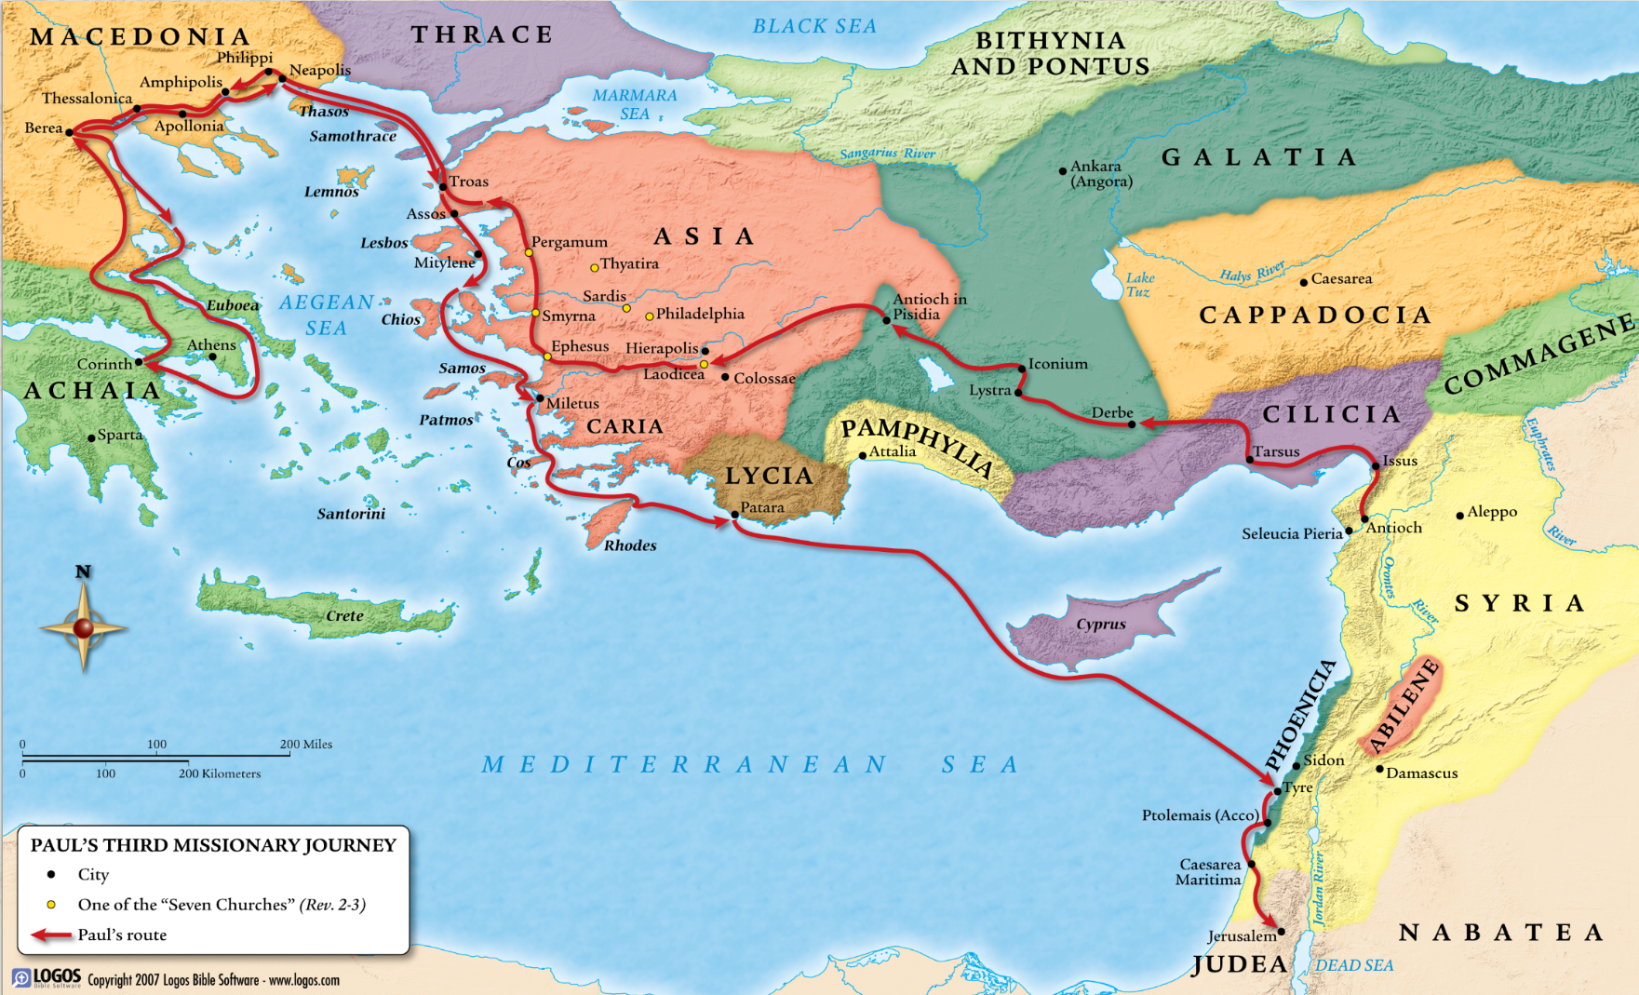
Paul’s 3rd
Missionary
Journey
53-57 AD
Paul’s 3rd
Missionary
Journey
53-57 AD
Paul’s 3rd
Missionary
Journey
53-57 AD
Paul’s 3rd
Missionary
Journey
53-57 AD
3
Paul’s 3rd
Missionary
Journey
53-57 AD
At Troas, Paul preached until midnight, Eutychus falls asleep and tumbles to his death from the 3rd story window. Paul revives him with Dr. Luke there to witness it.
Paul wrote his second letter to the Corinthians while in Macedonia.
4
2
1
5
After 2½ years in Ephesus, Paul left there after the riots and traveled to Macedonia.
We pickup the story in Miletus, where Paul stops briefly for a farewell gathering before traveling on to Jerusalem for the day of Pentecost.
Paul traveled through Macedonia to Greece where he stayed for three months. Paul wrote Romans while in Corinth.
Jews celebrated the giving of the Law, while Christians celebrated the giving of the Holy Spirit.

Slide 7

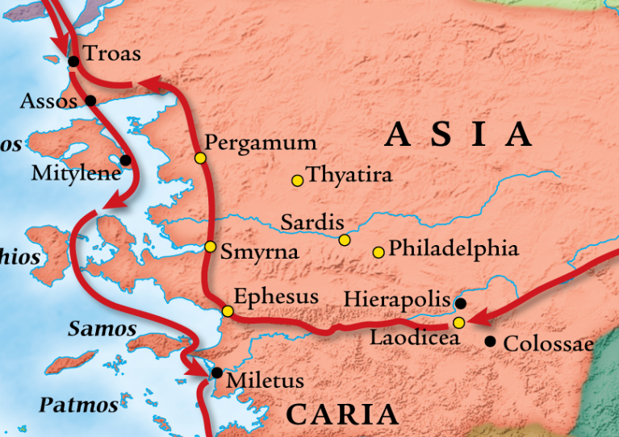
Seven Churches of Revelation
Which 2 escape criticism?
Ephesus
Smyrna
Pergamum
Thyatira
Sardis
Philadelphia
Laodicea
3
4
2
5
6
1
7

Slide 8
Servant Leadership
Acts 20
Acts 20 is Luke’s conclusion for Paul’s three missionary journeys.
From this point forward Paul’s focus will be on Rome, even though the road takes him through Jerusalem.
The key word for this chapter might well be Encouragement.
Wherever Paul went, he focused on this crucial ministry desperately needed in so many churches, then and now.
Key Word
ENCOURAGEMENT

Slide 9

Personal Testimony Acts 20:17-24
¹⁷ Now from Miletus, he sent to Ephesus and summoned the elders of the church. ¹⁸ When they came to him, he said to them, “You know, from the first day I set foot in Asia, how I was with you the whole time, ¹⁹ serving the Lord with all humility, with tears, and during the trials that came to me through the plots of the Jews. ²⁰ You know that I did not avoid proclaiming to you anything that was profitable or from teaching you publicly and from house to house. ²¹ I testified to both Jews and Greeks about repentance toward God and faith in our Lord Jesus.
²² “And now I am on my way to Jerusalem, compelled by the Spirit, not knowing what I will encounter there, ²³ except that in every town the Holy Spirit warns me that chains and afflictions are waiting for me. ²⁴ But I consider my life of no value to myself; my purpose is to finish my course and the ministry I received from the Lord Jesus, to testify to the gospel of God’s grace.
© Eric F. Glover 2021
9

Slide 10
¹⁸ When they came to him, he said to them, “You know, from the first day I set foot in Asia, how I was with you the whole time, ¹⁹ serving the Lord with all humility, with tears, and during the trials that came to me through the plots of the Jews. ²⁰ You know that I did not avoid proclaiming to you anything that was profitable or from teaching you publicly and from house to house.
¹⁸ When they came to him, he said to them, “You know, from the first day I set foot in Asia, how I was with you the whole time, ¹⁹ serving the Lord with all humility, with tears, and during the trials that came to me through the plots of the Jews. ²⁰ You know that I did not avoid proclaiming to you anything that was profitable or from teaching you publicly and from house to house.
¹⁸ When they came to him, he said to them, “You know, from the first day I set foot in Asia, how I was with you the whole time, ¹⁹ serving the Lord with all humility, with tears, and during the trials that came to me through the plots of the Jews. ²⁰ You know that I did not avoid proclaiming to you anything that was profitable or from teaching you publicly and from house to house.
¹⁸ When they came to him, he said to them, “You know, from the first day I set foot in Asia, how I was with you the whole time, ¹⁹ serving the Lord with all humility, with tears, and during the trials that came to me through the plots of the Jews. ²⁰ You know that I did not avoid proclaiming to you anything that was profitable or from teaching you publicly and from house to house.
¹⁸ When they came to him, he said to them, “You know, from the first day I set foot in Asia, how I was with you the whole time, ¹⁹ serving the Lord with all humility, with tears, and during the trials that came to me through the plots of the Jews. ²⁰ You know that I did not avoid proclaiming to you anything that was profitable or from teaching you publicly and from house to house.
¹⁸ When they came to him, he said to them, “You know, from the first day I set foot in Asia, how I was with you the whole time, ¹⁹ serving the Lord with all humility, with tears, and during the trials that came to me through the plots of the Jews. ²⁰ You know that I did not avoid proclaiming to you anything that was profitable or from teaching you publicly and from house to house.
¹⁸ When they came to him, he said to them, “You know, from the first day I set foot in Asia, how I was with you the whole time, ¹⁹ serving the Lord with all humility, with tears, and during the trials that came to me through the plots of the Jews. ²⁰ You know that I did not avoid proclaiming to you anything that was profitable or from teaching you publicly and from house to house.
¹⁸ When they came to him, he said to them, “You know, from the first day I set foot in Asia, how I was with you the whole time, ¹⁹ serving the Lord with all humility, with tears, and during the trials that came to me through the plots of the Jews. ²⁰ You know that I did not avoid proclaiming to you anything that was profitable or from teaching you publicly and from house to house.
¹⁸ When they came to him, he said to them, “You know, from the first day I set foot in Asia, how I was with you the whole time, ¹⁹ serving the Lord with all humility, with tears, and during the trials that came to me through the plots of the Jews. ²⁰ You know that I did not avoid proclaiming to you anything that was profitable or from teaching you publicly and from house to house.
¹⁸ When they came to him, he said to them, “You know, from the first day I set foot in Asia, how I was with you the whole time, ¹⁹ serving the Lord with all humility, with tears, and during the trials that came to me through the plots of the Jews. ²⁰ You know that I did not avoid proclaiming to you anything that was profitable or from teaching you publicly and from house to house.
Leading By Example
Acts 20:18-20
¹⁸ When they came to him, he said to them, “You know, from the first day I set foot in Asia, how I was with you the whole time, ¹⁹ serving the Lord with all humility, with tears, and during the trials that came to me through the plots of the Jews. ²⁰ You know that I did not avoid proclaiming to you anything that was profitable or from teaching you publicly and from house to house.
Leadership Model
Physically present
Continually engaged
Willfully serving
Humble attitude
Compassionate
Tenacious
Courageous
Wise/Knowlegable
Desire to teach
Available
Sound like anyone else you may know?
Can you spot Paul’s 10-Step Leadership Model in this passage?

Slide 11
Personal Testimony
Acts 20:21-24
²¹ I testified to both Jews and Greeks about repentance toward God and faith in our Lord Jesus. ²² “And now I am on my way to Jerusalem, compelled by the Spirit, not knowing what I will encounter there, ²³ except that in every town the Holy Spirit warns me that chains and afflictions are waiting for me. ²⁴ But I consider my life of no value to myself; my purpose is to finish my course and the ministry I received from the Lord Jesus, to testify to the gospel of God’s grace.
²¹ I testified to both Jews and Greeks about repentance toward God and faith in our Lord Jesus. ²² “And now I am on my way to Jerusalem, compelled by the Spirit, not knowing what I will encounter there, ²³ except that in every town the Holy Spirit warns me that chains and afflictions are waiting for me. ²⁴ But I consider my life of no value to myself; my purpose is to finish my course and the ministry I received from the Lord Jesus, to testify to the gospel of God’s grace.
Finish my course
Testify to the gospel
Paul’s mission was to testify, to be a witness, just like us.
What was Paul’s two-fold purpose according to this passage?

Slide 12
Personal Responsibility Acts 20:25-31
²⁵ “And now I know that none of you, among whom I went about preaching the kingdom, will ever see me again. ²⁶ Therefore I declare to you this day that I am innocent of the blood of all of you, ²⁷ because I did not avoid declaring to you the whole plan of God. ²⁸ Be on guard for yourselves and for all the flock of which the Holy Spirit has appointed you as overseers, to shepherd the church of God, which he purchased with his own blood. ²⁹ I know that after my departure savage wolves will come in among you, not sparing the flock. ³⁰ Men will rise up even from your own number and distort the truth to lure the disciples into following them. ³¹ Therefore be on the alert, remembering that night and day for three years I never stopped warning each one of you with tears.
© Eric F. Glover 2021
12

Slide 13
Personal Responsibility
Acts 20:25-31
Paul’s parting words to the Ephesian Elders serve as a challenge to all leaders, now and then.
Guard the Flock
“Be on guard for yourselves and for all the flock of which the Holy Spirit has appointed you as overseers” (v. 28a)
Shepherd the Flock
“shepherd the church of God, which he purchased with his own blood.” (v. 28b)
Warn the Flock
“be on the alert, remembering that night and day for three years I never stopped warning each one of you with tears” (v. 31)
What three things did Paul charge them with doing?
Warn them about what?

Slide 14
Personal Responsibility
Acts 20:25-31
²⁹ I know that after my departure savage wolves will come in among you, not sparing the flock. ³⁰ Men will rise up even from your own number and distort the truth to lure the disciples into following them.
Who were the “Savage Wolves?”
From where would they come?

Slide 15
Personal Example Acts 20:25-35
³² “And now I commit you to God and to the word of his grace, which is able to build you up and to give you an inheritance among all who are sanctified. ³³ I have not coveted anyone’s silver or gold or clothing. ³⁴ You yourselves know that I worked with my own hands to support myself and those who are with me. ³⁵ In every way I’ve shown you that it is necessary to help the weak by laboring like this and to remember the words of the Lord Jesus, because he said, ‘It is more blessed to give than to receive.’ ”
³⁶ After he said this, he knelt down and prayed with all of them. ³⁷ There were many tears shed by everyone. They embraced Paul and kissed him, ³⁸ grieving most of all over his statement that they would never see his face again. And they accompanied him to the ship.
³² “And now I commit you to God and to the word of his grace, which is able to build you up and to give you an inheritance among all who are sanctified. ³³ I have not coveted anyone’s silver or gold or clothing. ³⁴ You yourselves know that I worked with my own hands to support myself and those who are with me. ³⁵ In every way I’ve shown you that it is necessary to help the weak by laboring like this and to remember the words of the Lord Jesus, because he said, ‘It is more blessed to give than to receive.’ ”
³⁶ After he said this, he knelt down and prayed with all of them. ³⁷ There were many tears shed by everyone. They embraced Paul and kissed him, ³⁸ grieving most of all over his statement that they would never see his face again. And they accompanied him to the ship.
³² “And now I commit you to God and to the word of his grace, which is able to build you up and to give you an inheritance among all who are sanctified. ³³ I have not coveted anyone’s silver or gold or clothing. ³⁴ You yourselves know that I worked with my own hands to support myself and those who are with me. ³⁵ In every way I’ve shown you that it is necessary to help the weak by laboring like this and to remember the words of the Lord Jesus, because he said, ‘It is more blessed to give than to receive.’ ”
³⁶ After he said this, he knelt down and prayed with all of them. ³⁷ There were many tears shed by everyone. They embraced Paul and kissed him, ³⁸ grieving most of all over his statement that they would never see his face again. And they accompanied him to the ship.
³² “And now I commit you to God and to the word of his grace, which is able to build you up and to give you an inheritance among all who are sanctified. ³³ I have not coveted anyone’s silver or gold or clothing. ³⁴ You yourselves know that I worked with my own hands to support myself and those who are with me. ³⁵ In every way I’ve shown you that it is necessary to help the weak by laboring like this and to remember the words of the Lord Jesus, because he said, ‘It is more blessed to give than to receive.’ ”
³⁶ After he said this, he knelt down and prayed with all of them. ³⁷ There were many tears shed by everyone. They embraced Paul and kissed him, ³⁸ grieving most of all over his statement that they would never see his face again. And they accompanied him to the ship.
³² “And now I commit you to God and to the word of his grace, which is able to build you up and to give you an inheritance among all who are sanctified. ³³ I have not coveted anyone’s silver or gold or clothing. ³⁴ You yourselves know that I worked with my own hands to support myself and those who are with me. ³⁵ In every way I’ve shown you that it is necessary to help the weak by laboring like this and to remember the words of the Lord Jesus, because he said, ‘It is more blessed to give than to receive.’ ”
³⁶ After he said this, he knelt down and prayed with all of them. ³⁷ There were many tears shed by everyone. They embraced Paul and kissed him, ³⁸ grieving most of all over his statement that they would never see his face again. And they accompanied him to the ship.
³² “And now I commit you to God and to the word of his grace, which is able to build you up and to give you an inheritance among all who are sanctified. ³³ I have not coveted anyone’s silver or gold or clothing. ³⁴ You yourselves know that I worked with my own hands to support myself and those who are with me. ³⁵ In every way I’ve shown you that it is necessary to help the weak by laboring like this and to remember the words of the Lord Jesus, because he said, ‘It is more blessed to give than to receive.’ ”
³⁶ After he said this, he knelt down and prayed with all of them. ³⁷ There were many tears shed by everyone. They embraced Paul and kissed him, ³⁸ grieving most of all over his statement that they would never see his face again. And they accompanied him to the ship.
³² “And now I commit you to God and to the word of his grace, which is able to build you up and to give you an inheritance among all who are sanctified. ³³ I have not coveted anyone’s silver or gold or clothing. ³⁴ You yourselves know that I worked with my own hands to support myself and those who are with me. ³⁵ In every way I’ve shown you that it is necessary to help the weak by laboring like this and to remember the words of the Lord Jesus, because he said, ‘It is more blessed to give than to receive.’ ”
³⁶ After he said this, he knelt down and prayed with all of them. ³⁷ There were many tears shed by everyone. They embraced Paul and kissed him, ³⁸ grieving most of all over his statement that they would never see his face again. And they accompanied him to the ship.
³² “And now I commit you to God and to the word of his grace, which is able to build you up and to give you an inheritance among all who are sanctified. ³³ I have not coveted anyone’s silver or gold or clothing. ³⁴ You yourselves know that I worked with my own hands to support myself and those who are with me. ³⁵ In every way I’ve shown you that it is necessary to help the weak by laboring like this and to remember the words of the Lord Jesus, because he said, ‘It is more blessed to give than to receive.’ ”
³⁶ After he said this, he knelt down and prayed with all of them. ³⁷ There were many tears shed by everyone. They embraced Paul and kissed him, ³⁸ grieving most of all over his statement that they would never see his face again. And they accompanied him to the ship.
© Eric F. Glover 2021
15

Slide 16
Living
By Example
Acts 20:32-38
Not only did Paul teach them how to lead, but he also taught them how to live as leaders:
He taught them to feed on the Word (v. 32)
He taught them not to covet (v. 33-35)
He taught them how to work hard (v. 34)
He taught them how to care for the weak (v. 35)
He taught them to memorize Scripture (v. 35)
He taught them to pray (v. 36)
He taught them to love each other (v. 36-38)
Paul’s Missionary Journey Legacy
Living & Leading by Example

Slide 17
Living Testimony
“I'd rather see a sermon than hear one any day; I'd rather one should walk with me than merely tell the way. The eye's a better pupil and more willing than the ear, Fine counsel is confusing, but example's always clear; And the best of all the preachers are the men who live their creeds, For to see good put in action is what everybody needs.”
Edgar Guest
British-born, American Poet 1881-1959
© Eric F. Glover 2021
17

Slide 18
IN
IN powered Discipleship
Living & Leading by Example
What will be your legacy? What is your personal testimony about God working in and through your life?
How have leaders of our church been an encouragement to you in your Christian growth? How have they lived and lead by example for you?
Have you thanked and encouraged them lately?

Slide 19
INpowered Discipleship
An Inductive Study of the Book of Acts
Faithful Discipleship Acts 21:18-23:35

Slide 20
ICE CREAM SOCIAL
Tonight! – 7:00-9:00pm
Mike & Courtney Flores
447 Canterbury Rise
Franklin, TN 37067

