Slide 1

INpowered Discipleship
An Inductive Study of the Book of Acts
Persuasive Discipleship Acts 19:23-41

Slide 2
Focal Passages
Scripture Reading Volunteers:
Acts 19:23-27
Acts 19:28-34
Acts 19:35-41

Slide 3
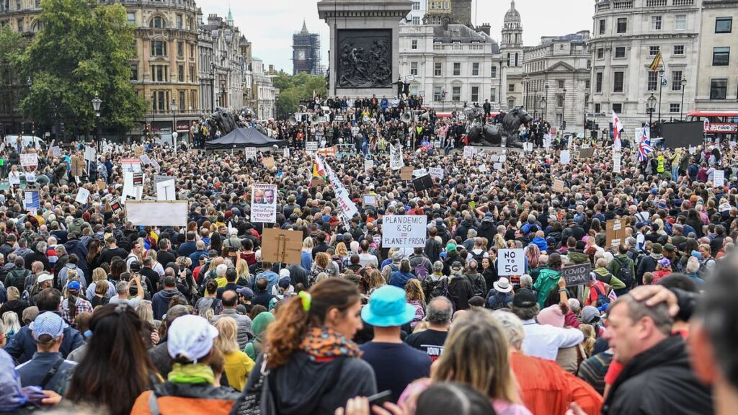
Riot or Peaceful Assembly?

Slide 4
Acts 1:8
“But you will receive when the Holy Spirit has come on you, and you will be My witnesses in Jerusalem, in all Judea and Samaria, and to the ends of the earth.”
POWER

Slide 5

Rioting in Ephesus Acts 19:23-27
²³About that time there was a major disturbance about the Way. ²⁴For a person named Demetrius, a silversmith who made silver shrines of Artemis, provided a great deal of business for the craftsmen. ²⁵When he had assembled them, as well as the workers engaged in this type of business, he said, “Men, you know that our prosperity is derived from this business. ²⁶You see and hear that not only in Ephesus, but in almost all of Asia, this man Paul has persuaded and misled a considerable number of people by saying that gods made by hand are not gods. ²⁷Not only do we run a risk that our business may be discredited, but also that the temple of the great goddess Artemis may be despised and her magnificence come to the verge of ruin—the very one all of Asia and the world worship.”
© Eric F. Glover 2021
5

Slide 6
Rioting in Ephesus Acts 19:23-27
²³About that time there was a major disturbance about the Way.
What caused the disturbance?
To whom does “the Way” refer?
© Eric F. Glover 2021
6

Slide 7
Rioting in Ephesus Acts 19:23-27
²³About that time there was a major disturbance about the Way. ²⁴For a person named Demetrius, a silversmith who made silver shrines of Artemis, provided a great deal of business for the craftsmen.
How would you describe Demetrius’ position in Ephesus?
Who was the ringleader?
© Eric F. Glover 2021
7

Slide 8
Rioting in Ephesus Acts 19:23-27
²³About that time there was a major disturbance about the Way. ²⁴For a person named Demetrius, a silversmith who made silver shrines of Artemis, provided a great deal of business for the craftsmen. ²⁵When he had assembled them, as well as the workers engaged in this type of business, he said, “Men, you know that our prosperity is derived from this business.
²³About that time there was a major disturbance about the Way. ²⁴For a person named Demetrius, a silversmith who made silver shrines of Artemis, provided a great deal of business for the craftsmen. ²⁵When he had assembled them, as well as the workers engaged in this type of business, he said, “Men, you know that our prosperity is derived from this business.
²³About that time there was a major disturbance about the Way. ²⁴For a person named Demetrius, a silversmith who made silver shrines of Artemis, provided a great deal of business for the craftsmen. ²⁵When he had assembled them, as well as the workers engaged in this type of business, he said, “Men, you know that our prosperity is derived from this business.
To what group did Demetrius present his case?
What was the basis of Demetrius’ case against the Way?
© Eric F. Glover 2021
8

Slide 9
Rioting in Ephesus Acts 19:23-27
²⁷Not only do we run a risk that our business may be discredited, but also that the temple of the great goddess Artemis may be despised and her magnificence come to the verge of ruin—the very one all of Asia and the world worship.”
What underlying motive did the silversmiths have for their protest?
In a time of economic recession, how might Christians be tempted to act like the Ephesians mob?
© Eric F. Glover 2021
9

Slide 10
Rioting in Ephesus Acts 19:23-27
Who did Demetrius blame for their situation?
²⁶You see and hear that not only in Ephesus, but in almost all of Asia, this man Paul has persuaded and misled a considerable number of people by saying that gods made by hand are not gods.
²⁶You see and hear that not only in Ephesus, but in almost all of Asia, this man Paul has persuaded and misled a considerable number of people by saying that gods made by hand are not gods.
²⁶You see and hear that not only in Ephesus, but in almost all of Asia, this man Paul has persuaded and misled a considerable number of people by saying that gods made by hand are not gods.
²⁶You see and hear that not only in Ephesus, but in almost all of Asia, this man Paul has persuaded and misled a considerable number of people by saying that gods made by hand are not gods.
What had Paul done to anger them?
How far had Paul’s influence spread?
© Eric F. Glover 2021
10

Slide 11
Mob Mentality Acts 19:28-34
²⁸ When they had heard this, they were filled with rage and began to cry out, “Great is Artemis of the Ephesians!” ²⁹ So the city was filled with confusion, and they rushed all together into the amphitheater, dragging along Gaius and Aristarchus, Macedonians who were Paul’s traveling companions. ³⁰ Although Paul wanted to go in before the people, the disciples did not let him. ³¹ Even some of the provincial officials of Asia, who were his friends, sent word to him, pleading with him not to venture into the amphitheater. ³² Some were shouting one thing and some another, because the assembly was in confusion, and most of them did not know why they had come together. ³³ Some Jews in the crowd gave instructions to Alexander after they pushed him to the front. Motioning with his hand, Alexander wanted to make his defense to the people. ³⁴ But when they recognized that he was a Jew, they all shouted in unison for about two hours, “Great is Artemis of the Ephesians!”
© Eric F. Glover 2021
11

Slide 12
Mob Mentality Acts 19:28-34
²⁸When they had heard this, they were filled with rage and began to cry out, “Great is Artemis of the Ephesians!” ²⁹So the city was filled with confusion, and they rushed all together into the amphitheater, dragging along Gaius and Aristarchus, Macedonians who were Paul’s traveling companions. ³⁰Although Paul wanted to go in before the people, the disciples did not let him. ³¹Even some of the provincial officials of Asia, who were his friends, sent word to him, pleading with him not to venture into the amphitheater.
²⁸When they had heard this, they were filled with rage and began to cry out, “Great is Artemis of the Ephesians!” ²⁹So the city was filled with confusion, and they rushed all together into the amphitheater, dragging along Gaius and Aristarchus, Macedonians who were Paul’s traveling companions. ³⁰Although Paul wanted to go in before the people, the disciples did not let him. ³¹Even some of the provincial officials of Asia, who were his friends, sent word to him, pleading with him not to venture into the amphitheater.
²⁸When they had heard this, they were filled with rage and began to cry out, “Great is Artemis of the Ephesians!” ²⁹So the city was filled with confusion, and they rushed all together into the amphitheater, dragging along Gaius and Aristarchus, Macedonians who were Paul’s traveling companions. ³⁰Although Paul wanted to go in before the people, the disciples did not let him. ³¹Even some of the provincial officials of Asia, who were his friends, sent word to him, pleading with him not to venture into the amphitheater.
²⁸When they had heard this, they were filled with rage and began to cry out, “Great is Artemis of the Ephesians!” ²⁹So the city was filled with confusion, and they rushed all together into the amphitheater, dragging along Gaius and Aristarchus, Macedonians who were Paul’s traveling companions. ³⁰Although Paul wanted to go in before the people, the disciples did not let him. ³¹Even some of the provincial officials of Asia, who were his friends, sent word to him, pleading with him not to venture into the amphitheater.
²⁸When they had heard this, they were filled with rage and began to cry out, “Great is Artemis of the Ephesians!” ²⁹So the city was filled with confusion, and they rushed all together into the amphitheater, dragging along Gaius and Aristarchus, Macedonians who were Paul’s traveling companions. ³⁰Although Paul wanted to go in before the people, the disciples did not let him. ³¹Even some of the provincial officials of Asia, who were his friends, sent word to him, pleading with him not to venture into the amphitheater.
How did the crowd respond?
Sound familiar?
Seen any crowds like that this past year?
Put yourself there in that scene, how are you feeling?
© Eric F. Glover 2021
12

Slide 13
Mob Mentality Acts 19:28-34
²⁸When they had heard this, they were filled with rage and began to cry out, “Great is Artemis of the Ephesians!” ²⁹So the city was filled with confusion, and they rushed all together into the amphitheater, dragging along Gaius and Aristarchus, Macedonians who were Paul’s traveling companions. ³⁰Although Paul wanted to go in before the people, the disciples did not let him. ³¹Even some of the provincial officials of Asia, who were his friends, sent word to him, pleading with him not to venture into the amphitheater.
²⁸When they had heard this, they were filled with rage and began to cry out, “Great is Artemis of the Ephesians!” ²⁹So the city was filled with confusion, and they rushed all together into the amphitheater, dragging along Gaius and Aristarchus, Macedonians who were Paul’s traveling companions. ³⁰Although Paul wanted to go in before the people, the disciples did not let him. ³¹Even some of the provincial officials of Asia, who were his friends, sent word to him, pleading with him not to venture into the amphitheater.
²⁸When they had heard this, they were filled with rage and began to cry out, “Great is Artemis of the Ephesians!” ²⁹So the city was filled with confusion, and they rushed all together into the amphitheater, dragging along Gaius and Aristarchus, Macedonians who were Paul’s traveling companions. ³⁰Although Paul wanted to go in before the people, the disciples did not let him. ³¹Even some of the provincial officials of Asia, who were his friends, sent word to him, pleading with him not to venture into the amphitheater.
How did Paul respond?
Why did his friends prevent him from appearing?
© Eric F. Glover 2021
13

Slide 14
Mass Hysteria Acts 19:32-34
³²Some were shouting one thing and some another, because the assembly was in confusion, and most of them did not know why they had come together. ³³Some Jews in the crowd gave instructions to Alexander after they pushed him to the front. Motioning with his hand, Alexander wanted to make his defense to the people. ³⁴But when they recognized that he was a Jew, they all shouted in unison for about two hours, “Great is Artemis of the Ephesians!”
³²Some were shouting one thing and some another, because the assembly was in confusion, and most of them did not know why they had come together. ³³Some Jews in the crowd gave instructions to Alexander after they pushed him to the front. Motioning with his hand, Alexander wanted to make his defense to the people. ³⁴But when they recognized that he was a Jew, they all shouted in unison for about two hours, “Great is Artemis of the Ephesians!”
³²Some were shouting one thing and some another, because the assembly was in confusion, and most of them did not know why they had come together. ³³Some Jews in the crowd gave instructions to Alexander after they pushed him to the front. Motioning with his hand, Alexander wanted to make his defense to the people. ³⁴But when they recognized that he was a Jew, they all shouted in unison for about two hours, “Great is Artemis of the Ephesians!”
Mass hysteria reigned in the amphitheater, and it was about to get worse.
Jews in the crowd tried to mount a defense, basically to say, “It’s not our fault.”
How did the crowd respond to the Jewish leader?
© Eric F. Glover 2021
14

Slide 15
³⁵ When the city clerk had calmed the crowd down, he said, “People of Ephesus! What person is there who doesn’t know that the city of the Ephesians is the temple guardian of the great Artemis, and of the image that fell from heaven? ³⁶ Therefore, since these things are undeniable, you must keep calm and not do anything rash. ³⁷ For you have brought these men here who are not temple robbers or blasphemers of our goddess. ³⁸ So if Demetrius and the craftsmen who are with him have a case against anyone, the courts are in session, and there are proconsuls. Let them bring charges against one another. ³⁹ But if you seek anything further, it must be decided in a legal assembly. ⁴⁰ In fact, we run a risk of being charged with rioting for what happened today, since there is no justification that we can give as a reason for this disturbance.” ⁴¹ After saying this, he dismissed the assembly.
Peaceful Resolution
Acts 19:35-41
³⁵ When the city clerk had calmed the crowd down, he said, “People of Ephesus! What person is there who doesn’t know that the city of the Ephesians is the temple guardian of the great Artemis, and of the image that fell from heaven? ³⁶ Therefore, since these things are undeniable, you must keep calm and not do anything rash. ³⁷ For you have brought these men here who are not temple robbers or blasphemers of our goddess. ³⁸ So if Demetrius and the craftsmen who are with him have a case against anyone, the courts are in session, and there are proconsuls. Let them bring charges against one another. ³⁹ But if you seek anything further, it must be decided in a legal assembly. ⁴⁰ In fact, we run a risk of being charged with rioting for what happened today, since there is no justification that we can give as a reason for this disturbance.” ⁴¹ After saying this, he dismissed the assembly.
The city clerk, their highest-ranking city official and liaison with Rome, basically calms the crowd by telling them that Rome is a greater threat to them than the Way.

Slide 16
³⁵ When the city clerk had calmed the crowd down, he said, “People of Ephesus! What person is there who doesn’t know that the city of the Ephesians is the temple guardian of the great Artemis, and of the image that fell from heaven? ³⁶ Therefore, since these things are undeniable, you must keep calm and not do anything rash. ³⁷ For you have brought these men here who are not temple robbers or blasphemers of our goddess. ³⁸ So if Demetrius and the craftsmen who are with him have a case against anyone, the courts are in session, and there are proconsuls. Let them bring charges against one another. ³⁹ But if you seek anything further, it must be decided in a legal assembly. ⁴⁰ In fact, we run a risk of being charged with rioting for what happened today, since there is no justification that we can give as a reason for this disturbance.” ⁴¹ After saying this, he dismissed the assembly.
Peaceful Resolution
Acts 19:35-41
How would feel, if you were the Apostle Paul or one of the disciples there that day?
The city clerk, their highest-ranking city official and liaison with Rome, basically calms the crowd by telling them that Rome is a greater threat to them than the Way.

Slide 17
Staying Focused
Acts 20:1
¹After the uproar was over, Paul sent for the disciples, encouraged them, and after saying farewell, departed to go to Macedonia.
How would you characterize Paul’s response?
Are you surprised by that?

Slide 18
Sharpened by Friction
“Let us be very careful that we do not waste our energy, and miss the meaning of our high calling, by any rejoicing in the patronage of the world. It is by the friction of persecution that the fine gold of character is made to flash and gleam with glory. The Church persecuted has always been the Church pure, and therefore the Church powerful. The Church patronized has always been the Church in peril, and very often the Church paralyzed.”
G. Campbell Morgan British evangelist, preacher, leading Bible teacher, and prolific author. 1863-1945

Slide 19
IN
IN powered Discipleship
PURSASIVE DISCIPLESHIP
The Gospel message, preached far and wide, was impactful as evident in Ephesus and nearly all of Asia.
Demetrius credited that to the persuasiveness of Paul, but it was the Truth of the Gospel message that drove the results, fueled by the power of the Holy Spirit.
Satan tried to distract the disciples from fulfilling their mission through any means possible, including mob rule and anarchy.
But the disciples avoided distractions, remained focused and pressed on with their high calling, INpowered.

Slide 20
INpowered Discipleship
An Inductive Study of the Book of Acts
Leading Disciples Acts 20:1-38

