Slide 1

Happy Independence Day

Slide 2

INpowered Discipleship
An Inductive Study of the Book of Acts
Tenacious Discipleship Acts 19:8-20

Slide 3
Focal Passages
Scripture Reading Volunteers:
Acts 19:8-10
Acts 19:11-12
Acts 19:13-17
Acts 19:18-20

Slide 4
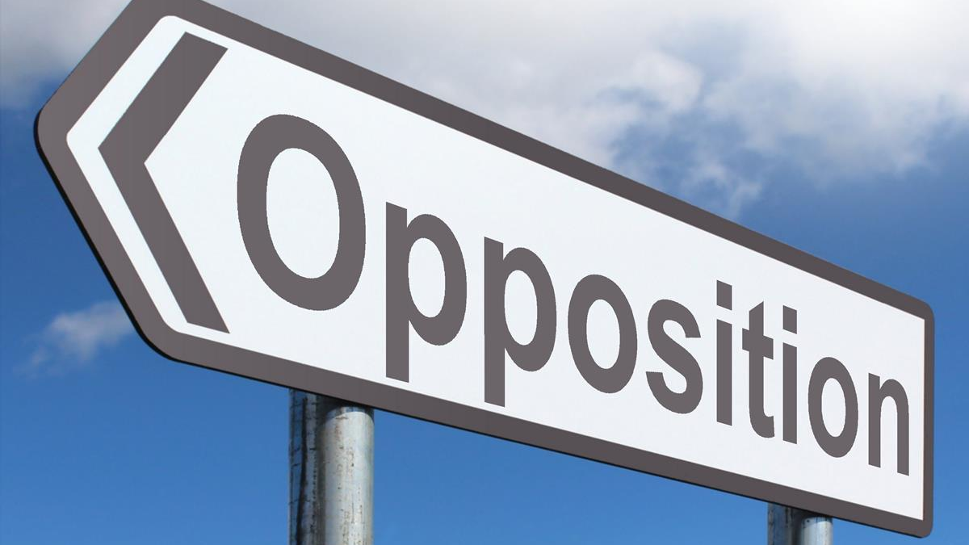

Slide 5
Acts 1:8
“But you will receive when the Holy Spirit has come on you, and you will be My witnesses in Jerusalem, in all Judea and Samaria, and to the ends of the earth.”
POWER

Slide 6
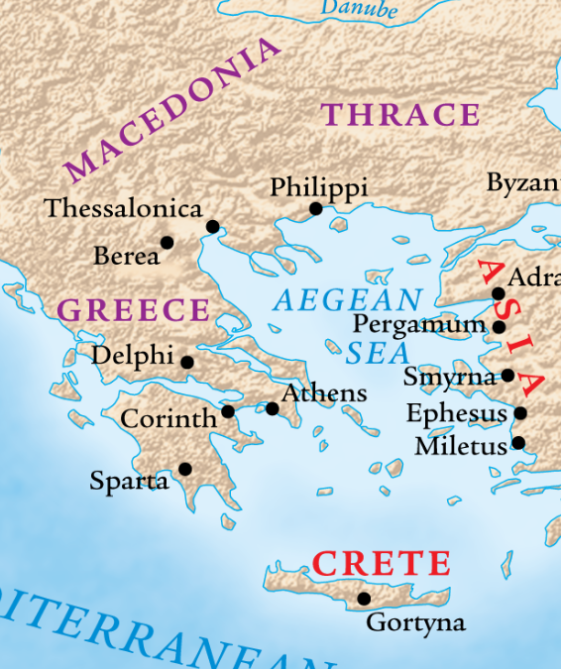
The 2^{nd &} 3rd
Missionary
Journeys
50-52, 53-57 AD
Ephesus
Paul visited Ephesus on his 2nd missionary journey and promised to return, if God willed it (18:21).
On his way back, across the interior regions, he encountered several disciples who had been taught by Apollos.
They had an incomplete view of the gospel, so Paul shared the whole gospel with them; they believed, were baptized, and received the Holy Spirit.
We pickup the story today with Paul back in Ephesus.

Slide 7

Jewish Opposition Acts 19:8-10
⁸ Paul entered the synagogue and spoke boldly over a period of three months, arguing and persuading them about the kingdom of God. ⁹ But when some became hardened and would not believe, slandering the Way in front of the crowd, he withdrew from them, taking the disciples, and conducted discussions every day in the lecture hall of Tyrannus. ¹⁰ This went on for two years, so that all the residents of Asia, both Jews and Greeks, heard the word of the Lord.
What happened?
How long did Paul preach in the synagogue in Ephesus?
How did Paul respond?
© Eric F. Glover 2021
7

Slide 8
Paul’s Tenacity Acts 19:8-10
⁸ Paul entered the synagogue and spoke boldly over a period of three months, arguing and persuading them about the kingdom of God. ⁹ But when some became hardened and would not believe, slandering the Way in front of the crowd, he withdrew from them, taking the disciples, and conducted discussions every day in the lecture hall of Tyrannus. ¹⁰ This went on for two years, so that all the residents of Asia, both Jews and Greeks, heard the word of the Lord.
Paul was tenacious and undeterred by the opposition!
© Eric F. Glover 2021
8

Slide 9
¹¹God was performing extraordinary miracles by Paul’s hands, ¹²so that even facecloths or aprons that had touched his skin were brought to the sick, and the diseases left them, and the evil spirits came out of them.
God’s Confirmation
Acts 19:8-10
The miracles God performed through Paul provided incontrovertible evidence that Paul was from God and spoke for God.
Steeped in superstition, the Ephesians failed to understand that Paul was merely the human channel for God’s power.
The idea that healing power could be magically transmitted through objects was prevalent in the ancient world.
God honored Paul’s tenacity!
What happens often, when someone garners this much attention?

Slide 10
Counterfeit Competition Acts 19:13-17
¹³Now some of the itinerant Jewish exorcists also attempted to pronounce the name of the Lord Jesus over those who had evil spirits, saying, “I command you by the Jesus that Paul preaches!” ¹⁴Seven sons of Sceva, a Jewish high priest, were doing this. ¹⁵The evil spirit answered them, “I know Jesus, and I recognize Paul—but who are you?” ¹⁶Then the man who had the evil spirit jumped on them, overpowered them all, and prevailed against them, so that they ran out of that house naked and wounded. ¹⁷When this became known to everyone who lived in Ephesus, both Jews and Greeks, they became afraid, and the name of the Lord Jesus was held in high esteem.
© Eric F. Glover 2021
10

Slide 11
The itinerant Jewish exorcists decided to add the name of Jesus to their repertoire of incantations.
But they had neither the right to use the name nor the power to command demons.
Unexpected Outcome
The attempt to provide competition completely backfired and only brought greater conviction among the Ephesians of the power of Jesus’ name and the truth of Paul’s preaching.
What was their objective?
How did it work out for them?
What was the end result?
© Eric F. Glover 2021
11

Slide 12
End Result
Acts 19:18-20
¹⁸And many who had become believers came confessing and disclosing their practices, ¹⁹while many of those who had practiced magic collected their books and burned them in front of everyone. So they calculated their value and found it to be fifty thousand pieces of silver. ²⁰In this way the word of the Lord spread and prevailed.
Economic Impact
50,000 days’ wages for an average laborer. That’s 160 years!
Magicians were not alone; others were impacted too.

Slide 13
IN
IN powered Discipleship
TENACIOUS DISCIPLESHIP
1 John 4:4
“You are from God, little children, and you have conquered them, because the one who is in you is greater than the one who is in the world.”
Paul boldly shared the Good News despite relentless opposition, and his tenacity is a model for all believers.
All the satanic forces of the occult and magic arrayed against Paul, but they could not overpower the Word of God.
The bold preaching of the Gospel, the confirming miracles, the defeat of the exorcists, the resultant awe for the name of Jesus, and the public repudiation of the magical arts demonstrated the invincible might of God’s Word.
Acts 1:8
“But you will receive power when the Holy Spirit has come on you, and you will be my witnesses…”

Slide 14
IN
IN powered Discipleship
SO
Be strong and courageous; don’t be terrified or afraid of them. For the Lord your God is the one who will go with you; he will not leave you or abandon you.”
Deuteronomy 31:6

Slide 15
IN
IN powered Discipleship
Do not fear, for I am with you; do not be afraid, for I am your God. I will strengthen you; I will help you; I will hold on to you with my righteous right hand… For I am the Lord your God, who holds your right hand, who says to you, “Do not fear, I will help you.
Isaiah 41:10,13

Slide 16
IN
IN powered Discipleship
Do not fear, for I am with you; do not be afraid, for I am your God. I will strengthen you; I will help you; I will hold on to you with my righteous right hand… For I am the Lord your God, who holds your right hand, who says to you, “Do not fear, I will help you.
Isaiah 41:10,13
3X
3X
4X

Slide 17
IN
IN powered Discipleship
Be Tenacious!

Slide 18
INpowered Discipleship
An Inductive Study of the Book of Acts
Persuasive Discipleship Acts 19:23-41

