Slide 1

INpowered Discipleship
An Inductive Study of the Book of Acts
Pure Discipleship Acts 18:24 - 19:7

Slide 2
Focal Passages
Volunteers needed:
Acts 18:24-28
Acts 19:1-7

Slide 3

Have you seen this symbol?
What does it represent?

Slide 4
Acts 1:8
“But you will receive when the Holy Spirit has come on you, and you will be My witnesses in Jerusalem, in all Judea and Samaria, and to the ends of the earth.”
POWER

Slide 5
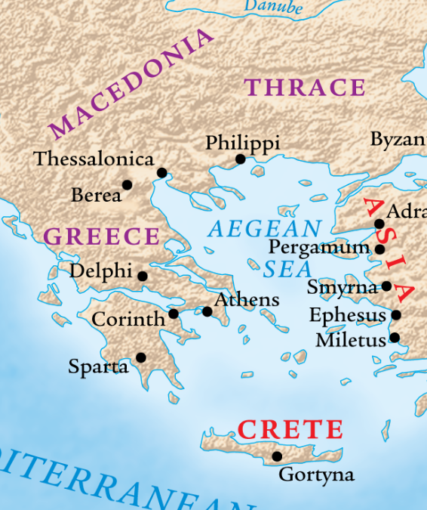
The 2^{nd &} 3rd
Missionary
Journeys
50-52, 53-57 AD
Ephesus
Leading commercial center in Asia Minor – population ~300,000
Beautiful city, very sophisticated, wealthy, and pagan.
Major religious center – focusing on the worship of Diana (Artemis)
Home of the Temple of Artemis, one of the seven wonder of the ancient world – four times the size of the Parthenon in Athens.

Slide 6
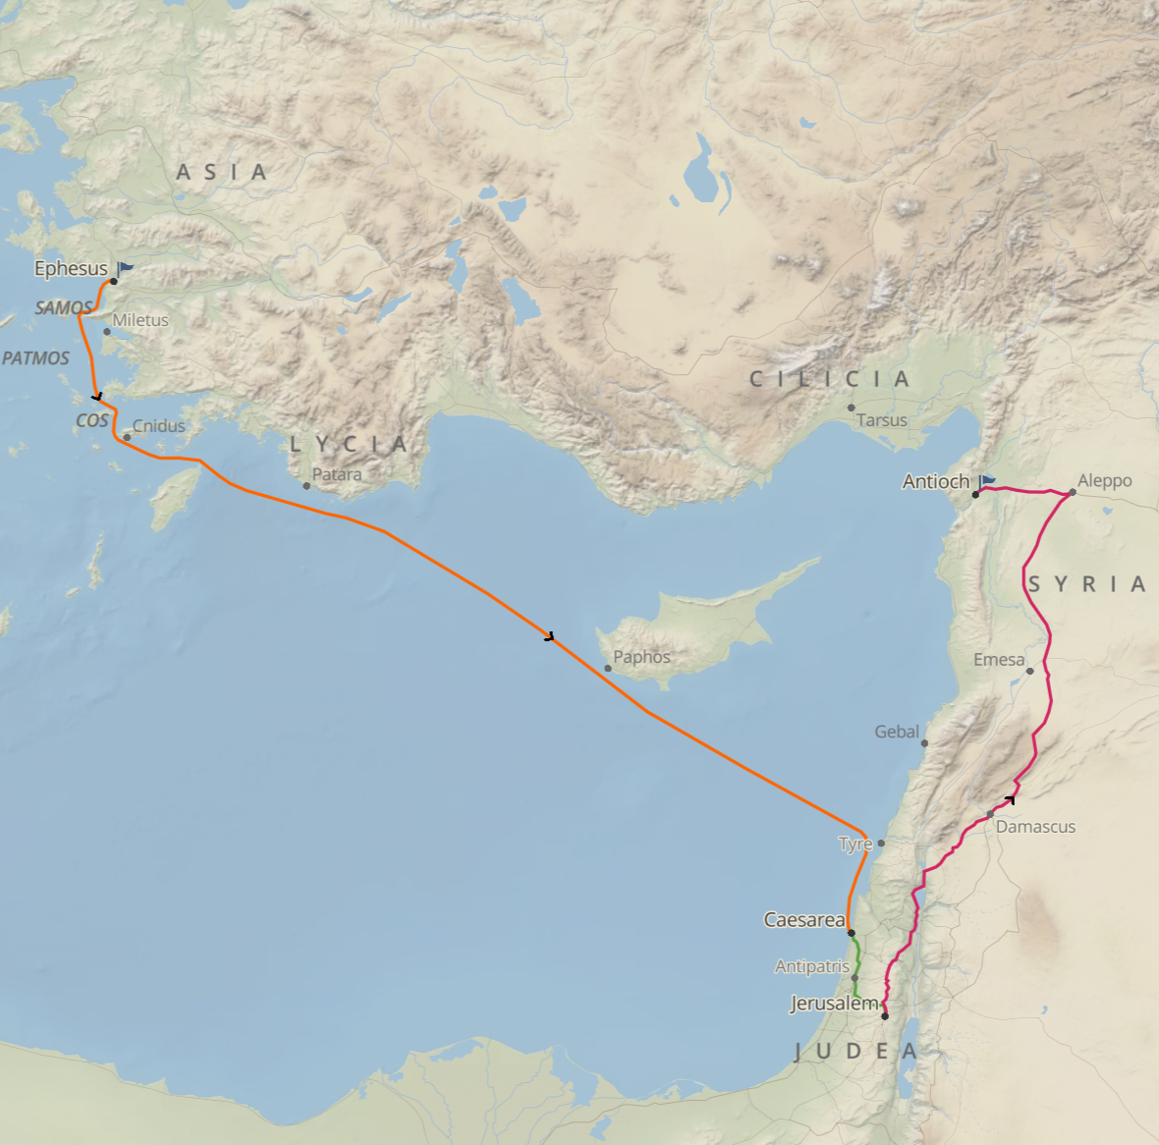
2nd Missionary Journey Concludes
The Interlude
Paul sailed from Corinth to Ephesus, with Priscilla and Aquila, where he stayed briefly and debated Jews in the synagogue.
He left Priscilla and Aquila there in Ephesus and traveled back to Antioch in Syria, after visiting the church in Jerusalem first.
While Paul was away, a well-educated, eloquent Jew from Alexandria named Apollos arrived in Ephesus.
Apollos started speaking and teaching passionately about Jesus – but there was a problem.
© Eric F. Glover 2021
6
© Eric F. Glover 2021

Slide 7
²⁴ Now a Jew named Apollos, a native Alexandrian, an eloquent man who was competent in the use of the Scriptures, arrived in Ephesus. ²⁵ He had been instructed in the way of the Lord; and being fervent in spirit, he was speaking and teaching accurately about Jesus, although he knew only John’s baptism. ²⁶ He began to speak boldly in the synagogue. After Priscilla and Aquila heard him, they took him aside and explained the way of God to him more accurately. ²⁷ When he wanted to cross over to Achaia, the brothers and sisters wrote to the disciples to welcome him. After he arrived, he was a great help to those who by grace had believed. ²⁸ For he vigorously refuted the Jews in public, demonstrating through the Scriptures that Jesus is the Messiah.
Incomplete Knowledge
Acts 18:24-28

Slide 8
²⁴ Now a Jew named Apollos, a native Alexandrian, an eloquent man who was competent in the use of the Scriptures, arrived in Ephesus. ²⁵ He had been instructed in the way of the Lord; and being fervent in spirit, he was speaking and teaching accurately about Jesus, although he knew only John’s baptism. ²⁶ He began to speak boldly in the synagogue. After Priscilla and Aquila heard him, they took him aside and explained the way of God to him more accurately. ²⁷ When he wanted to cross over to Achaia, the brothers and sisters wrote to the disciples to welcome him. After he arrived, he was a great help to those who by grace had believed. ²⁸ For he vigorously refuted the Jews in public, demonstrating through the Scriptures that Jesus is the Messiah.
Incomplete Knowledge
Acts 18:24-28
Apollos sounds like the perfect Christian leader.
What’s the problem?

Slide 9
Incomplete Knowledge
Acts 18:24-28
²⁵ He had been instructed in the way of the Lord; and being fervent in spirit, he was speaking and teaching accurately about Jesus, although he knew only John’s baptism.
Apollos’ doctrine regarding Jesus was accurate but deficient. He had not heard about Pentecost.
What was John’s baptism?

Slide 10
Incomplete Knowledge
Acts 18:24-28
²⁵ He had been instructed in the way of the Lord; and being fervent in spirit, he was speaking and teaching accurately about Jesus, although he knew only John’s baptism.
John’s baptism symbolized cleansing because of repentance.
Luke 3:16
John answered them all, “I baptize you with water, but one who is more powerful than I am is coming. I am not worthy to untie the strap of his sandals. He will baptize you with the Holy Spirit and fire.
Luke 3:2-3
²during the high priesthood of Annas and Caiaphas, God's word came to John the son of Zechariah in the wilderness. ³He went into all the vicinity of the Jordan, proclaiming a baptism of repentance for the forgiveness of sins,
See Week 9: The Ministry of John the Baptist from our study in Luke’s Gospel for deeper insight on this topic.

Slide 11
²⁵ He had been instructed in the way of the Lord; and being fervent in spirit, he was speaking and teaching accurately about Jesus, although he knew only John’s baptism.
Incomplete Knowledge
Acts 18:24-28
Christian baptism symbolizes union with Christ in His death, burial, and resurrection by means of Spirit baptism.
Additional References
1 Cor. 12:13
Gal. 3:27
Col. 2:12
Romans 6:3-5
³Or are you unaware that all of us who were baptized into Christ Jesus were baptized into his death? ⁴Therefore we were buried with him by baptism into death, in order that, just as Christ was raised from the dead by the glory of the Father, so we too may walk in newness of life. ⁵For if we have been united with him in the likeness of his death, we will certainly also be in the likeness of his resurrection.

Slide 12
Complete Knowledge
Acts 18:24-28
²⁴ Now a Jew named Apollos, a native Alexandrian, an eloquent man who was competent in the use of the Scriptures, arrived in Ephesus. ²⁵ He had been instructed in the way of the Lord; and being fervent in spirit, he was speaking and teaching accurately about Jesus, although he knew only John’s baptism. ²⁶ He began to speak boldly in the synagogue. After Priscilla and Aquila heard him, they took him aside and explained the way of God to him more accurately. ²⁷ When he wanted to cross over to Achaia, the brothers and sisters wrote to the disciples to welcome him. After he arrived, he was a great help to those who by grace had believed. ²⁸ For he vigorously refuted the Jews in public, demonstrating through the Scriptures that Jesus is the Messiah.
How did Priscilla and Aquila handle the situation?

Slide 13
Correct Knowledge
Acts 19:1-7
¹ While Apollos was in Corinth, Paul traveled through the interior regions and came to Ephesus. He found some disciples ² and asked them, “Did you receive the Holy Spirit when you believed?”
“No,” they told him, “we haven’t even heard that there is a Holy Spirit.”
³ “Into what then were you baptized?” he asked them.
“Into John’s baptism,” they replied.
⁴ Paul said, “John baptized with a baptism of repentance, telling the people that they should believe in the one who would come after him, that is, in Jesus.”
⁵ When they heard this, they were baptized into the name of the Lord Jesus. ⁶ And when Paul had laid his hands on them, the Holy Spirit came on them, and they began to speak in tongues and to prophesy. ⁷ Now there were about twelve men in all.

Slide 14
Correct Knowledge
Acts 19:1-7
¹ While Apollos was in Corinth, Paul traveled through the interior regions and came to Ephesus. He found some disciples ² and asked them, “Did you receive the Holy Spirit when you believed?”
“No,” they told him, “we haven’t even heard that there is a Holy Spirit.”
³ “Into what then were you baptized?” he asked them.
“Into John’s baptism,” they replied.
⁴ Paul said, “John baptized with a baptism of repentance, telling the people that they should believe in the one who would come after him, that is, in Jesus.”
⁵ When they heard this, they were baptized into the name of the Lord Jesus. ⁶ And when Paul had laid his hands on them, the Holy Spirit came on them, and they began to speak in tongues and to prophesy. ⁷ Now there were about twelve men in all.
What questions did Paul ask them?

Slide 15
Correct Knowledge
Acts 19:1-7
¹ While Apollos was in Corinth, Paul traveled through the interior regions and came to Ephesus. He found some disciples ² and asked them, “Did you receive the Holy Spirit when you believed?”
“No,” they told him, “we haven’t even heard that there is a Holy Spirit.”
³ “Into what then were you baptized?” he asked them.
“Into John’s baptism,” they replied.
⁴ Paul said, “John baptized with a baptism of repentance, telling the people that they should believe in the one who would come after him, that is, in Jesus.”
⁵ When they heard this, they were baptized into the name of the Lord Jesus. ⁶ And when Paul had laid his hands on them, the Holy Spirit came on them, and they began to speak in tongues and to prophesy. ⁷ Now there were about twelve men in all.
What questions did Paul ask them?
How did they answer?

Slide 16
Correct Knowledge
Acts 19:1-7
¹ While Apollos was in Corinth, Paul traveled through the interior regions and came to Ephesus. He found some disciples ² and asked them, “Did you receive the Holy Spirit when you believed?”
“No,” they told him, “we haven’t even heard that there is a Holy Spirit.”
³ “Into what then were you baptized?” he asked them.
“Into John’s baptism,” they replied.
⁴ Paul said, “John baptized with a baptism of repentance, telling the people that they should believe in the one who would come after him, that is, in Jesus.”
⁵ When they heard this, they were baptized into the name of the Lord Jesus. ⁶ And when Paul had laid his hands on them, the Holy Spirit came on them, and they began to speak in tongues and to prophesy. ⁷ Now there were about twelve men in all.
What questions did Paul ask them?
How did they answer?
Baptism itself did not save them.

Slide 17
Correct Knowledge
Acts 19:1-7
¹ While Apollos was in Corinth, Paul traveled through the interior regions and came to Ephesus. He found some disciples ² and asked them, “Did you receive the Holy Spirit when you believed?”
“No,” they told him, “we haven’t even heard that there is a Holy Spirit.”
³ “Into what then were you baptized?” he asked them.
“Into John’s baptism,” they replied.
⁴ Paul said, “John baptized with a baptism of repentance, telling the people that they should believe in the one who would come after him, that is, in Jesus.”
⁵ When they heard this, they were baptized into the name of the Lord Jesus. ⁶ And when Paul had laid his hands on them, the Holy Spirit came on them, and they began to speak in tongues and to prophesy. ⁷ Now there were about twelve men in all.
Paul told them that they needed to believe in Jesus to be saved.

Slide 18
Correct Knowledge
Acts 19:1-7
¹ While Apollos was in Corinth, Paul traveled through the interior regions and came to Ephesus. He found some disciples ² and asked them, “Did you receive the Holy Spirit when you believed?”
“No,” they told him, “we haven’t even heard that there is a Holy Spirit.”
³ “Into what then were you baptized?” he asked them.
“Into John’s baptism,” they replied.
⁴ Paul said, “John baptized with a baptism of repentance, telling the people that they should believe in the one who would come after him, that is, in Jesus.”
⁵ When they heard this, they were baptized into the name of the Lord Jesus. ⁶ And when Paul had laid his hands on them, the Holy Spirit came on them, and they began to speak in tongues and to prophesy. ⁷ Now there were about twelve men in all.
Salvation came only after they believed in Jesus.

Slide 19
IN
IN powered Discipleship
PURE DISCIPLESHIP
Head knowledge is insufficient for salvation as shown by Apollos.
Baptism alone is insufficient for salvation as shown by the Ephesians.
Salvation comes by grace through faith in Jesus Christ alone, as Paul wrote to the Ephesians in his letter (Eph. 2:8-9).
The power of the indwelling Holy Spirit comes upon all who believe.

Slide 20
INpowered Discipleship
An Inductive Study of the Book of Acts
Tenacious Discipleship Acts 19:8-41

