Slide 1

INpowered Discipleship
An Inductive Study of the Book of Acts
Obedient Discipleship
Acts 18:1-28

Slide 3
Acts 1:8
“But you will receive
when the Holy Spirit has come on you, and you will be My witnesses in Jerusalem, in all Judea and Samaria,
and to the ends of the earth.”
POWER

Slide 4
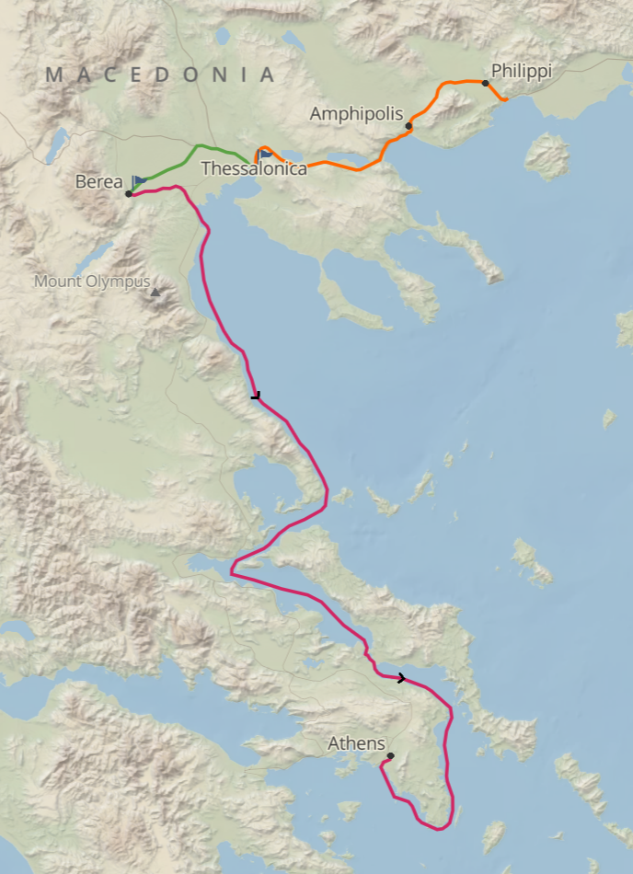
Thessalonica
    Capital of Macedonia
    Paul preached Jesus for three consecutive weeks
    in the synagogue.
    Some Jews, many God-fearing Greeks, and a few prominent women believed.
    A group of jealous Jews formed a mob, started
    a riot and accused Paul and Silas of treason.
    The church sent Paul and Silas away by night to Berea for their safety.
The 2nd
Missionary
Journey
50-52 AD

Slide 5
Berea
    Paul preached in the synagogue and the people received the Word eagerly.
    Many Bereans believed, including many prominent Greek women and men.
    Jews from Thessalonica came to agitate the crowd.
    The church sent Paul away for safety, but Silas and Timothy stayed.
    Paul went to Athens, where Silas and Timothy joined him.
The 2nd
Missionary
Journey
50-52 AD

Slide 6
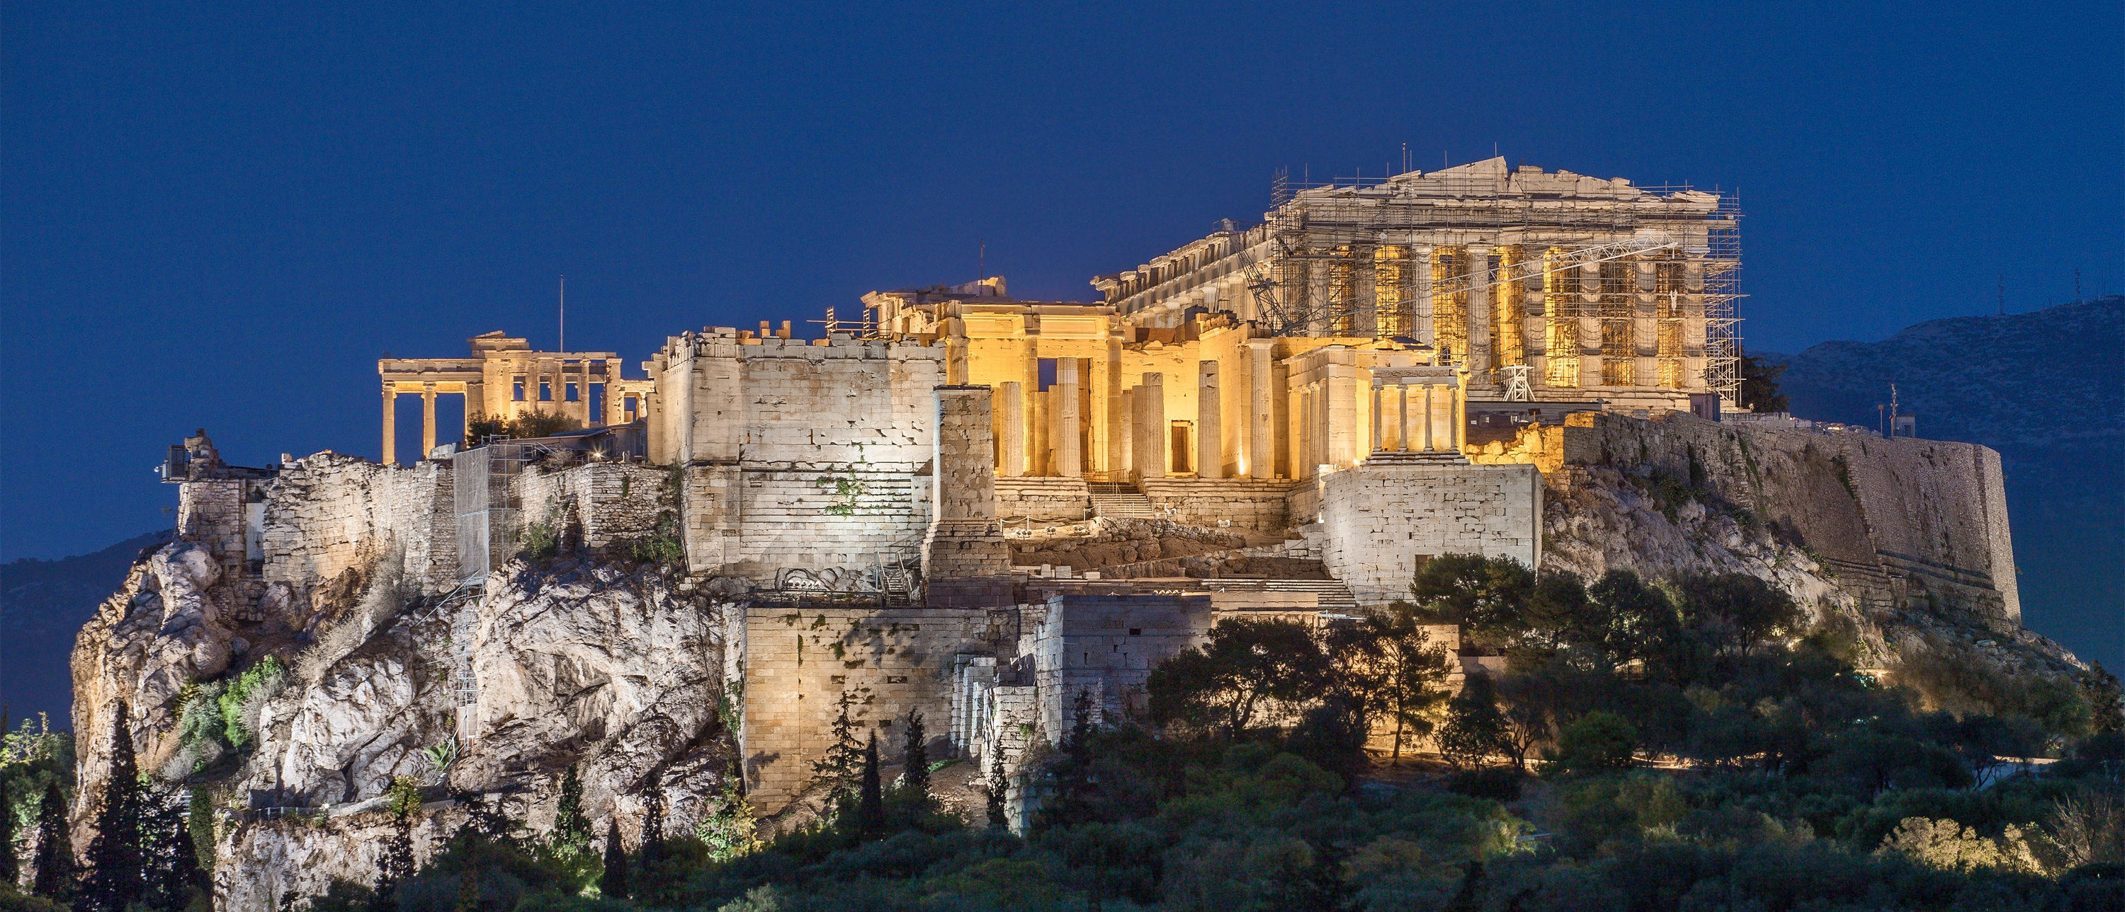
Acts 17:16
¹⁶While Paul was waiting for them in Athens, he was deeply distressed when he saw that
the city was full
of idols.
    Athens reached its peak in the 5th Century BC during the days of Socrates (469-399), Plato (428-347) and Aristotle (384-322).
    At the time of Paul’s visit (50-52 AD), Athens was well past
    its prime, living on bygone glories, rich in monuments, but
    a comparatively small town by modern criteria.
Paul saw neither the beauty of the setting nor the brilliance of the city, but its rampant idolatry.

Slide 7
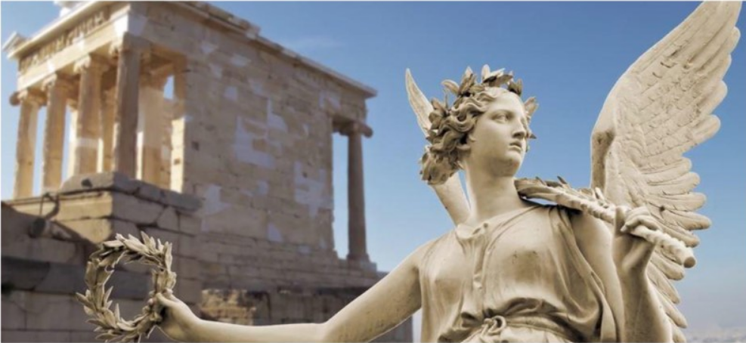
Athens
Athens had innumerable temples, shrines, statues and altars including a huge gold and ivory statue of Athena that could be seen from forty miles away.
    The statues were beautiful, they were made of stone, brass, gold, silver, ivory and marble and they were elegantly fashioned by the world’s greatest sculptors.
    There were images of Apollo, Jupiter, Venus, Mercury, Neptune, and Diana – the whole Greek pantheon, all the gods of Olympus.
Paul was greatly distressed by what he saw.
© Eric F. Glover 2021
7
© Eric F. Glover 2021

Slide 8
Compelled to Act Acts 17:17-21
17So he reasoned in the synagogue with the Jews and with those who worshiped God, as well as in the marketplace every day with those who happened to be there. 18Some of the Epicurean and Stoic philosophers also debated with him. Some said, “What is this ignorant show-off trying to say?”
Others replied, “He seems to be a preacher of foreign deities”—because he was telling the good news about Jesus and the resurrection.
19They took him and brought him to the Areopagus, and said, “May we learn about this new teaching you are presenting? 20Because what you say sounds strange to us, and we want to know what these things mean.” 21Now all the Athenians and the foreigners residing there spent their time on nothing else but telling or hearing something new.

Slide 9
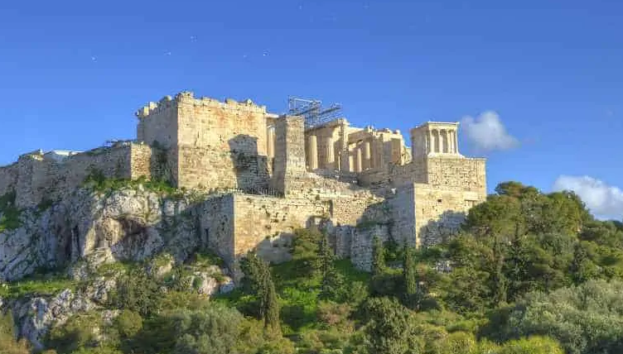
Compelled to Act
Immediately, Paul began witnessing:
  To Jews and God-fearing Greeks
  in the Synagogue.
  To the General Public who happened to be
  in the marketplace (the Agora).
  To Epicurean and Stoic philosophers
  in the Areopagus.
To Whom & Where?

Slide 10
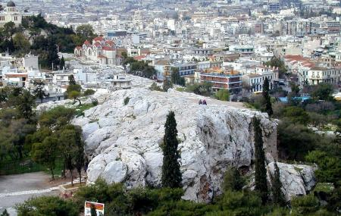
Paul the Apologist
Areopagus
(aka Mars Hill)
Apologetics: The English word “apology” comes from a Greek word which basically means “to give a defense.” Christian apologetics, then, is the science of giving a defense of the Christian faith.
Paul defended his faith before the intellectual elite:
  Epicureans: Materialists, believing in no life beyond this life, their goal was “detachment,” a life lived free from pain and stress.
  Stoics: Pantheists, believing that the universe is God and, conversely, that there is no God but the combined substance, forces, and laws that are manifested in the existing universe. The universe is identical with divinity.
Rising 400 feet above the city, Mars Hill was an important meeting place where
philosophy, religion, and
law were discussed.
Do you know anyone like them?
Have you experienced anything similar?
© Eric F. Glover 2021
10
© Eric F. Glover 2021

Slide 11
INpowered to Speak Acts 17:22-34
22Paul stood in the middle of the Areopagus and said, “People of Athens! I see that you are extremely religious in every respect. 23For as I was passing through and observing the objects of your worship, I even found an altar on which was inscribed, ‘To an Unknown God.’ Therefore, what you worship in ignorance, this I proclaim to you. 24The God who made the world and everything in it—he is Lord of heaven and earth—does not live in shrines made by hands. 25Neither is he served by human hands, as though he needed anything, since he himself gives everyone life and breath and all things. 26From one man he has made every nationality to live over the whole earth and has determined their appointed times and the boundaries of where they live. 27He did this so that they might seek God, and perhaps they might reach out and find him, though he is not far from each one of us.

Slide 12
INpowered to Speak Acts 17:22-34
28For in him we live and move and have our being, as even some of your own poets have said, ‘For we are also his offspring.’ 29Since, then, we are God’s offspring, we shouldn’t think that the divine nature is like gold or silver or stone, an image fashioned by human art and imagination.
30“Therefore, having overlooked the times of ignorance, God now commands all people everywhere to repent, 31because he has set a day when he is going to judge the world in righteousness by the man he has appointed. He has provided proof of this to everyone by raising him from the dead.”
32When they heard about the resurrection of the dead, some began to ridicule him, but others said, “We’d like to hear from you again about this.” 33So Paul left their presence. 34However, some people joined him and believed, including Dionysius the Areopagite, a woman named Damaris, and others with them.

Slide 13
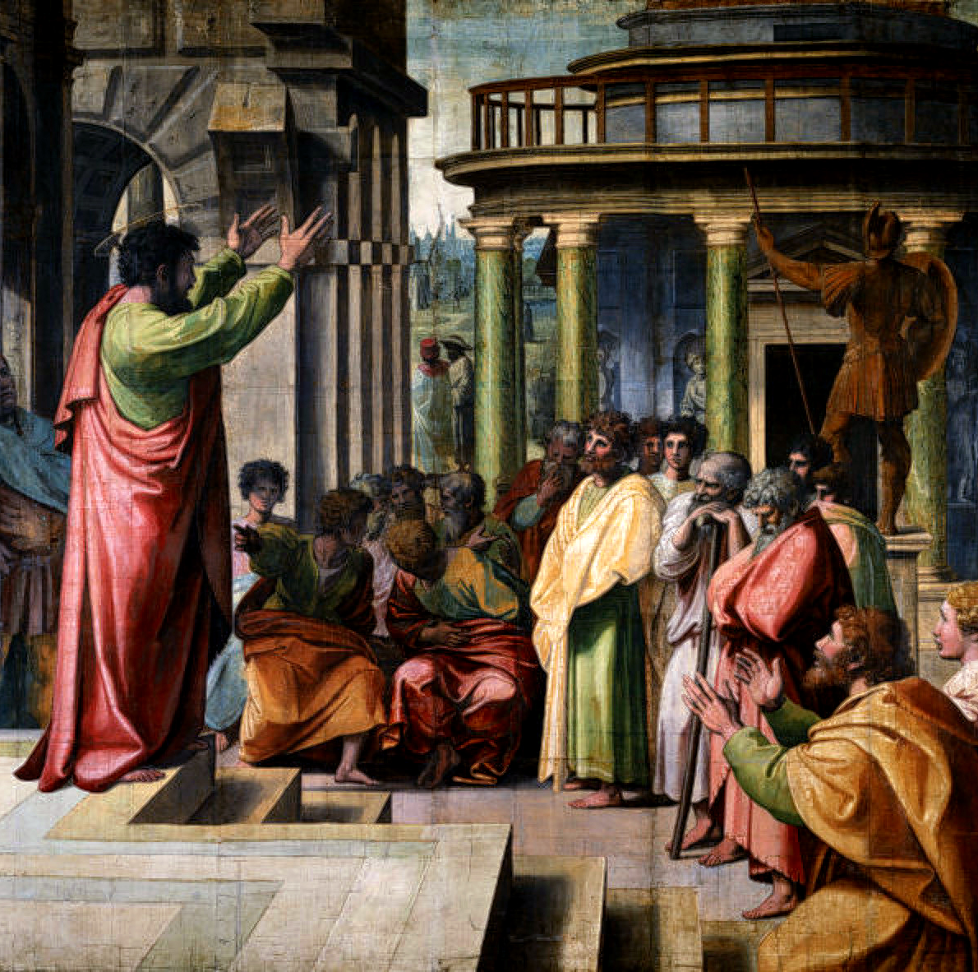
INpowered
to Speak
The Areopagus, once a powerful ruling body, acted more like guardians of the city’s religion, morals and education in Paul’s day.
Paul proclaimed five spiritual truths
to them about the one true, living God:
  God is the creator of the universe
  God is the sustainer of life
  God is the ruler of all nations
  God is the father of human beings
  God is the judge of the world

Slide 14
Devoted Discipleship
Lessons
from Paul
Paul tried to build bridges with the scholars, beginning where they were mentally and offering counterpoints to stimulate their thinking.
  He did not try to win the argument!
  It was a spiritual exchange, not an intellectual debate.
  Paul gave a powerful witness and then he left, leaving the results up to God.
    Dionysius believed, as did a woman named Damaris and a number of others.
“I planted,
Apollos watered,
but God gave the increase.”
1 Cor. 3:6
What did Paul not do?
© Eric F. Glover 2021
14
© Eric F. Glover 2021

Slide 15
IN
IN powered Discipleship
  Paul was devoted to God and the indwelling Holy Spirit enabled him to give a powerful defense for the hope that was within him.
  He was compelled to act and INpowered to speak – he could not standby and watch men and women worship idols instead of God.
  Idol worship is not limited to primitive societies; there are many today who worship idols right in our neighborhoods, perhaps even in our families.
  Some, like the Stoics of old, worship the universe as their god. But an idol can
  be any person or thing that becomes an object of devotion, other than God.
To whom or what are your devoted?

Slide 16
INpowered Discipleship
An Inductive Study of the Book of Acts
Obedient Discipleship
Acts 18:1-28

