Slide 1

INpowered Discipleship
An Inductive Study of the Book of Acts
Confident Discipleship Acts 15:1-35

Slide 2
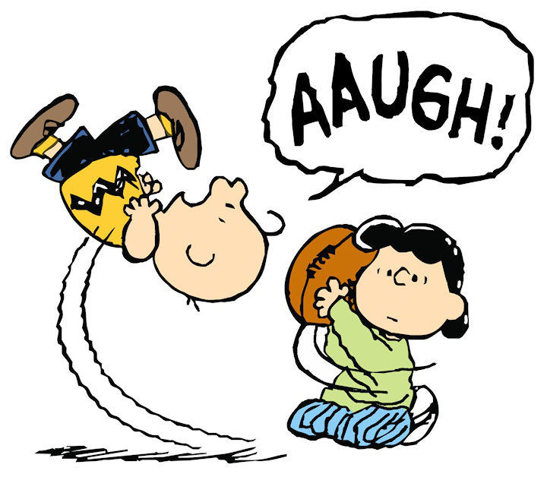
Bait & Switch

Slide 3
Acts 1:8
“But you will receive when the Holy Spirit has come on you, and you will be My witnesses in Jerusalem, in all Judea and Samaria, and to the ends of the earth.”
POWER

Slide 4
The Problem Acts 15:1-5
1Some men came down from Judea and began to teach the brothers, “Unless you are circumcised according to the custom prescribed by Moses, you cannot be saved.” 2After Paul and Barnabas had engaged them in serious argument and debate, Paul and Barnabas and some others were appointed to go up to the apostles and elders in Jerusalem about this issue. 3When they had been sent on their way by the church, they passed through both Phoenicia and Samaria, describing in detail the conversion of the Gentiles, and they brought great joy to all the brothers and sisters.
4When they arrived at Jerusalem, they were welcomed by the church, the apostles, and the elders, and they reported all that God had done with them. 5But some of the believers who belonged to the party of the Pharisees stood up and said, “It is necessary to circumcise them and to command them to keep the law of Moses.”

Slide 5
The Problem
What was the problem?
Gentiles were accepting Christ and becoming members of the church without circumcision.
A few Jewish men insisted that circumcision was necessary for salvation.
They argued that faith alone was insufficient for salvation.
To them: Faith + Works = Salvation
What did the church do to resolve the conflict?

Slide 6
The Defense Acts 15:6-10
6The apostles and the elders gathered to consider this matter. 7After there had been much debate, Peter stood up and said to them, “Brothers, you are aware that in the early days God made a choice among you, that by my mouth the Gentiles would hear the gospel message and believe. 8And God, who knows the heart, bore witness to them by giving them the Holy Spirit, just as he also did to us. 9He made no distinction between us and them, cleansing their hearts by faith. 10Now then, why are you testing God by putting a yoke on the disciples’ necks that neither our ancestors nor we have been able to bear? 11On the contrary, we believe that we are saved through the grace of the Lord Jesus in the same way they are.”

Slide 7
The Defense
What was Peter’s defense?
God knows their hearts and He gave them the Holy Spirit.
God makes no distinction between Jewish believers and Gentile believers.
Demanding circumcision for Gentiles would be akin to testing God.
Gentiles are saved the same way as Jews, by grace through faith.
Ephesians 2:8-9
“For you are saved by grace through faith, and this is not from yourselves; it is God’s gift – not from works, so that no one can boast.”

Slide 8
The Defense Acts 15:12
12The whole assembly became silent and listened to Barnabas and Paul describe all the signs and wonders God had done through them among the Gentiles.
Who else gave testimony on behalf of Gentile believers?

Slide 9
The Deliberation Acts 15:13-14, 19-20
13After they stopped speaking, James responded, “Brothers, listen to me. 14Simeon has reported how God first intervened to take from the Gentiles a people for his name.
* * * * *
19Therefore, in my judgment, we should not cause difficulties for those among the Gentiles who turn to God, 20but instead we should write to them to abstain from things polluted by idols, from sexual immorality, from eating anything that has been strangled, and from blood.
James, the half-brother of Jesus, was the leader of the church in Jerusalem.

Slide 10
Practical Matters of Fellowship
The Decision
James was concerned not only that Jews not trouble Gentiles, but also that Gentiles not trouble Jews.
The danger was that Gentiles, reveling in their freedom in Christ, would pressure Jewish believers to exercise the same liberty and violate their consciences.
So, James and other leaders urged Gentiles to abstain from four things to promote fellowship:
Things polluted by idols,
Sexual immorality,
Eating anything that has been strangled, and
Blood.
© Eric F. Glover 2021
10
© Eric F. Glover 2021

Slide 11
The Law of Love
¹³Therefore, let us no longer judge one another. Instead decide never to put a stumbling block or pitfall in the way of your brother or sister. ¹⁴I know and am persuaded in the Lord Jesus that nothing is unclean in itself. Still, to someone who considers a thing to be unclean, to that one it is unclean. ¹⁵For if your brother or sister is hurt by what you eat, you are no longer walking according to love. Do not destroy, by what you eat, someone for whom Christ died. ¹⁶Therefore, do not let your good be slandered, ¹⁷for the kingdom of God is not eating and drinking, but righteousness, peace, and joy in the Holy Spirit. ¹⁸Whoever serves Christ in this way is acceptable to God and receives human approval.
¹⁹So then, let us pursue what promotes peace and what builds up one another. ²⁰Do not tear down God’s work because of food. Everything is clean, but it is wrong to make someone fall by what he eats. ²¹It is a good thing not to eat meat, or drink wine, or do anything that makes your brother or sister stumble. ²²Whatever you believe about these things, keep between yourself and God.
Romans 14:13-22

Slide 12
The Ruling Acts 15:23-29
From the apostles and the elders, your brothers, To the brothers and sisters among the Gentiles in Antioch, Syria, and Cilicia:
Greetings.
Since we have heard that some without our authorization went out from us and troubled you with their words and unsettled your hearts, we have unanimously decided to select men and send them to you along with our dearly loved Barnabas and Paul, who have risked their lives for the name of our Lord Jesus Christ. Therefore we have sent Judas and Silas, who will personally report the same things by word of mouth. For it was the Holy Spirit’s decision—and ours—not to place further burdens on you beyond these requirements: that you abstain from food offered to idols, from blood, from eating anything that has been strangled, and from sexual immorality. You will do well if you keep yourselves from these things.
Farewell.

Slide 13
The Impact Acts 15:6-10
30So they were sent off and went down to Antioch, and after gathering the assembly, they delivered the letter. 31When they read it, they rejoiced because of its encouragement. 32Both Judas and Silas, who were also prophets themselves, encouraged the brothers and sisters and strengthened them with a long message. 33After spending some time there, they were sent back in peace by the brothers and sisters to those who had sent them. 35But Paul and Barnabas, along with many others, remained in Antioch, teaching and proclaiming the word of the Lord.
The letter was well received and encouraged all the believers in Antioch.
The first major crisis in the church was averted and the Gospel message continued to be preached in Antioch and beyond.

Slide 14
IN
IN powered Discipleship
Confident Discipleship
The Early Church Taught us Two Permanent Lessons
Salvation is by Faith alone and not by Faith + anything.
Self-restraint is often required in order to preserve fellowship and/or advance the gospel
Though I am free and belong to no man, I make myself a slave to everyone, to win as many as possible. To the Jews I became like a Jew, to win the Jews. To those under the law I became like one under the law (though I myself am not under the law), so as to win those under the law. (1 Cor 9:19-20)

Slide 15
INpowered Discipleship
An Inductive Study of the Book of Acts
Liberated Disciples Acts 16:1-40

