Slide 1

INpowered Discipleship
An Inductive Study of the Book of Acts
Purposeful Discipleship
Acts 13:1 - 14:28

Slide 2


Slide 3
Acts 1:8
“But you will receive
when the Holy Spirit has come on you, and you will be My witnesses in Jerusalem, in all Judea and Samaria,
and to the ends of the earth.”
POWER

Slide 4
Saul & Barnabas Commissioned
Acts 13:1-3
God had already called Saul and Barnabas before He made it known
to the church.
¹Now in the church at Antioch there were prophets and teachers: Barnabas, Simeon who was called Niger, Lucius of Cyrene, Manaen, a close friend of Herod the tetrarch, and Saul.
²As they were worshiping the Lord and fasting, the Holy Spirit said, “Set apart for me Barnabas and Saul for the work to which I have called them.” ³Then after they had fasted, prayed, and laid hands on them, they sent them off.
Like God’s call to Abram, the specifics were vague, but the call was clear.
In both cases, the response to God’s call required an adventurous step of faith.
The church embraced God’s call on Paul and Barnabas and laid hands on them to commission them into missionary service.
© Eric F. Glover 2021
4
© Eric F. Glover 2021

Slide 5
Missionary Commissioning
How many of you have attended a missionary commissioning service like this in the past?
Do we have anyone with us today, in person or online, who has been commissioned for missionary service?

Slide 6
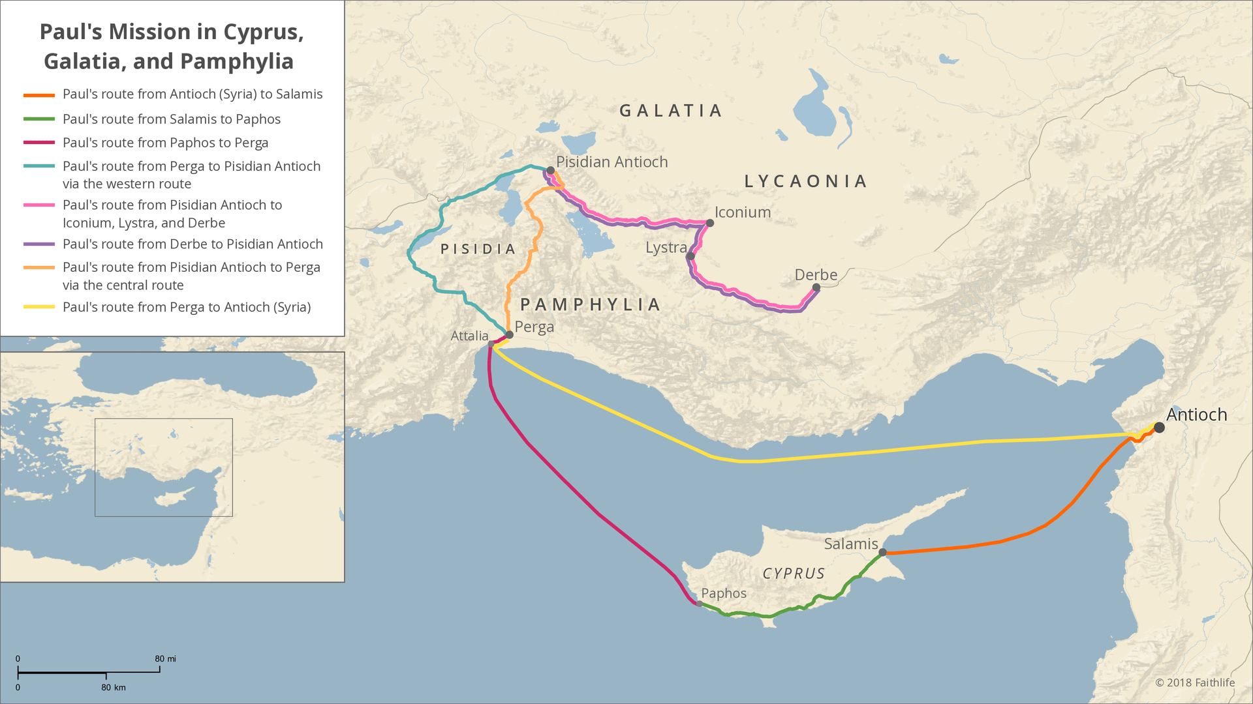
46-48 AD

Slide 7
1st Missionary Journey Acts 13:4-12
4So being sent out by the Holy Spirit, they went down to Seleucia, and from there they sailed to Cyprus. 5Arriving in Salamis, they proclaimed the word of God in the Jewish synagogues. They also had John as their assistant. 6When they had traveled the whole island as far as Paphos, they came across a sorcerer, a Jewish false prophet named Bar-Jesus. 7He was with the proconsul, Sergius Paulus, an intelligent man. This man summoned Barnabas and Saul and wanted to hear the word of God. 8But Elymas the sorcerer (that is the meaning of his name) opposed them and tried to turn the proconsul away from the faith.

Slide 8
1st Missionary Journey Acts 13:4-12
9But Saul—also called Paul—filled with the Holy Spirit, stared straight at Elymas 10and said, “You are full of all kinds of deceit and trickery, you son of the devil and enemy of all that is right.
Won’t you ever stop perverting the straight paths of the Lord? 11Now, look, the Lord’s hand is against you. You are going to be blind, and will not see the sun for a time.” Immediately a mist and darkness fell on him, and he went around seeking someone to lead him by the hand.
12Then, when he saw what happened, the proconsul believed, because he was astonished at the teaching of the Lord.

Slide 9
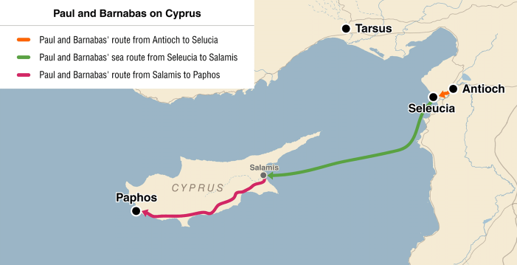
1st Missionary Journey Acts 13:4-12
Ministry to Cyprus
  Homeland of Barnabas, the capital city was Paphos.
  They were opposed in Paphos by Bar-Jesus (aka Elymas the sorcerer)
  Sergius Paulus was Paul’s first recorded individual conversion and the first totally Gentile convert with no religious background in Judaism.
  Luke switched from Saul to Paul (13:9) signaling the move into Gentile territory

Slide 10
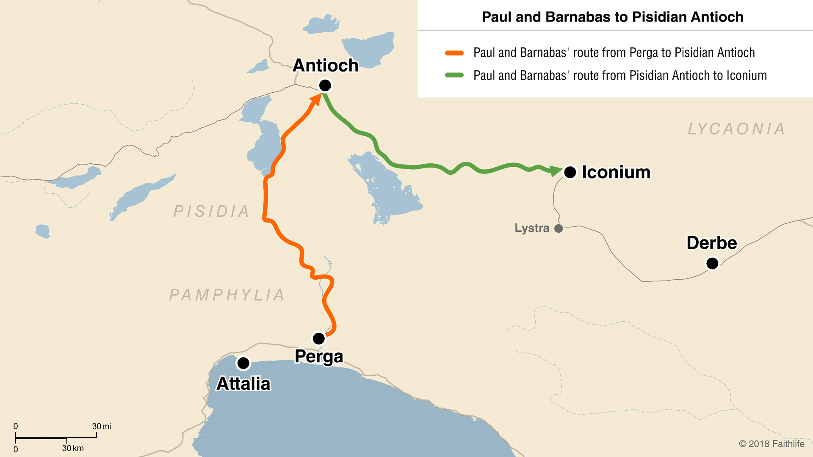
1st Missionary Journey Acts 13:13-52
Ministry to Pisidian Antioch
  John Mark left Paul & Barnabas at Perga and returned to Jerusalem (13:13).
  Paul preached the gospel boldly to Jews and Gentiles worshipping in the synagogue.
  The reaction was mixed, some of the Gentiles believed but the Jews rejected their message and stirred up persecution against them.
  They left town and shook dust from their feet (not responsible for their rejection).

Slide 11
1st Missionary Journey Acts 14:1-7
Ministry to Iconium
  Paul and Barnabas stayed a long time in Iconium and spoke boldly in the Jewish synagogues.
  Great numbers of Jews and Gentiles believed but some of the Jews stirred up trouble.
  The people of the city were divided, some sided with the Jews others with the missionaries.
  The Jews became jealous and plotted to stone Paul and Barnabas, so they fled the city to Lystra and Derbe.

Slide 12
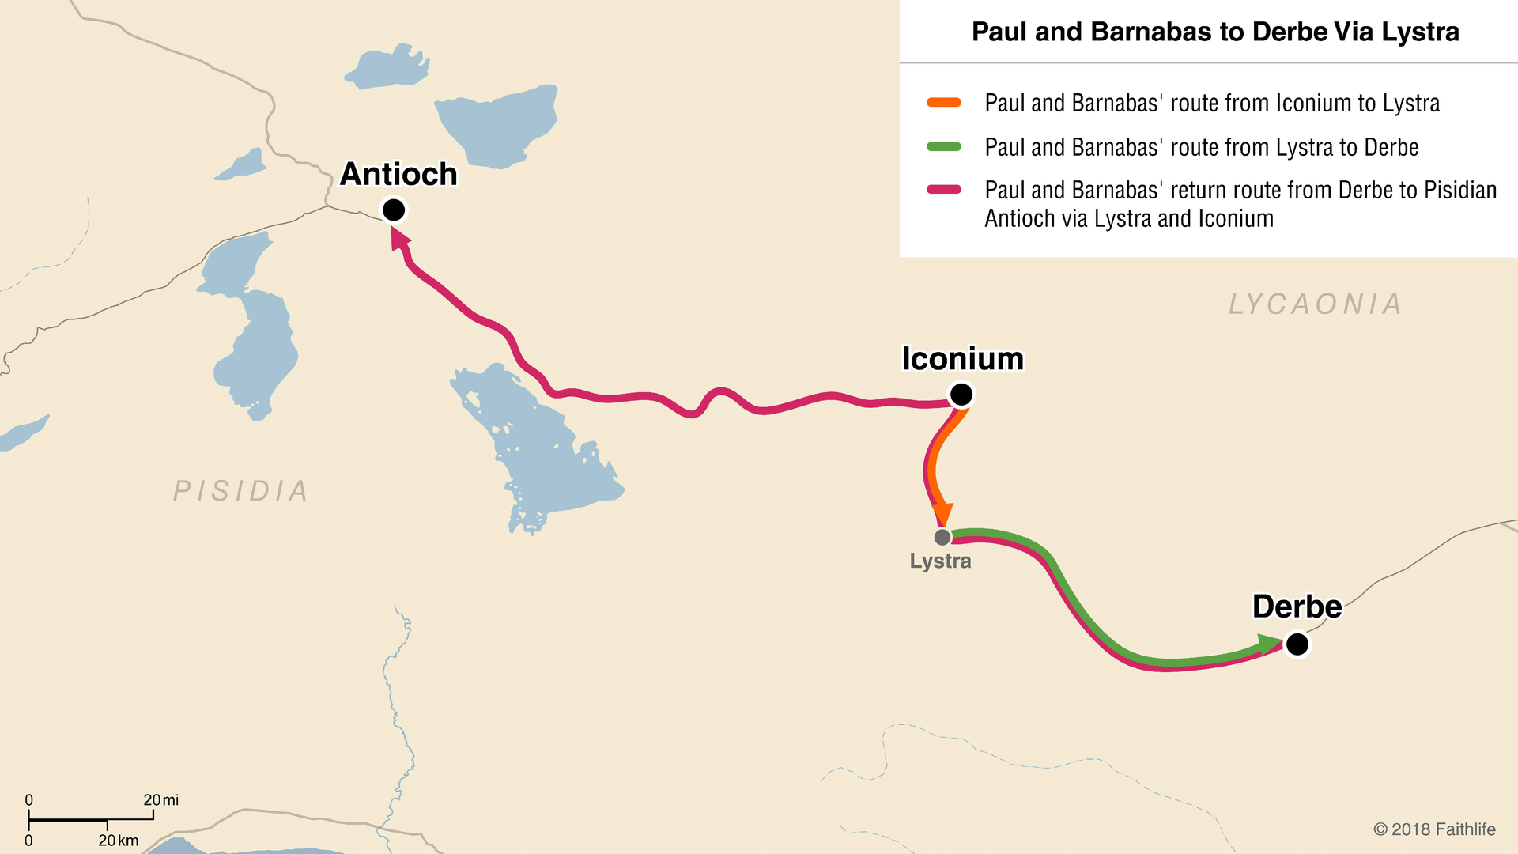
1st Missionary Journey Acts 14:8-28
Ministry to Lystra & Derbe
  Paul healed a crippled man in Lystra and the citizens started to worship them as gods – Barnabas, they called Zeus, and Paul, Hermes.
  Paul & Barnabas tore their robes, rejected the praise and worship and preached the Gospel to them.
  Jews came from Antioch and Iconium and stirred up the crowd and Paul was stoned and left for dead (14:19-20).
  The next day they moved on to Derbe, preaching the Gospel and making many disciples before returning to Antioch.

Slide 13
1st Missionary Journey Acts 14:21-23
21After they had preached the gospel in that town and made many disciples, they returned to Lystra, to Iconium, and to Antioch, 22strengthening the disciples by encouraging them to continue in the faith and by telling them, “It is necessary to go through many hardships to enter the kingdom of God.” 23When they had appointed elders for them in every church and prayed with fasting, they committed them to the Lord in whom they had believed.
Strengthening
the Disciples:
Encouraging them
Preparing them
Providing for them

Slide 14
Acts 14:24-28
24They passed through Pisidia and came to Pamphylia. 25After they had spoken the word in Perga, they went down to Attalia. 26From there they sailed back to Antioch where they had been commended to the grace of God for the work they had now completed. 27After they arrived and gathered the church together, they reported everything God had done with them and that he had opened the door of faith to the Gentiles. 28And they spent a considerable time with the disciples.

Slide 15
Paul’s Missionary Strategy
When Paul left the infant churches in Cyprus and Asia Minor and returned to Antioch, they didn’t have:
  Apostles
  Pastors or trained clergy
  Professional missionaries
  Missionary boards or agencies
  Seminaries or Bible colleges
  Denominations or associations
  New Testament Scriptures
What did they have?
POWER

Slide 16
Acts 1:8
“But you will receive
when the Holy Spirit has come on you, and you will be My witnesses in Jerusalem, in all Judea and Samaria,
and to the ends of the earth.”
POWER
What do you have?

Slide 17
INpowered Discipleship
An Inductive Study of the Book of Acts
Confident Discipleship
Acts 15:1-35

