Slide 1

INpowered Discipleship
An Inductive Study of the Book of Acts
Relentless Discipleship Acts 12:1-25

Slide 2
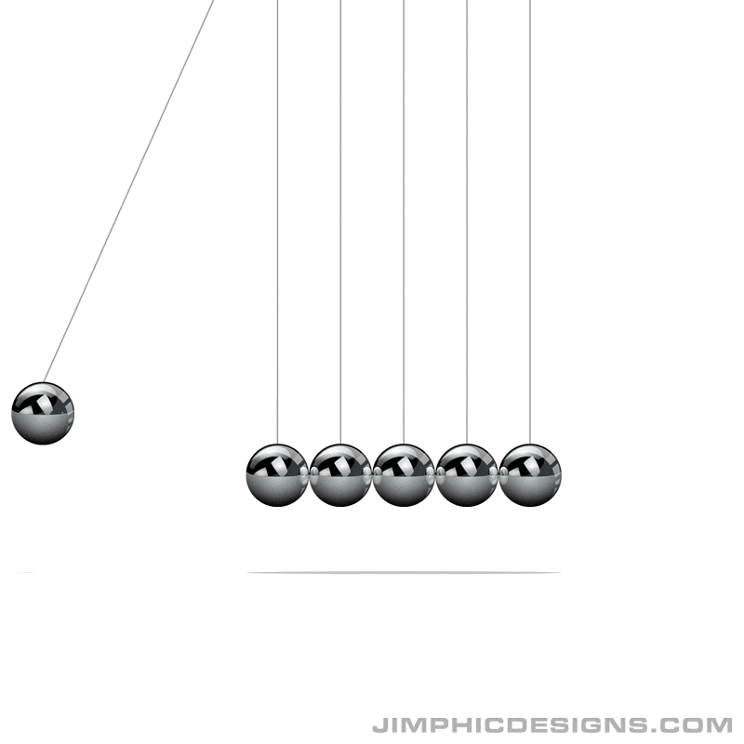
Newton’s 3rd Law of Motion For every action, there is an equal and opposite reaction

Slide 3
Opposing Forces
Force
Counterforce
The saving power of God
The destructive power of Herod

Slide 4
Acts 1:8
“But you will receive when the Holy Spirit has come on you, and you will be My witnesses in Jerusalem, in all Judea and Samaria, and to the ends of the earth.”
POWER

Slide 5
Herod’s Plot Acts 12:1-5
¹About that time King Herod violently attacked some who belonged to the church, ²and he executed James, John’s brother, with the sword. ³When he saw that it pleased the Jews, he proceeded to arrest Peter too, during the Festival of Unleavened Bread. ⁴After the arrest, he put him in prison and assigned four squads of four soldiers each to guard him, intending to bring him out to the people after the Passover. ⁵So Peter was kept in prison, but the church was praying fervently to God for him.
Herod Agrippa 1
Grandson of Herod the Great
Educated and raised in Rome
Appointed King by Caligula
Classmate of Emperor Claudius
King over Palestine (37-44 AD)
Anxious to preserve peace, he curried favor of the Jews but was despised by them because of his Roman upbringing and his Edomite ancestry (half-Jewish).
© Eric F. Glover 2021
© Eric F. Glover 2021

Slide 6
Herod’s Plot Acts 12:1-5
¹About that time King Herod violently attacked some who belonged to the church, ²and he executed James, John’s brother, with the sword. ³When he saw that it pleased the Jews, he proceeded to arrest Peter too, during the Festival of Unleavened Bread. ⁴After the arrest, he put him in prison and assigned four squads of four soldiers each to guard him, intending to bring him out to the people after the Passover. ⁵So Peter was kept in prison, but the church was praying fervently to God for him.
Counterforce
The church is rapidly expanding across Palestine and Asia Minor and is a threat to his leadership.
© Eric F. Glover 2021
6
© Eric F. Glover 2021

Slide 7
Herod’s Plot Acts 12:1-5
¹About that time King Herod violently attacked some who belonged to the church, ²and he executed James, John’s brother, with the sword. ³When he saw that it pleased the Jews, he proceeded to arrest Peter too, during the Festival of Unleavened Bread. ⁴After the arrest, he put him in prison and assigned four squads of four soldiers each to guard him, intending to bring him out to the people after the Passover. ⁵So Peter was kept in prison, but the church was praying fervently to God for him.
Herod wasn’t taking chances, he placed Peter in a maximum-security prison arrangement.
© Eric F. Glover 2021
7
© Eric F. Glover 2021

Slide 8
Herod’s Plot Acts 12:1-5
¹About that time King Herod violently attacked some who belonged to the church, ²and he executed James, John’s brother, with the sword. ³When he saw that it pleased the Jews, he proceeded to arrest Peter too, during the Festival of Unleavened Bread. ⁴After the arrest, he put him in prison and assigned four squads of four soldiers each to guard him, intending to bring him out to the people after the Passover. ⁵So Peter was kept in prison, but the church was praying fervently to God for him.
Jewish law prohibited trials and sentencing during holy feast days, so Herod intended to execute Peter after Passover.
Herod intended to bring Peter out for a public “show” trial, which would be followed by his execution.
© Eric F. Glover 2021
8
© Eric F. Glover 2021

Slide 9
Herod’s Plot Acts 12:1-5
¹About that time King Herod violently attacked some who belonged to the church, ²and he executed James, John’s brother, with the sword. ³When he saw that it pleased the Jews, he proceeded to arrest Peter too, during the Festival of Unleavened Bread. ⁴After the arrest, he put him in prison and assigned four squads of four soldiers each to guard him, intending to bring him out to the people after the Passover. ⁵So Peter was kept in prison, but the church was praying fervently to God for him.
The situation looked extremely bleak, even hopeless for Peter - no possibility of escape.
What could the church do, they were powerless against the armed might of Rome?
© Eric F. Glover 2021
9
© Eric F. Glover 2021

Slide 10
Herod’s Defeat Acts 12:6-19
6When Herod was about to bring him out for trial, that very night Peter, bound with two chains, was sleeping between two soldiers, while the sentries in front of the door guarded the prison. 7Suddenly an angel of the Lord appeared, and a light shone in the cell. Striking Peter on the side, he woke him up and said, “Quick, get up!” And the chains fell off his wrists. 8“Get dressed,” the angel told him, “and put on your sandals.” And he did. “Wrap your cloak around you,” he told him, “and follow me.” 9So he went out and followed, and he did not know that what the angel did was really happening, but he thought he was seeing a vision. 10After they passed the first and second guards, they came to the iron gate that leads into the city, which opened to them by itself. They went outside and passed one street, and suddenly the angel left him.
11When Peter came to himself, he said, “Now I know for certain that the Lord has sent his angel and rescued me from Herod’s grasp and from all that the Jewish people expected.” 12As soon as he realized this, he went to the house of Mary, the mother of John who was called Mark, where many had assembled and were praying. 13He knocked at the door of the outer gate, and a servant named Rhoda came to answer.

Slide 11
Herod’s Defeat Acts 12:6-19
14She recognized Peter’s voice, and because of her joy, she did not open the gate but ran in and announced that Peter was standing at the outer gate.
15“You’re out of your mind!” they told her. But she kept insisting that it was true, and they said, “It’s his angel.” 16Peter, however, kept on knocking, and when they opened the door and saw him, they were amazed.
17Motioning to them with his hand to be silent, he described to them how the Lord had brought him out of the prison. “Tell these things to James and the brothers,” he said, and he left and went to another place.
18At daylight, there was a great commotion among the soldiers as to what had become of Peter. 19After Herod had searched and did not find him, he interrogated the guards and ordered their execution. Then Herod went down from Judea to Caesarea and stayed there.

Slide 12
Herod’s Defeat Acts 12:6-19
Peter’s liberation seemed impossible, and his execution seemed extreme likely.
Herod and the church were aligned against one another, each side armed:
Herod had legal authority, the power of the sword and the security of the prison.
The church had prayer; the only power the powerless possess.
The church believed that God could grant release to the jailed apostle in answer to their prayers, and they prayed fervently.
Herod
Church

Slide 13
Herod’s Defeat Acts 12:6-19
Despite being in maximum-security lockdown, Peter showed no sign of anxiety, let alone alarm.
On the contrary, Peter fell asleep.
God answered the prayers of His people, and the angel of the Lord delivered Peter from prison.
Herod’s plan to quell the uprising of the church was defeated.
“Peter, bound with two chains, was sleeping between two soldiers”

Slide 14
Herod’s Death Acts 12:20-25
Sir Isaac Newton was wrong!
Force > Counterforce
²⁰Herod had been very angry with the people of Tyre and Sidon. Together they presented themselves before him. After winning over Blastus, who was in charge of the king’s bedroom, they asked for peace, because their country was supplied with food from the king’s country. ²¹On an appointed day, dressed in royal robes and seated on the throne, Herod delivered a speech to them. ²²The assembled people began to shout, “It’s the voice of a god and not of a man!” ²³At once an angel of the Lord struck him because he did not give the glory to God, and he was eaten by worms and died.
²⁴But the word of God spread and multiplied. ²⁵After they had completed their relief mission, Barnabas and Saul returned to Jerusalem, taking along John who was called Mark.
Can you admire the artistry with which Luke depicts the complete reversal of the church’s situation.
In the beginning Herod is on the rampage, arresting and persecuting church leaders.
At the end, Herod himself is struck down and dies.
© Eric F. Glover 2021
© Eric F. Glover 2021

Slide 15
Herod’s Death Acts 12:20-25
The chapter opens with James dead, Peter in prison and Herod triumphing.
The chapter closes with Herod dead, Peter free, and God triumphing.
The power of God to overthrow hostile human plans and establish His own in their place is on full display.

Slide 16

IN
IN powered Discipleship
Tyrants may be permitted for a time to boast and bluster, oppressing the church and hindering the spread of the gospel.
Tyrants will not last, in the end, their empires will be broken, and their pride humbled.
The pendulum may swing against us for a while, but in the end God’s will and His plans will prevail.

Slide 17

IN
IN powered Discipleship
When dark days come, remember these important Scriptures:
“Even though I walk through the valley of the shadow of death, I will fear no evil, for you are with me; your rod and your staff, they comfort me.” (Psalm 23:4)
“Trust in the LORD with all your heart and lean not on your own understanding; in all your ways acknowledge him, and he will make your paths straight.” (Prov 3:5-6)
“Now to him who is able to do immeasurably more than all we ask or imagine, according to his power that is at work within us,” (Eph 3:20)
“For nothing will be impossible with God.” (Luke 1:37)

Slide 18
IN
IN powered Discipleship
!
When times are tough, let us learn from the 1st century church in Jerusalem.
Pray Fervently and Trust the Lord!

Slide 19
INpowered Discipleship
An Inductive Study of the Book of Acts
Purposeful Discipleship Acts 13:1 - 14:25

