Slide 1

INpowered Discipleship
An Inductive Study of the Book of Acts
Empowered Discipleship
Acts 11:19-30

Slide 2
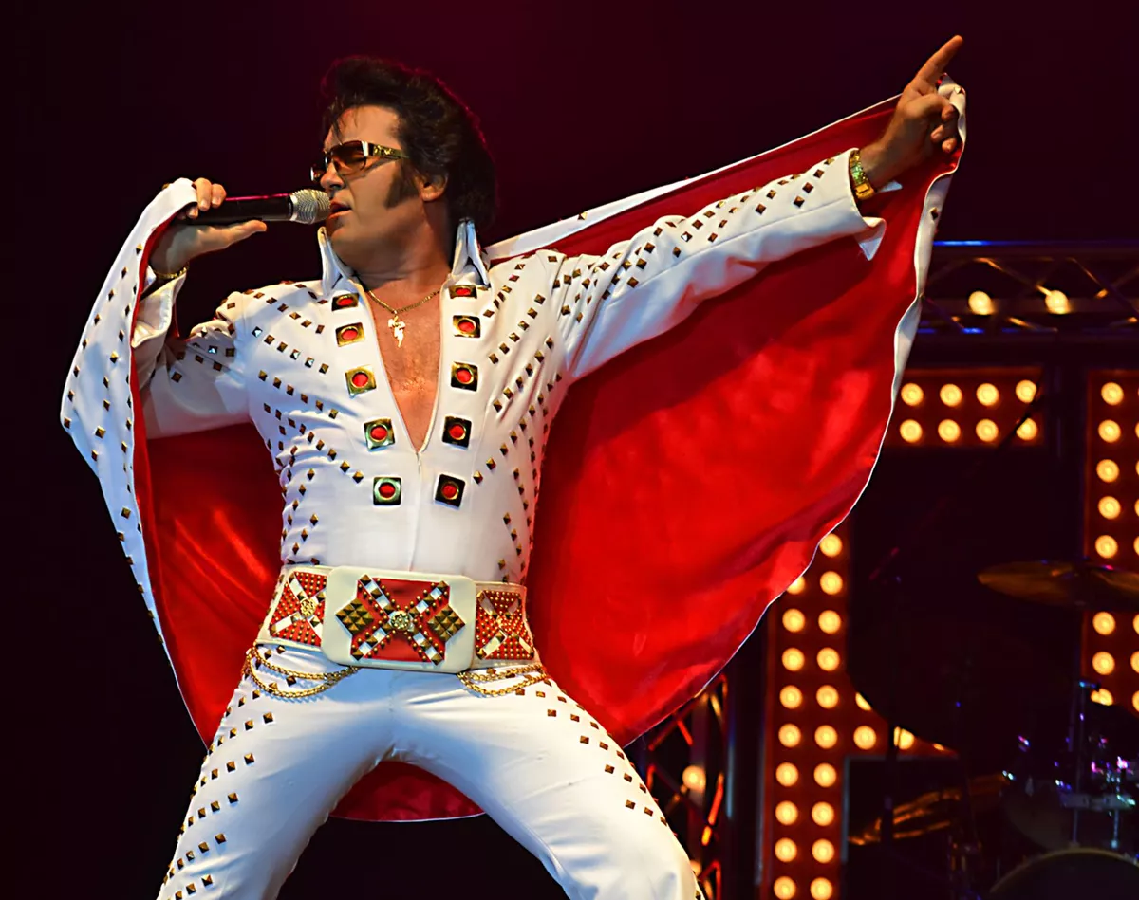

Impersonation or Imitation
What’s the difference?

Slide 3
Acts 1:8
“But you will receive
when the Holy Spirit has come on you, and you will be My witnesses in Jerusalem, in all Judea and Samaria,
and to the ends of the earth.”
POWER

Slide 4
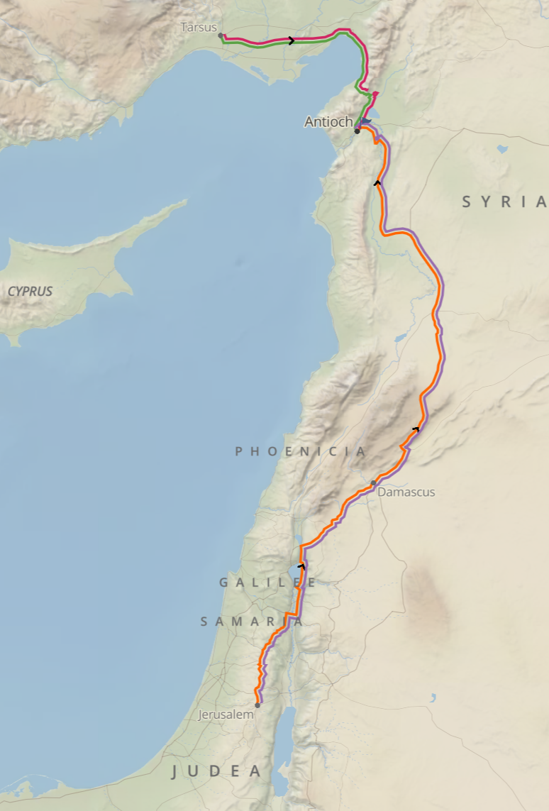
Empowered Discipleship
Acts 11:19-21
¹⁹Now those who had been scattered by the persecution in connection with Stephen traveled as far as Phoenicia, Cyprus and Antioch, telling the message only to Jews. ²⁰Some of them, however, men from Cyprus and Cyrene, went to Antioch and began to speak to Greeks also, telling them the good news about the Lord Jesus. ²¹The Lord's hand was with them, and a great number of people believed and turned to the Lord.
© Eric F. Glover 2021

Slide 5
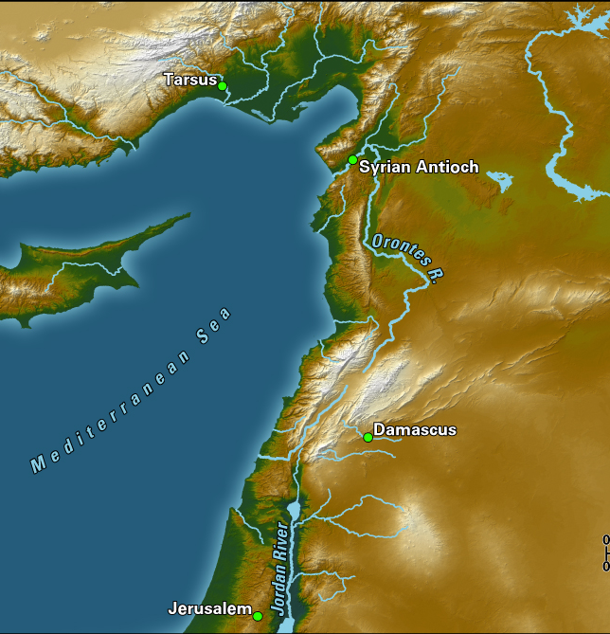
Antioch
Home to Nicolas, one of the seven deacons.
The third-largest city in the Roman Empire, after Rome and Alexandria.
About 20 miles inland from the Mediterranean Sea and 300 miles north of Jerusalem.
A busy seaport trade hub possessing a lively mix of people from different cultures and religions with high intellectual and political status.
Beautifully situated and carefully planned, it was a commercial center and the home of a large Jewish community.
It became the base of operations for Paul’s missionary journeys.

Slide 6
Empowered Laymen Acts 11:19-21
“All except the apostles were scattered throughout Judea and Samaria,” as a result of the persecution that broke out after Stephen’s martyrdom (8:1).
So, laymen from Cyrus and Cyrene founded the Antioch church!
  Nicolas was likely one of the founders:
    He was a native of Antioch, and
    He was one of the seven deacons appointed in Jerusalem.

Slide 7

Empowered Laymen Acts 11:19-21
The disciples began preaching the Gospel to the Greeks and
the Lord’s hand was with them.
  God supernaturally empowered their witness and large numbers of Jews and Greeks turned to Christ.
    When the Lord’s hand is on someone, the activity is supernaturally empowered
    and successful.
    When the Lord removes His hand or places His hand against someone, the results
    are always disastrous.
Nothing of lasting significance can be accomplished,
without the supernatural empowering of the Lord.

Slide 8
²²News of this reached the ears of the church at Jerusalem, and they sent Barnabas to Antioch. ²³When he arrived and saw the evidence of the grace of God, he was glad and encouraged them all to remain true to the Lord with all their hearts. ²⁴He was a good man, full of the Holy Spirit and faith, and a great number of people were brought to the Lord.
Acts 11:22-24
The Visible
Grace of God
in Antioch

Slide 9

The Visible Grace of God Acts 11:22-24
Barnabas saw evidence of God’s grace in Antioch
    We often talk about experiencing or feeling the grace
    of God, but have you ever seen the grace of God?
  How does one see or witness the grace of God?

Slide 10
The Visible Grace of God Acts 11:22-24
What evidence of God’s grace did Barnabas see?
Productive Discipleship
(11:24)
Serious Prayer and Fasting (13:1-3)
Spontaneous Generosity
(11:27-30)
Evangelistic Outreach
(11:20, 26)
Inclusive Fellowship
(11:20)
  Great numbers converted.
  Conversion is a key sign of God’s activity.
  When God’s people truly encounter Him, they develop an insatiable appetite for regular communication
  with Him.
  This church responded quickly, giving generously to meet the needs of their brethren in Judea during the great famine.
  Missionary minded laymen from Cyprus and Cyrene started the church.
  It became the home base of Paul during his missionary journeys.
  Jews and Gentiles regularly ate together in Antioch (Gal 2:11-12).

Slide 11

The Visible Grace of God Acts 11:22-24
When God truly indwells people,
His grace should be evident for all to see!
Is there evidence of God’s grace in our Church?
Is there evidence of God’s grace in our life?

Slide 12
Acts 11:25-26
²⁵Then Barnabas went to Tarsus to look for Saul, ²⁶and when he found him, he brought him to Antioch. So for a whole year Barnabas and Saul met with the church and taught great numbers of people. The disciples were called Christians first at Antioch.
Imitators
of Christ

Slide 13
Imitators of Christ Acts 11:25-36
Why were the disciples called Christians in Antioch?
  The word “Christian” was probably a term of derision given by the secular community to the disciples in Antioch. But why?
  Perhaps they were accusing the disciples of attempting to be “little Christs,” that is imitators of Christ.
Oh, how I pray that we may be described likewise by the secular world today!

Slide 14
²⁷During this time some prophets came down from Jerusalem to Antioch. ²⁸One of them, named Agabus, stood up and through the Spirit predicted that a severe famine would spread over the entire Roman world. (This happened during the reign of Claudius.) ²⁹The disciples, each according to his ability, decided to provide help for the brothers living in Judea. ³⁰This they did, sending their gift to the elders by Barnabas and Saul.
Acts 11:27-30
Sharing
God’s Grace

Slide 15
Sharing God’s Grace Acts 11:27-30
The believers in Antioch, having experienced the grace of God, shared freely and graciously with others in need.
They responded spontaneously and immediately to the need in Judea.

Slide 16

IN powered Discipleship
In our world today, as in Antioch of old, God uses willing lay people in widespread ministries.
You have been supernaturally INpowered, spiritually empower and uniquely gifted to make an impact in your world, just as the disciples did in Antioch.
When the world looks at us, do they see “little Christs” – people who strive to imitate Christ in everything they do.

Slide 17
INpowered Discipleship
An Inductive Study of the Book of Acts
Resilient Discipleship
Acts 12:1-25

