Slide 1


INpowered
Discipleship
An Inductive Study of Acts
Transformational Discipleship Acts 9:1-31

Slide 2
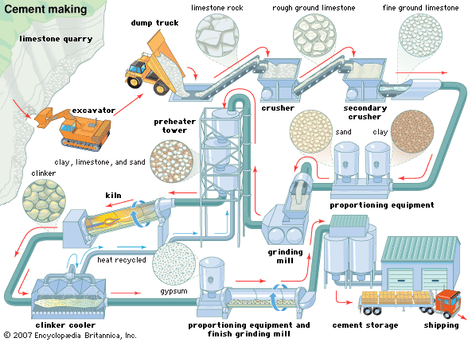
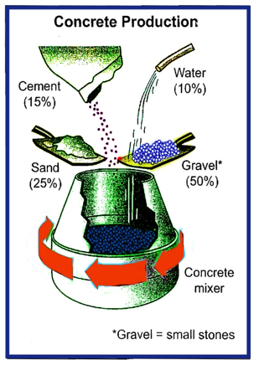
Making Concrete

Slide 3

Acts 1:8
power
“But you will receive when the Holy Spirit has come on you, and you will be My witnesses in Jerusalem, in all Judea and Samaria, and to the ends of the earth.”

Slide 4

The Raw Material Acts 9:1-2
¹ Meanwhile, Saul was still breathing out murderous threats against the Lord's disciples. He went to the high priest ² and asked him for letters to the synagogues in Damascus, so that if he found any there who belonged to the Way, whether men or women, he might take them as prisoners to Jerusalem.
Saul was a zealous opponent of the Way:
He approved of Stephen’s stoning (8:1)
He began to ravage the church (8:3)
He was breathing out murderous threats (9:1)
He was dedicated to slaughtering Christians, as if it was his life’s breath.
He was a self-appointed inquisitor, asking for and receiving extradition orders from the High Priest.
Saul was consumed by hatred and hostility; he was in no mood to consider the claims of Christ.
His heart was filled with hatred and his mind was poisoned by prejudice.
Saul, like stone, was hardened and not inclined to change!

Slide 5
The Preparation of Saul Acts 9:3-9
³ As he neared Damascus on his journey, suddenly a light from heaven flashed around him. ⁴ He fell to the ground and heard a voice say to him, "Saul, Saul, why do you persecute me?" ⁵ "Who are you, Lord?" Saul asked. "I am Jesus, whom you are persecuting," he replied. ⁶ "Now get up and go into the city, and you will be told what you must do." ⁷ The men traveling with Saul stood there speechless; they heard the sound but did not see anyone. ⁸ Saul got up from the ground, but when he opened his eyes he could see nothing. So they led him by the hand into Damascus. ⁹ For three days he was blind, and did not eat or drink anything.
Saul expected to enter Damascus in the fullness of his pride and prowess, as a self-confident zealot.
But Jesus had other plans for him, so He humbled him to get his attention.
Saul was led into Damascus as a captive of the very Christ he had opposed.
Jesus initiated the transformation of Saul.

Slide 6
The Transformation Process Acts 9:10-25
¹⁰ In Damascus there was a disciple named Ananias. The Lord called to him in a vision, "Ananias!" "Yes, Lord," he answered. ¹¹ The Lord told him, "Go to the house of Judas on Straight Street and ask for a man from Tarsus named Saul, for he is praying. ¹² In a vision he has seen a man named Ananias come and place his hands on him to restore his sight." ¹³ "Lord," Ananias answered, "I have heard many reports about this man and all the harm he has done to your saints in Jerusalem. ¹⁴ And he has come here with authority from the chief priests to arrest all who call on your name." ¹⁵ But the Lord said to Ananias, "Go! This man is my chosen instrument to carry my name before the Gentiles and their kings and before the people of Israel. ¹⁶ I will show him how much he must suffer for my name." ¹⁷ Then Ananias went to the house and entered it. Placing his hands on Saul, he said, "Brother Saul, the Lord-Jesus, who appeared to you on the road as you were coming here-has sent me so that you may see again and be filled with the Holy Spirit."
Note the transformation in Ananias’ thinking as well.

Slide 7
The Transformation Process Acts 9:10-25
¹⁸ Immediately, something like scales fell from Saul's eyes, and he could see again. He got up and was baptized, ¹⁹ and after taking some food, he regained his strength. Saul spent several days with the disciples in Damascus. ²⁰ At once he began to preach in the synagogues that Jesus is the Son of God. ²¹ All those who heard him were astonished and asked, "Isn't he the man who raised havoc in Jerusalem among those who call on this name? And hasn't he come here to take them as prisoners to the chief priests?" ²² Yet Saul grew more and more powerful and baffled the Jews living in Damascus by proving that Jesus is the Christ. ²³ After many days had gone by, the Jews conspired to kill him, ²⁴ but Saul learned of their plan. Day and night they kept close watch on the city gates in order to kill him. ²⁵ But his followers took him by night and lowered him in a basket through an opening in the wall.

Slide 8
The Transformation Process Acts 9:10-25
^{19…} Saul spent several days with the disciples in Damascus. ²⁰ At once he began to preach in the synagogues that Jesus is the Son of God.
The transformation of Saul’s attitudes and character was immediate and apparent:
Saul had a new reverence for God
Saul had a new relationship to the church, into which Ananias introduced him
Saul had a new mission, to be a servant and witness to the Gentiles
Saul was God’s chosen instrument to carry his name before the Gentiles and their kings and before the people of Israel.
²² Yet Saul grew more and more powerful and baffled the Jews living in Damascus by proving that Jesus is the Christ.
The transformation of Saul was complete, he was a new creation.

Slide 9
The Product of Transformation Acts 9:26-31
²⁶ When he came to Jerusalem, he tried to join the disciples, but they were all afraid of him, not believing that he really was a disciple. ²⁷ But Barnabas took him and brought him to the apostles. He told them how Saul on his journey had seen the Lord and that the Lord had spoken to him, and how in Damascus he had preached fearlessly in the name of Jesus. ²⁸ So Saul stayed with them and moved about freely in Jerusalem, speaking boldly in the name of the Lord. ²⁹ He talked and debated with the Grecian Jews, but they tried to kill him. ³⁰ When the brothers learned of this, they took him down to Caesarea and sent him off to Tarsus. ³¹ Then the church throughout Judea, Galilee and Samaria enjoyed a time of peace. It was strengthened; and encouraged by the Holy Spirit, it grew in numbers, living in the fear of the Lord.
The undeniable conversion of Saul is on full display in Jerusalem. He did a 180 and went from persecutor to proclaimer.

Slide 10
The Product of Transformation Acts 9:26-31
Saul fully embraced his new responsibility to the world.
The change in Saul following conversion was immediate and remarkable:
His life became Christ-centered
He witnessed in the power of the Holy Spirit
His witness was bold, courageous and fearless
His witness was costly and self-sacrificing

Slide 11
The Process of Assimilation Acts 9:17, 27
¹⁷ Then Ananias went to the house and entered it. Placing his hands on Saul, he said, "Brother Saul,
There is an urgent need for modern day Ananias and Barnabas who overcome their misgivings and hesitations and take the initiative to embrace newcomers.
The assimilation of new believers into the body is of paramount importance and we are each and all responsible for it.
Let us be intentional about it and follow in the footsteps of Ananias and Barnabas.
^{27…} Barnabas took him and brought him to the apostles
Who do you know that needs help assimilating into the body?

Slide 12
IN powered Discipleship
Most of you know someone like Saul
And some of you have been praying and asking God to save your Saul for many years.
Be encouraged by this biblical account, no one is beyond the reach of God’s sovereign grace.
God can take the hardest heart and make it soft, moldable, and malleable in His hands.
Keep praying, keep witnessing, keep loving, and never give up on them.
Who is your Saul? Who has God laid on your heart?
Limestone doesn’t become concrete without help!

Slide 13
INpowered
Discipleship
An Inductive Study of Acts
Inclusive Discipleship Acts 10:1-48

