Slide 1

INpowered Discipleship
An Inductive Study of the Book of Acts
Unified Discipleship Acts 16:1-40

Slide 2
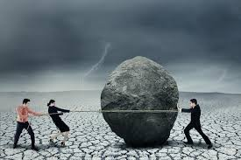
Unified
Team
Effort

Slide 3
Acts 1:8
“But you will receive when the Holy Spirit has come on you, and you will be My witnesses in Jerusalem, in all Judea and Samaria, and to the ends of the earth.”
POWER

Slide 4
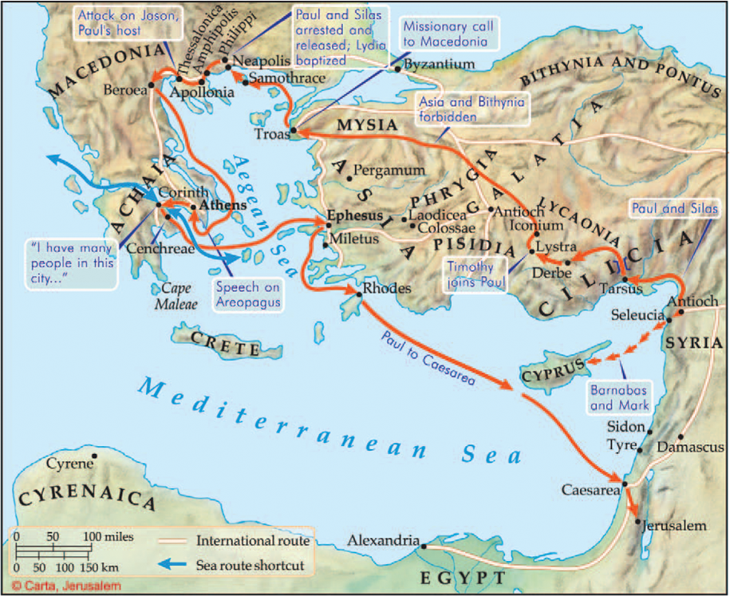
Macedonian Call
Forbidden
The 2nd
Missionary
Journey
50-52 AD
Timothy

Slide 5
The Macedonian Call Acts 16:6-10
The Evangelization of Europe
6 They went through the region of Phrygia and Galatia; they had been forbidden by the Holy Spirit to speak the word in Asia. 7 When they came to Mysia, they tried to go into Bithynia, but the Spirit of Jesus did not allow them. 8 Passing by Mysia they went down to Troas. 9 During the night Paul had a vision in which a Macedonian man was standing and pleading with him, “Cross over to Macedonia and help us!” 10 After he had seen the vision, we immediately made efforts to set out for Macedonia, concluding that God had called us to preach the gospel to them.
Luke joined Paul at Troas, note the change to “we” in v10.

Slide 6
The Macedonian Call Acts 16:6-10
When God closes one door, He often opens another.
6 They went through the region of Phrygia and Galatia; they had been forbidden by the Holy Spirit to speak the word in Asia. 7 When they came to Mysia, they tried to go into Bithynia, but the Spirit of Jesus did not allow them. 8 Passing by Mysia they went down to Troas. 9 During the night Paul had a vision in which a Macedonian man was standing and pleading with him, “Cross over to Macedonia and help us!” 10 After he had seen the vision, we immediately made efforts to set out for Macedonia, concluding that God had called us to preach the gospel to them.
What door is God opening/closing for you?

Slide 7
Welcome to Philippi
Philippi was a Roman colony and a leading city in the district of Macedonia.
Named after the father of Alexander the Great
Lydia, a dealer in purple cloth from Thyatira, was saved there after listening to Paul’s preaching.
Paul exorcised a demon from a fortune-telling slave girl, resulting in beatings and imprisonment.
Paul and Silas were locked away in the inner prison with their feet in stocks.
Philippi was an entirely new mission field, a city without a synagogue.
The 1st Christian Church in Europe

Slide 8
²⁵ About midnight Paul and Silas were praying and singing hymns to God, and the prisoners were listening to them. ²⁶ Suddenly there was such a violent earthquake that the foundations of the jail were shaken, and immediately all the doors were opened, and everyone’s chains came loose. ²⁷ When the jailer woke up and saw the doors of the prison standing open, he drew his sword and was going to kill himself, since he thought the prisoners had escaped.
²⁸ But Paul called out in a loud voice, “Don’t harm yourself, because we’re all here!”
Midnight Deliverance
Acts 16:25-34
What were Paul and Silas doing, in prison?
Who heard them praying and singing?
How does this compare with Peter’s imprisonment by Herod? (Acts 12)
© Eric F. Glover 2021
8
© Eric F. Glover 2021

Slide 9
Key Question
²⁹ The jailer called for lights, rushed in, and fell down trembling before Paul and Silas. ³⁰ He escorted them out and said, “Sirs, what must I do to be saved?”
³¹ They said, “Believe in the Lord Jesus, and you will be saved—you and your household.” ³² And they spoke the word of the Lord to him along with everyone in his house. ³³ He took them the same hour of the night and washed their wounds. Right away he and all his family were baptized. ³⁴ He brought them into his house, set a meal before them, and rejoiced because he had come to believe in God with his entire household.
How did Paul answer the Jailer’s question?
According to Paul, he need only believe in the Lord Jesus to be saved. He did not need to perform works.

Slide 10
⁸ For you are saved by grace through faith, and this is not from yourselves; it is God’s gift—⁹ not from works, so that no one can boast.
Justification by Faith
Ephesians 2:8-9
All that is needed for justification is faith in the Lord Jesus.
© Eric F. Glover 2021
10
© Eric F. Glover 2021

Slide 11
Unified Disciples
In Philippi three very different kinds of individuals are singled out:
A religious woman named Lydia
A demon-possessed slave girl
A Roman jailer
They represent three groups held in contempt by Jews: women, slaves and Gentiles.
By converting and/or delivering them, God crossed all gender, ethnic and social barriers.
What does this passage teach us about God?

Slide 12
³⁵ When daylight came, the chief magistrates sent the police to say, “Release those men.”
³⁶ The jailer reported these words to Paul: “The magistrates have sent orders for you to be released. So come out now and go in peace.”
³⁷ But Paul said to them, “They beat us in public without a trial, although we are Roman citizens, and threw us in jail. And now are they going to send us away secretly? Certainly not! On the contrary, let them come themselves and escort us out.”
Official Apology
Acts 16:35-40
Paul and Silas had certain rights as Roman citizens, including a public hearing and protection from scourging.
© Eric F. Glover 2021
12
© Eric F. Glover 2021

Slide 13
³⁸ The police reported these words to the magistrates. They were afraid when they heard that Paul and Silas were Roman citizens. ³⁹ So they came to appease them, and escorting them from prison, they urged them to leave town. ⁴⁰ After leaving the jail, they came to Lydia’s house, where they saw and encouraged the brothers and sisters, and departed.
Official Apology
Acts 16:35-40
Notice Luke switched back to they in v40 as Paul and Silas departed Philippi.
What does this imply about Luke?
© Eric F. Glover 2021
13
© Eric F. Glover 2021

Slide 14
IN
IN powered Discipleship
The church at Philippi began with a meager few but grew to become a model church – healthy, strong, generous and diverse.
When God sends us somewhere to minister, he has someone ready to listen – be ready to explain the gospel to anyone, anytime, anywhere.
And remember, as Paul wrote to the Philippians, “He who started a good work in you will carry it on to completion until the day of Christ Jesus.”
What door has God opened for you?

Slide 15
INpowered Discipleship
An Inductive Study of the Book of Acts
Devoted Disciples Acts 17-18

