Slide 1


INpowered
Discipleship
An Inductive Study of Acts
INpowered Disciples
Acts 1:1-26

Slide 2


Prologue
INpowered Discipleship
¹I wrote the first narrative, Theophilus, about all that Jesus began to do and teach ²until the day he was taken up, after he had given instructions through the Holy Spirit to the apostles he had chosen. ³After he had suffered, he also presented himself alive to them by many convincing proofs, appearing to them over a period of forty days and speaking about the kingdom of God. (Act 1:1-3)

Slide 3


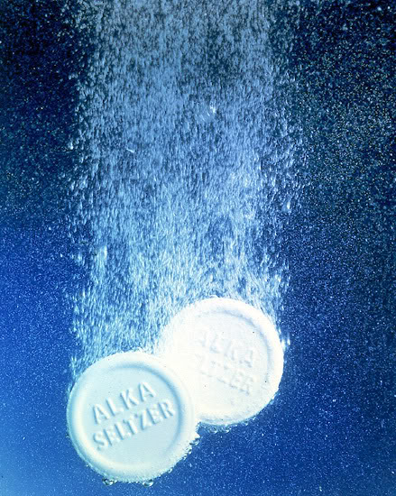
Plop Plop,
Fizz Fizz
INpowered Discipleship
Would Alka-Seltzer
work if you dropped
the packet into the water?

Slide 4
Powerful Promise
INpowered Discipleship
“I am going to send you what my Father has promised; but stay in the city until you have been clothed with power from on high." (Luke 24:48-49)
⁴While he was with them, he commanded them not to leave Jerusalem, but to wait for the Father’s promise. “Which,” he said, “you have heard me speak about; ⁵for John baptized with water, but you will be baptized with the Holy Spirit in a few days.” (Acts 1:4-5)

Slide 5
Misunderstood
INpowered Discipleship
⁶So when they had come together, they asked him, “Lord, are you restoring the kingdom to Israel
at this time?” (Act 1:6)
  The disciples are still confused about Jesus' ministry, expecting Him to overthrow Rome.
  They were concerned about those with political power over them.
  Jesus tells them about a much greater power, which they were about to receive.

Slide 6
INpowered Discipleship!
power
“But you will receive
when the Holy Spirit has come on you, and you
will be My witnesses in Jerusalem, in all Judea
and Samaria, and to the ends of the earth.”

Slide 7
Power
INpowered Discipleship
Dunamin: From the Greek root word dunamis, it means mighty ability, miraculous power.
It is the root word of our English words dynamite, dynamo, and dynamic.
  Why did they need such power?
  Why was it given?

Slide 8
INpowered Discipleship!
power
“But you will receive
when the Holy Spirit has come on you, and you
will be My witnesses in Jerusalem, in all Judea
and Samaria, and to the ends of the earth.”

Slide 9
Witnesses
INpowered Discipleship
Matures (mar-toos) in the Greek means to be a witness (literally, judicially or figuratively).
It calls to mind one who bears “witness” to
what he has seen or heard or knows.
  The Book of Acts records the spread of
  the gospel in Jerusalem and to Judea, Samaria, Europe, Africa and Asia.

Slide 10
Epilogue
INpowered Discipleship
⁹After he had said this, he was taken up as they were watching, and a cloud took him out of their sight. ¹⁰While he was going, they were gazing into heaven, and suddenly two men in white clothes stood by them. ¹¹They said, “Men of Galilee, why do you stand looking up into heaven? This same Jesus, who has been taken from you into heaven, will come in the same way that you have seen him going into heaven.” (Act 1:9-11)

Slide 11
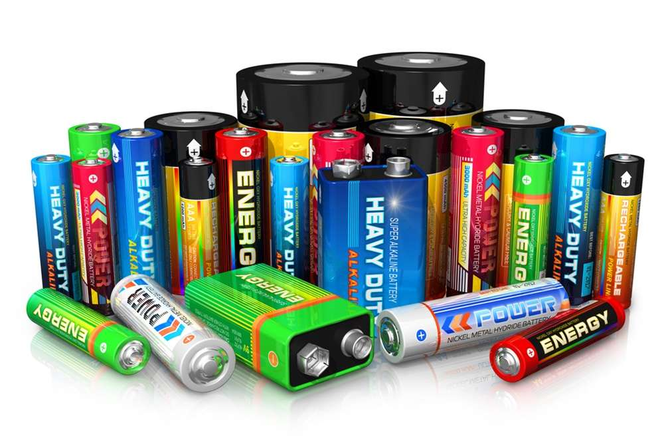
INpowered Discipleship
Internally Powered
Created for the same purpose – to transfer power
Designed for different applications, different tasks
External power source, internal storage
Dysfunctional without power
Worthless unless used
Dangerous if misused

Slide 12

INpowered Discipleship
INpowered
Come in different shapes & sizes – don’t look alike
Created for a purpose – to make disciples
Uniquely designed and equipped for the task
Internally powered – we can do nothing on our own
Some are fully charged, and some are dead
Some remain in the original wrapper, unused

Slide 13
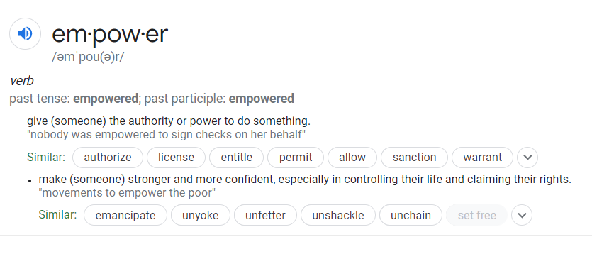
INpowered Discipleship
INpowered
Christians are not only empowered to “do something,” they are also inpowered
to “be something!”

Slide 14
INpowered Discipleship
Witnesses!
INpowered Discipleship!
Disciples Making Disciples

Slide 15
INpowered
Discipleship
Unlike most batteries, Christians are not disposable!
We have an infinite source of renewable power!
Fully charged (INpowered) Christians transformed the world!
The Book of Acts is chockfull of exciting examples!
I can’t wait to see what God does among us!
Make sure your batteries are fully charged!
The world awaits!

Slide 16

INpowered
Discipleship

