Slide 1

Doub less Living!
The Gospel of
LUKE
That you may have certainty!

Slide 2

You’re Invited to
The Dinner Party

Slide 3
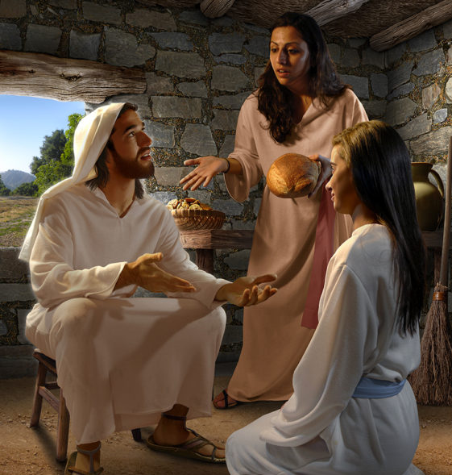
Proper Perspective
Mary & Martha
Luke 10:38-42

Slide 4
Proper Perspective
³⁸ While they were traveling, he entered a village, and a woman named Martha welcomed him into her home. ³⁹ She had a sister named Mary, who also sat at the Lord's feet and was listening to what he said. ⁴⁰ But Martha was distracted by her many tasks, and she came up and asked, "Lord, don't you care that my sister has left me to serve alone? So tell her to give me a hand."
⁴¹ The Lord answered her, "Martha, Martha, you are worried and upset about many things, ⁴² but one thing is necessary. Mary has made the right choice, and it will not be taken away from her."
Luke 10:38-42

Slide 5
Proper Perspective
³⁸ While they were traveling, he entered a village, and a woman named Martha welcomed him into her home. ³⁹ She had a sister named Mary, who also sat at the Lord's feet and was listening to what he said.
Luke 10:38-42
Luke doesn't identify the locale. What does that tell you?
That suggest that the event is more important that the place.

Slide 6
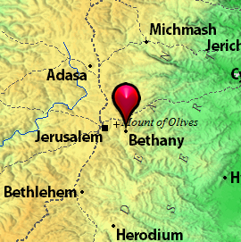
Proper Perspective
³⁸ While they were traveling, he entered a village, and a woman named Martha welcomed him into her home. ³⁹ She had a sister named Mary, who also sat at the Lord's feet and was listening to what he said.
Luke 10:38-42
Who are Martha & Mary, what do you know about them?
Sisters of Lazarus (John 11:2)
Close friends, loved by Jesus (John 11:3)
Mary anointed Jesus’ feet with expensive perfume in her home in Bethany. (John 12:3)
Mary was not the sinful woman who anointed Jesus’ feet at the Pharisees’ house in Galilee. (Luke 7)

Slide 7
Proper Perspective
³⁸ While they were traveling, he entered a village, and a woman named Martha welcomed him into her home. ³⁹ She had a sister named Mary, who also sat at the Lord's feet and was listening to what he said.
Luke 10:38-42
What did Mary do while Martha attended to household tasks and served others?
What does this tell you about Jesus’ ministry?
What was unusual about what Mary did?
The Samaritan’s response in the previous account was unusual too.

Slide 8
Proper Perspective
⁴⁰ But Martha was distracted by her many tasks, and she came up and asked, "Lord, don't you care that my sister has left me to serve alone? So tell her to give me a hand."
Luke 10:38-42
What had Martha so distracted?
How easy was it for Mary to concentrate on Jesus’ words while slaving away alone preparing the meal?

Slide 9
Proper Perspective
⁴⁰ But Martha was distracted by her many tasks, and she came up and asked, "Lord, don't you care that my sister has left me to serve alone? So tell her to give me a hand."
Luke 10:38-42
How would you describe Martha’s mood?
What was Martha so indignant about?

Slide 10
Proper Perspective
⁴⁰ But Martha was distracted by her many tasks, and she came up and asked, "Lord, don't you care that my sister has left me to serve alone? So tell her to give me a hand."
Luke 10:38-42
Do you see anything ironic about Martha’s perspective?
She is diligently working to serve Him, but she is too busy for Him.

Slide 11
Proper Perspective
⁴¹ The Lord answered her, "Martha, Martha, you are worried and upset about many things, ⁴² but one thing is necessary. Mary has made the right choice, and it will not be taken away from her."
Luke 10:38-42
Take note of Jesus’ tender response to Martha.
Some might say this has a pejorative tone from Jesus.
In Greek, a double vocative like this is a sign of emotion.

Slide 12
Proper Perspective
⁴¹ The Lord answered her, "Martha, Martha, you are worried and upset about many things, ⁴² but one thing is necessary. Mary has made the right choice, and it will not be taken away from her."
Luke 10:38-42
What word would you use to describe Martha at that moment?
In her focus on things, she is forgetting the most important person, and the circumstances are overwhelming her.

Slide 13
Proper Perspective
⁴¹ The Lord answered her, "Martha, Martha, you are worried and upset about many things, ⁴² but one thing is necessary. Mary has made the right choice, and it will not be taken away from her."
Luke 10:38-42
What does Jesus mean when He says, “One thing is necessary”?
A major feature of discipleship is choosing to order one’s affairs properly.

Slide 14
Proper Perspective
⁴¹ The Lord answered her, "Martha, Martha, you are worried and upset about many things, ⁴² but one thing is necessary. Mary has made the right choice, and it will not be taken away from her."
Luke 10:38-42
“Service of the hand cannot supersede service with the ear, since the ear guides the heart and the hand.”
Darrell Bock, BECNT

Slide 15
Proper Perspective
⁴¹ The Lord answered her, "Martha, Martha, you are worried and upset about many things, ⁴² but one thing is necessary. Mary has made the right choice, and it will not be taken away from her."
Luke 10:38-42
What does this final phrase in the passage mean?
The disciple who reflects on Jesus’ teaching receives a meal that is never removed.

Slide 16


Deliberate Discipleship
Serving the Lord and others is an essential part of a disciple’s life, but we cannot be so distracted by service that we ignore God.
“Serve the Lord with gladness” (Psalm 100:2) but be careful that your service for Christ doesn’t keep you from being with Him.
The worries of life should never prevent us from consuming God’s Word. A disciple should never be too busy to sit at Jesus’ feet.
Time spent with Him in prayer, worship, and Bible study equips us to love Him and serve Him more effectively.
Which of these areas needs more focus and attention in your life in the coming week?

