Slide 1

Doub less Living!
The Gospel of
LUKE
That you may have certainty!

Slide 2


Where “magic” happens
Comfort Zone
2

Slide 3
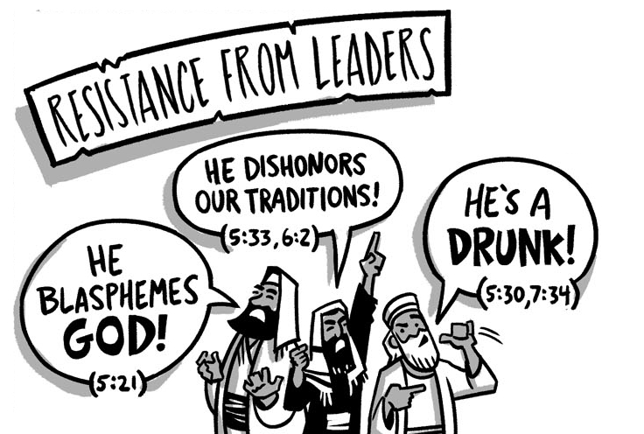

The Rise of Opposition
Four Controversies
Part Two
Luke 5:33–39

Slide 4
The Rise of Opposition 4 Controversies
❹
❸
Healing
Luke 6:6-11
❷
Plucking
Luke 6:1-5
❶
Fasting
Luke 5:33-39
Association
Luke 5:27-32
Sabbath
4

Slide 5
Controversy Over Fasting Luke 5:33-39 (CSB)
³³Then they said to him, "John's disciples fast often and say prayers, and those of the Pharisees do the same, but yours eat and drink."
³⁴Jesus said to them, "You can't make the wedding guests fast while the groom is with them, can you? ³⁵But the time will come when the groom will be taken away from them—then they will fast in those days.“
³⁶He also told them a parable: "No one tears a patch from a new garment and puts it on an old garment. Otherwise, not only will he tear the new, but also the piece from the new garment will not match the old. ³⁷And no one puts new wine into old wineskins. Otherwise, the new wine will burst the skins, it will spill, and the skins will be ruined. ³⁸No, new wine is put into fresh wineskins. ³⁹And no one, after drinking old wine, wants new, because he says, 'The old is better.'"

Slide 6
Why Don’t You Fast? Luke 5:33 (CSB)
³³Then they said to him, "John's disciples fast often and say prayers, and those of the Pharisees do the same, but yours eat and drink."
❶
What event preceded this passage?
❷
What has the Pharisees so upset?
❸
Why is fasting such a big deal to them?
6

Slide 7
Fasting in 1st Century Judaism
Fasting held a high place in Judaism’s psyche and devout Jews fasted and prayed regularly in anticipation of the Messiah’s coming.
Required for certain specific occasions (e.g. Yom Kippur)
The zealous fasted twice a week (usually Monday & Thursday)
In order to spend serious, focused time with God
A central act of great piety among Jews
Fasting was a serious issue in ancient spiritual life

Slide 8
All About Timing Luke 5:34-35 (CSB)
³⁴Jesus said to them, "You can't make the wedding guests fast while the groom is with them, can you? ³⁵But the time will come when the groom will be taken away from them—then they will fast in those days.“
❶
How did Jesus answer the question about fasting?
❷
What did Jesus say would cause his disciples to fast?
“There are a time and place for fasting, but the time of Jesus’ ministry is not such a period, because the very event that much fasting commemorates—the deliverance of God’s people—
is present in him.” (Darrell Bock, BECNT)
8

Slide 9
Cloth Metaphor Luke 5:36 (CSB)
³⁶He also told them a parable: "No one tears a patch from a new garment and puts it on an old garment. Otherwise, not only will he tear the new, but also the piece from the new garment will not match the old.
❶
What was the point of Jesus’ illustration about new and old garments?
The Point
What Jesus offers is decidedly distinct—
a new approach to God. The new cannot be mixed with the old.
❷
What happens when a patch meant for an old garment is taken from a new garment?
9

Slide 10
Wineskins Metaphor Luke 5:37-38 (CSB)
³⁷And no one puts new wine into old wineskins. Otherwise, the new wine will burst the skins, it will spill, and the skins will be ruined. ³⁸No, new wine is put into fresh wineskins.
❶
What happens to wineskins over time?
The Point
New wine must have new skins; new ways must have new containers.
❷
Why would the old wineskins burst with new wine?
❸
What was the point of Jesus’ wineskin illustration?
10

Slide 11
Concluding Proverb Luke 5:39 (CSB)
³⁹And no one, after drinking old wine, wants new, because he says, 'The old is better.'"
❶
What point is Jesus trying to make by quoting this common proverb of the day?
Some people will never leave their comfort zone,
they will never alter the way they look at Jesus.
They reject the new in favor of the old.
11

Slide 12


Deliberate Discipleship
Are there any areas in your life where you are prone
to practice false piety?
In what ways are we like brittle old wineskins unable
to take in all that Jesus has to offer us?
Where is Jesus challenging you to leave your comfort zone to fulfill our shared mission of making disciples?
What can you do this week to become more open
to change as God directs?
Doub less Living! © 2019
12

Slide 13
The Rise of Opposition
Four Controversies
Part Three
Luke 6:1-11
13

