Slide 1

Doub less Living!
The Gospel of
LUKE
That you may have certainty!

Slide 2
au ▪ thor ▪ i ▪ ty
The power to influence or command thought, opinion or behavior
Who is your favorite leader, and what qualities do they posses that makes you want to follow them?

Slide 3
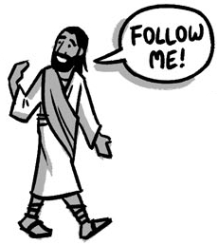
Gathering Disciples Jesus Demonstrates His Authority
Luke 5:1-11
Luke 5:12-16
Luke 5:17-26

Slide 4
Miraculous Catch Luke 5:1-11
1 As the crowd was pressing in on Jesus to hear God's word, he was standing by Lake Gennesaret. 2 He saw two boats at the edge of the lake; the fishermen had left them and were washing their nets. 3 He got into one of the boats, which belonged to Simon, and asked him to put out a little from the land. Then he sat down and was teaching the crowds from the boat. 4 When he had finished speaking, he said to Simon, "Put out into deep water and let down your nets for a catch.“ 5 "Master," Simon replied, "we've worked hard all night long and caught nothing. But if you say so, I'll let down the nets.“ 6 When they did this, they caught a great number of fish, and their nets began to tear. 7 So they signaled to their partners in the other boat to come and help them; they came and filled both boats so full that they began to sink. 8 When Simon Peter saw this, he fell at Jesus's knees and said, "Go away from me, because I'm a sinful man, Lord!" 9 For he and all those with him were amazed at the catch of fish they had taken, 10 and so were James and John, Zebedee's sons, who were Simon's partners. "Don't be afraid," Jesus told Simon. "From now on you will be catching people." 11 Then they brought the boats to land, left everything, and followed him.

Slide 5
Miraculous Catch Luke 5:1-11
❶ Why were the people crowding around Jesus?
❷ What does the great catch of fish tell you about Jesus?
❸ How would you explain Peter’s reaction?
❹ How does Jesus respond to Peter’s confession?
❺ How does this story related to the story in John 21?

Slide 6
Cleansing of the Leper Luke 5:12-16
12 While he was in one of the towns, a man was there who had leprosy all over him. He saw Jesus, fell facedown, and begged him: "Lord, if you are willing, you can make me clean.“ 13 Reaching out his hand, Jesus touched him, saying, "I am willing; be made clean," and immediately the leprosy left him. 14 Then he ordered him to tell no one: "But go and show yourself to the priest, and offer what Moses commanded for your cleansing as a testimony to them." 15 But the news about him spread even more, and large crowds would come together to hear him and to be healed of their sicknesses. 16 Yet he often withdrew to deserted places and prayed.

Slide 7
Cleansing of the Leper Luke 5:12-16
❶ What did the leprous man do when he saw Jesus?
❷ How did Jesus respond to the man’s request?
❸ When and why did Jesus touch the leper?
❹ What were Jesus’ orders to the man after healing him?
❺ How did Jesus respond to all of the attention?

Slide 8
Healing of the Paralytic Luke 5:17-26
17 On one of those days while he was teaching, Pharisees and teachers of the law were sitting there who had come from every village of Galilee and Judea, and also from Jerusalem. And the Lord's power to heal was in him. 18 Just then some men came, carrying on a stretcher a man who was paralyzed. They tried to bring him in and set him down before him. 19 Since they could not find a way to bring him in because of the crowd, they went up on the roof and lowered him on the stretcher through the roof tiles into the middle of the crowd before Jesus. 20 Seeing their faith he said, "Friend, your sins are forgiven.“ 21 Then the scribes and the Pharisees began to think to themselves: "Who is this man who speaks blasphemies? Who can forgive sins but God alone?“ 22 But perceiving their thoughts, Jesus replied to them, "Why are you thinking this in your hearts? 23 Which is easier: to say, 'Your sins are forgiven you,' or to say, 'Get up and walk’? 24 But so that you may know that the Son of Man has authority on earth to forgive sins“ – he told the paralyzed man, "I tell you: Get up, take your stretcher, and go home." 25 Immediately he got up before them, picked up what he had been lying on, and went home glorifying God. 26 Then everyone was astounded, and they were giving glory to God. And they were filled with awe and said, "We have seen incredible things today. "

Slide 9
Healing of the Paralytic Luke 5:17-26
❶ Who came to see Jesus, and why did they come?
❷ How would you describe the paralytic’s friends?
❸ What is different about Jesus’ initial response to this need?
❹ What was the official reaction to Jesus’ words?
❺ Why does Jesus then provide physical healing to the man?

Slide 10
Gathering Disciples Jesus Demonstrates His Authority
What “nets” do you need to leave behind today in following Christ?
What areas in your life can you identify where God is requiring obedience from you, despite your past failures?
What person in your life could most benefit from a caring touch from you this week in Christ’s name?
What times can you set aside this week to humble yourself before God and tell Him your needs?
Luke 5:1-26
What friend needs you to carry them to Jesus right now in bold faith, placing their needs ahead of your own?

Slide 11
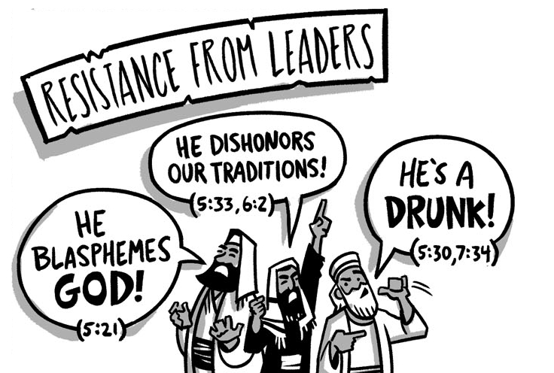
The Rise of Opposition
Four Controversies
Luke 5:29 – 6:11

