Slide 1

Doub less Living!
The Gospel of
LUKE
That you may have certainty!

Slide 2

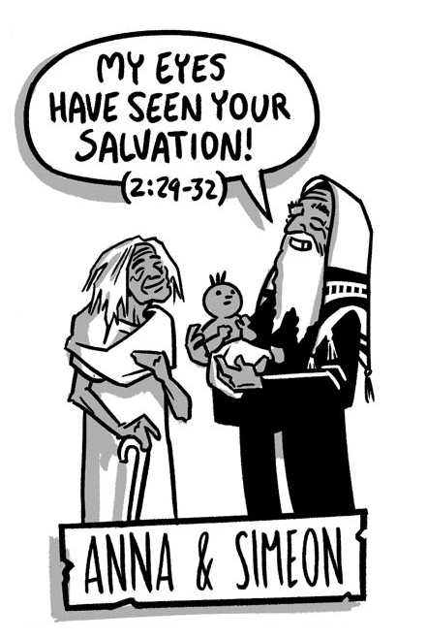
Jesus Presented, Provisioned, Protected, and Prepared Luke 2:21-24 Matthew 2:11-15 Luke 2:46-52

Slide 3

Advent: Hope, Love, Joy & Peace

Slide 4
²¹ When the eight days were completed for his circumcision, he was named Jesus—the name given by the angel before he was conceived. ²² And when the days of their purification according to the law of Moses were finished, they brought him up to Jerusalem to present him to the Lord ²³ (just as it is written in the law of the Lord, Every firstborn male will be dedicated to the Lord) ²⁴ and to offer a sacrifice (according to what is stated in the law of the Lord, a pair of turtledoves or two young pigeons).
Jesus Presented
to God
Luke 2:21-24
Notes:
Read: 2:21-38
Why did Mary & Joseph bring Jesus to the Temple?
What did the Law of the Lord require of them? [Lev. 12:1-8]
How do Mary and Joseph obey Jewish Law?
What does their offering reveal about their financial state?
How old was Jesus the first time they took Him to the Temple?

Slide 5
Presented to God Luke 2:21-24
❶ Why did Mary & Joseph bring Jesus to the Temple?
❷ What did the Law of the Lord require of them? (Lev. 12:1-8)
❸ What does their offering reveal about their financial state?
❹ How old was Jesus the first time they took Him to the Temple?

Slide 6
Jesus Provisioned by God
Matthew 2:11-12
¹¹ Entering the house, they saw the child with Mary his mother, and falling to their knees, they worshiped him. Then they opened their treasures and presented him with gifts: gold, frankincense, and myrrh. ¹² And being warned in a dream not to go back to Herod, they returned to their own country by another route.
Notes:
Read: 2:1-15
Who came looking for Jesus?
How did King Herod react to the visit of the Magi?
What were King Herod’s instructions to the Magi?
What did the Magi do when they found Jesus?
God’s provision followed Mary & Joseph’s obedient sacrifice.
What does that tell us about God’s blessing today?

Slide 7
Provisioned by God Matt 2:11-12
❶ Who came looking for Jesus?
❷ What did the Magi do when they found Jesus?
❸ God’s provision followed Mary & Joseph’s obedient sacrifice.
❹ What does that tell us about God’s blessing today?

Slide 8
Jesus Protected by God
Matthew 2:13-15
¹³ After they were gone, an angel of the Lord appeared to Joseph in a dream, saying, "Get up! Take the child and his mother, flee to Egypt, and stay there until I tell you. For Herod is about to search for the child to kill him." ¹⁴ So he got up, took the child and his mother during the night, and escaped to Egypt. ¹⁵ He stayed there until Herod's death, so that what was spoken by the Lord through the prophet might be fulfilled: Out of Egypt I called my Son.
Notes:
What happened after the Magi left the home of Mary, Joseph and Jesus?
Where did the angel tell Joseph to go, and why?
How did Joseph respond to the warning he received?
How long were they to stay in Egypt?
Why was the “escape to Egypt” significant in the life of Christ? (2:15)
What was God protecting them from?

Slide 9
Protected by God Matt 2:13-15
❶ What happened after the Magi left the home?
❷ Where did the angel tell Joseph to go, and why?
❸ What was God protecting them from?
❹ How did Joseph respond to the warning he received?
❺ Why was the “escape to Egypt” significant in the life of Christ?

Slide 10
⁴⁶ After three days, they found him in the temple sitting among the teachers, listening to them and asking them questions. ⁴⁷ And all those who heard him were astounded at his understanding and his answers. ⁴⁸ When his parents saw him, they were astonished, and his mother said to him, "Son, why have you treated us like this? Your father and I have been anxiously searching for you." ⁴⁹ "Why were you searching for me?" he asked them. "Didn't you know that it was necessary for me to be in my Father's house?" ⁵⁰ But they did not understand what he said to them. ⁵¹ Then he went down with them and came to Nazareth and was obedient to them. His mother kept all these things in her heart. ⁵² And Jesus increased in wisdom and stature, and in favor with God and with people.
Jesus Prepared by God
Luke 2:46-52
Notes:
Read: 2:39-38
Why did Jesus’ parents go to Jerusalem every year?
How did Jesus get left behind in Jerusalem?
What was Jesus doing during the three days that He was on His own?
What affect did Jesus’ questions and answers have on the teachers in Jerusalem?
How did Mary respond when she and Joseph finally found Jesus?
After replying to Mary what did Jesus do?
What happened to Jesus when they returned to Nazareth?

Slide 11
Prepared by God Luke 2:46-52
❶ Why did Jesus’ parents go to Jerusalem every year?
❷ What was Jesus doing while He was on His own?
❸ What affect did Jesus’ questions & answers have on the teachers?
❹ After replying to Mary what did Jesus do?
❺ What happened to Jesus when they returned to Nazareth?

Slide 12
Synoptic Timeline
Parturition (Birth)
Circumcision
Purification
Presentation
Simeon & Anna
Provision
Protection
Preparation
Proclamation
Angelic Warning
Wise Men
Flight to Egypt
Massacre
Herod’s Death
Return to Galilee
Public Prep
Private Prep

Slide 13
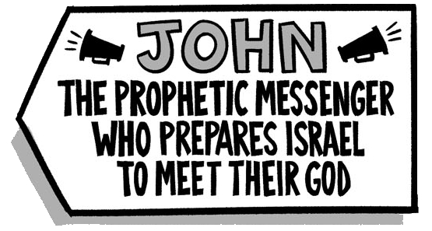
The Ministry of John the Baptist Luke 3:1-38

