Slide 1

Doub less Living!
The Gospel of
LUKE
That you may have certainty!

Slide 2
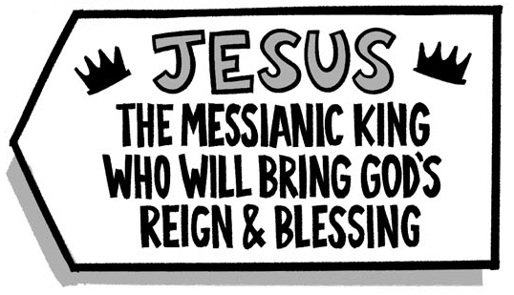
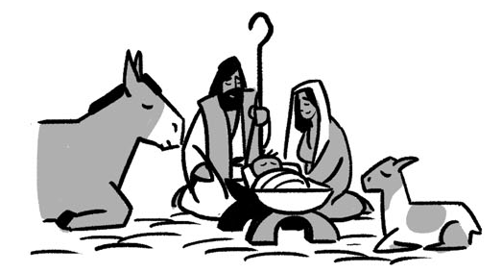
The Birth of Jesus Matthew 1:18-25 Luke 2:1-7 Luke 2:1-8-20

Slide 3
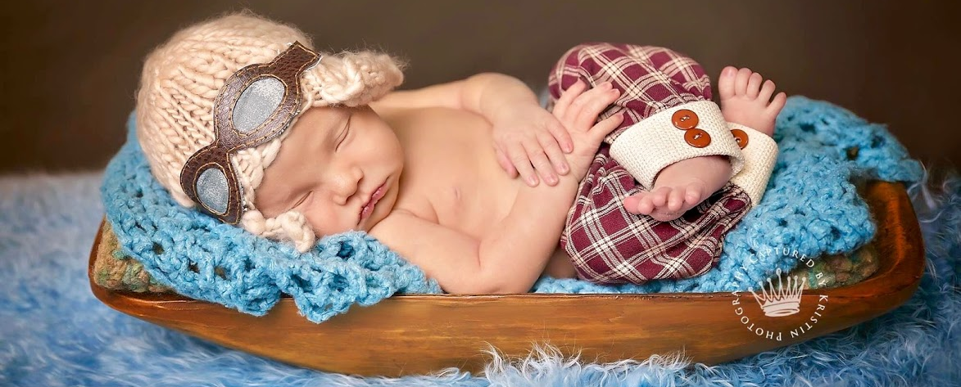
What is the most unique birth announcement you’ve ever seen?

Slide 4
Joseph’s Dream Matthew 1:18-25
¹⁸ The birth of Jesus Christ came about this way: After his mother Mary had been engaged to Joseph, it was discovered before they came together that she was pregnant from the Holy Spirit. ¹⁹ So her husband Joseph, being a righteous man, and not wanting to disgrace her publicly, decided to divorce her secretly.
²⁰ But after he had considered these things, an angel of the Lord appeared to him in a dream, saying, "Joseph, son of David, don't be afraid to take Mary as your wife, because what has been conceived in her is from the Holy Spirit. ²¹ She will give birth to a son, and you are to name him Jesus, because he will save his people from their sins." ²² Now all this took place to fulfill what was spoken by the Lord through the prophet:
²³ See, the virgin will become pregnant and give birth to a son, and they will name him Immanuel, which is translated "God is with us."
²⁴ When Joseph woke up, he did as the Lord's angel had commanded him. He married her ²⁵ but did not have sexual relations with her until she gave birth to a son. And he named him Jesus.
4

Slide 5
Matthew 1:18-25
¹⁸ The birth of Jesus Christ came about this way: After his mother Mary had been engaged to Joseph, it was discovered before they came together that she was pregnant from the Holy Spirit. ¹⁹ So her husband Joseph, being a righteous man, and not wanting to disgrace her publicly, decided to divorce her secretly.
²⁰ But after he had considered these things, an angel of the Lord appeared to him in a dream, saying, "Joseph, son of David, don't be afraid to take Mary as your wife, because what has been conceived in her is from the Holy Spirit. ²¹ She will give birth to a son, and you are to name him Jesus, because he will save his people from their sins." ²² Now all this took place to fulfill what was spoken by the Lord through the prophet:
²³ See, the virgin will become pregnant and give birth to a son, and they will name him Immanuel, which is translated "God is with us.“
²⁴ When Joseph woke up, he did as the Lord's angel had commanded him. He married her ²⁵ but did not have sexual relations with her until she gave birth to a son. And he named him Jesus.
We’ve talked a lot about Mary the past few weeks, what does this passage reveal about Joseph’s personal character, his respect for Mary, and his allegiance to God?
What two names are given to Mary’s child and what do they mean?

Slide 6
The Birth of Jesus Luke 2:1-7
¹ In those days a decree went out from Caesar Augustus that the whole empire should be registered. ² This first registration took place while Quirinius was governing Syria. ³ So everyone went to be registered, each to his own town. ⁴ Joseph also went up from the town of Nazareth in Galilee, to Judea, to the city of David, which is called Bethlehem, because he was of the house and family line of David, ⁵ to be registered along with Mary, who was engaged to him and was pregnant. ⁶ While they were there, the time came for her to give birth. ⁷ Then she gave birth to her firstborn Son, and she wrapped him tightly in cloth and laid him in a manger, because there was no guest room available for them.

Slide 7
¹ In those days a decree went out from Caesar Augustus that the whole empire should be registered. ² This first registration took place while Quirinius was governing Syria. ³ So everyone went to be registered, each to his own town. ⁴ Joseph also went up from the town of Nazareth in Galilee, to Judea, to the city of David, which is called Bethlehem, because he was of the house and family line of David, ⁵ to be registered along with Mary, who was engaged to him and was pregnant. ⁶ While they were there, the time came for her to give birth. ⁷ Then she gave birth to her firstborn Son, and she wrapped him tightly in cloth and laid him in a manger, because there was no guest room available for them.
What was the purpose of Joseph and Mary’s trip to Bethlehem?
What was Joseph and Mary’s marital status at the time of Jesus’ birth?
When did this trip occur?
What year, month and day was Jesus born?
Why do we celebrate Christmas on December 25th?
What was Bethlehem like the night Jesus was born?
Luke 2:1-7
7

Slide 8
Good News of Great Joy
Luke 2:8-12
⁸ In the same region, shepherds were staying out in the fields and keeping watch at night over their flock. ⁹ Then an angel of the Lord stood before them, and the glory of the Lord shone around them, and they were terrified. ¹⁰ But the angel said to them, "Don't be afraid, for look, I proclaim to you good news of great joy that will be for all the people: ¹¹ Today in the city of David a Savior was born for you, who is the Messiah, the Lord. ¹² This will be the sign for you: You will find a baby wrapped tightly in cloth and lying in a manger."

Slide 9
Who were the first people to hear the Good News about Jesus’ birth?
⁸ In the same region, shepherds were staying out in the fields and keeping watch at night over their flock. ⁹ Then an angel of the Lord stood before them, and the glory of the Lord shone around them, and they were terrified. ¹⁰ But the angel said to them, "Don't be afraid, for look, I proclaim to you good news of great joy that will be for all the people: ¹¹ Today in the city of David a Savior was born for you, who is the Messiah, the Lord. ¹² This will be the sign for you: You will find a baby wrapped tightly in cloth and lying in a manger."
Who delivered the Good News and how did the Shepherds respond?
Why is this announcement significant?
1. The Messiah has been born
2. The birth occurred in the city of David
3. Jesus is the Savior, Christ and Lord
Luke 2:8-12

Slide 10
Heavenly Response
Luke 2:13-18
¹³ Suddenly there was a multitude of the heavenly host with the angel, praising God and saying: ¹⁴ Glory to God in the highest heaven, and peace on earth to people he favors! ¹⁵ When the angels had left them and returned to heaven, the shepherds said to one another, "Let's go straight to Bethlehem and see what has happened, which the Lord has made known to us.“ ¹⁶ They hurried off and found both Mary and Joseph, and the baby who was lying in the manger. ¹⁷ After seeing them, they reported the message they were told about this child, ¹⁸ and all who heard it were amazed at what the shepherds said to them.

Slide 11
¹³ Suddenly there was a multitude of the heavenly host with the angel, praising God and saying: ¹⁴ Glory to God in the highest heaven, and peace on earth to people he favors! ¹⁵ When the angels had left them and returned to heaven, the shepherds said to one another, "Let's go straight to Bethlehem and see what has happened, which the Lord has made known to us.“ ¹⁶ They hurried off and found both Mary and Joseph, and the baby who was lying in the manger. ¹⁷ After seeing them, they reported the message they were told about this child, ¹⁸ and all who heard it were amazed at what the shepherds said to them.
The Shepherds gained a rare glimpse at heavenly praise as heaven addresses earth about Jesus’ significance.
The sound of that praise was infinitely grander and more glorious than Handel’s Messiah.
How did the Shepherds respond to this heavenly announcement?
What was the ultimate outcome of the Shepherds experience?
Luke 2:13-18

Slide 12
Earthly Response
Luke 2:19-20
¹⁹ But Mary was treasuring up all these things in her heart and meditating on them. ²⁰ The shepherds returned, glorifying and praising God for all the things they had seen and heard, which were just as they had been told.

Slide 13
1.
How can you glorify and praise God with other Christians this week?
In what ways can you honor Jesus with your Thanksgiving celebrations?
How can you make sure there is always room at "your Inn” for Jesus?
Who in your life needs to hear the Good News about Jesus birth, life, death and resurrection?
2.
4.
3.
The Birth of JESUS
Luke 2:1-20

Slide 14
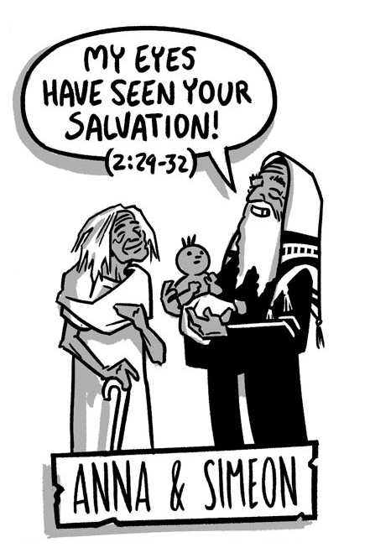
Jesus Presented Luke 2:21-40

