Slide 1

Doub less Living!
The Gospel of
LUKE
That you may have certainty!

Slide 2
Significant Historical Events in…
Six Flags opened in Texas
Breakfast at Tiffany’s released
Mr. Ed first aired
Peace Corps established
Berlin Wall began
Pampers introduced
First human in space
Cuban Missile Crisis
Bay of Pigs
Can you Guess the Year?
What significant events happened the year you were born?

Slide 3
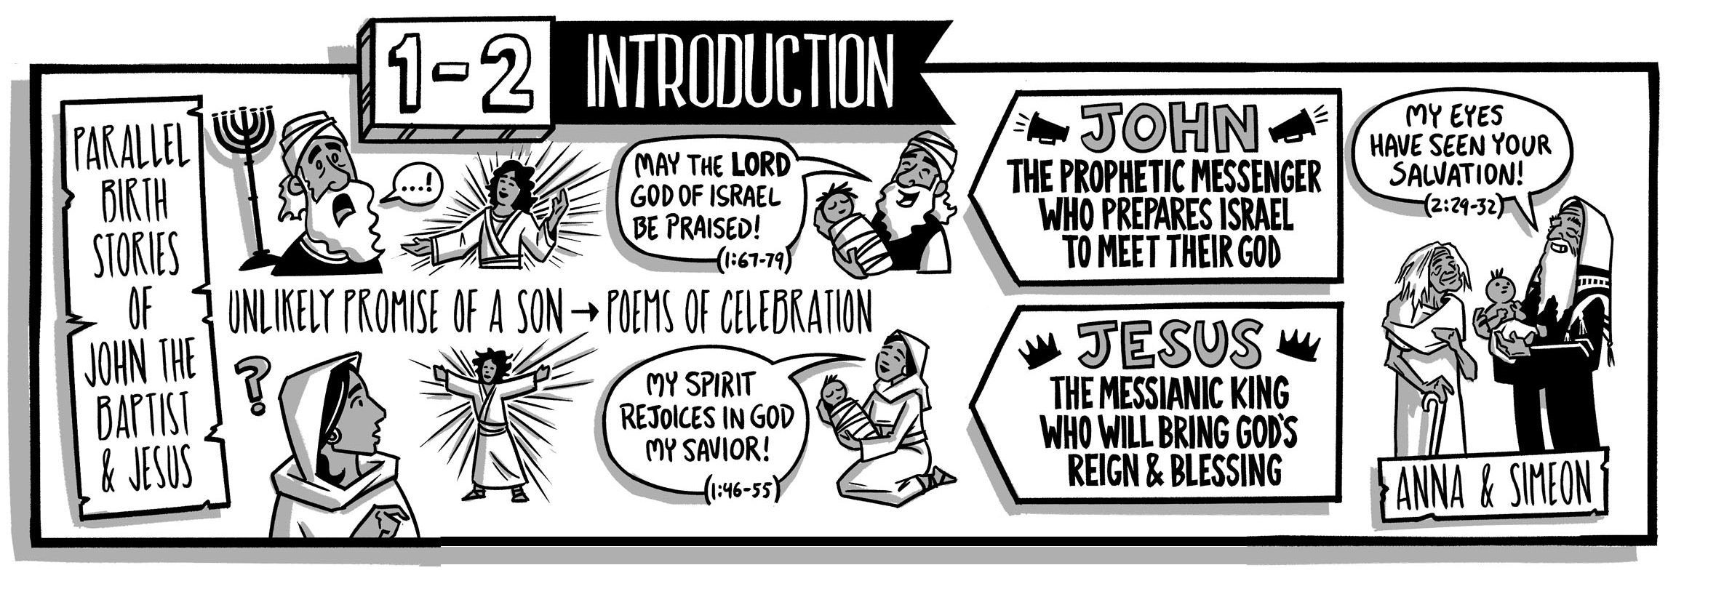

Birth Announcement Luke 1:5-25

Slide 4
Childless Servants Luke 1:5-7
⁵ In the days of King Herod of Judea, there was a priest of Abijah's division named Zechariah. His wife was from the daughters of Aaron, and her name was Elizabeth. ⁶ Both were righteous in God's sight, living without blame according to all the commands and requirements of the Lord. ⁷ But they had no children because Elizabeth could not conceive, and both of them were well along in years.
Who was King Herod and what do you know about him?
What characteristics do Zechariah and Elizabeth have in common?
How did Zechariah and Elizabeth handle the frustration of being childlessness?

Slide 5
Faithful Servants Luke 1:8-10
⁸ When his division was on duty and he was serving as priest before God, ⁹ it happened that he was chosen by lot, according to the custom of the priesthood, to enter the sanctuary of the Lord and burn incense. ¹⁰ At the hour of incense the whole assembly of the people was praying outside.
For what duty was Zechariah chosen by lot?
What were the people doing while Zechariah burned incense?
What does this indicate about the significance of corporate worship in the life of the people?

Slide 6
Unexpected Encounter Luke 1:11-13
¹¹ An angel of the Lord appeared to him, standing to the right of the altar of incense. ¹² When Zechariah saw him, he was terrified and overcome with fear. ¹³ But the angel said to him: "Do not be afraid, Zechariah, because your prayer has been heard. Your wife Elizabeth will bear you a son, and you will name him John.
What experience gripped Zechariah with fear?
What does Zechariah’s reaction to the angel’s appearance tell you about him?
What does the angel’s first sentence reveal about Zechariah’s prayer life?

Slide 7
Exciting Promises Luke 1:14-17
¹⁴ There will be joy and delight for you, and many will rejoice at his birth. ¹⁵ For he will be great in the sight of the Lord and will never drink wine or beer. He will be filled with the Holy Spirit while still in his mother's womb. ¹⁶ He will turn many of the children of Israel to the Lord their God. ¹⁷ And he will go before him in the spirit and power of Elijah, to turn the hearts of fathers to their children, and the disobedient to the understanding of the righteous, to make ready for the Lord a prepared people."
What six aspects of John’s character were foretold by the angel?
1. A joy and delight to parents
2. Great in the sight of the Lord
3. Never drink wine or beer
4. Filled with the Holy Spirit
5. Lead many people to the Lord
6. Go before the Lord

Slide 8
Uncertain Response Luke 1:18-20
¹⁸ "How can I know this?" Zechariah asked the angel. "For I am an old man, and my wife is well along in years.“ ¹⁹ The angel answered him, "I am Gabriel, who stands in the presence of God, and I was sent to speak to you and tell you this good news. ²⁰ Now listen. You will become silent and unable to speak until the day these things take place, because you did not believe my words, which will be fulfilled in their proper time."
For what is Zechariah asking in verse 18?
How did Gabriel respond to Zechariah’s question?
Why was Zechariah rendered unable to speak until the day of the prophecy’s fulfillment?
Do you see anything ironic about Gabriel’s actions?

Slide 9
Promise Fulfilled Luke 1:21-25
²¹ Meanwhile, the people were waiting for Zechariah, amazed that he stayed so long in the sanctuary. ²² When he did come out, he could not speak to them. Then they realized that he had seen a vision in the sanctuary. He was making signs to them and remained speechless. ²³ When the days of his ministry were completed, he went back home. ²⁴ After these days his wife Elizabeth conceived and kept herself in seclusion for five months. She said, ²⁵ "The Lord has done this for me. He has looked with favor in these days to take away my disgrace among the people."
How did Elizabeth react to the fulfillment of God’s promise?

Slide 10
Zechariah & Elizabeth
Childless servants, frustratingly unable to conceive
Faithful servants righteous and blameless
Unexpected encounter with Gabriel
Exciting promises from God
Uncertain response from Zechariah
Praise from Elizabeth
Promise fulfilled by God

Slide 11
Lessons Learned From… Zechariah & Elizabeth
God is in control and hears our prayers
He can do more than we can ask or imagine
We can entrust our long-term frustrations to Him
Never give up hope that He will answer prayer
Continue to serve faithfully until He does
Trust him with the ultimate outcome

Slide 12
Birth Announcement Luke 1:26-56

