Slide 1
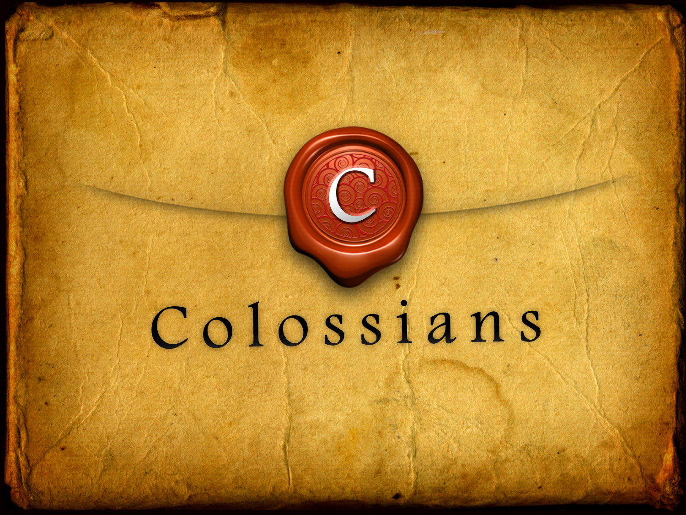
Center of Everything
1:1 – 1:23

Slide 2

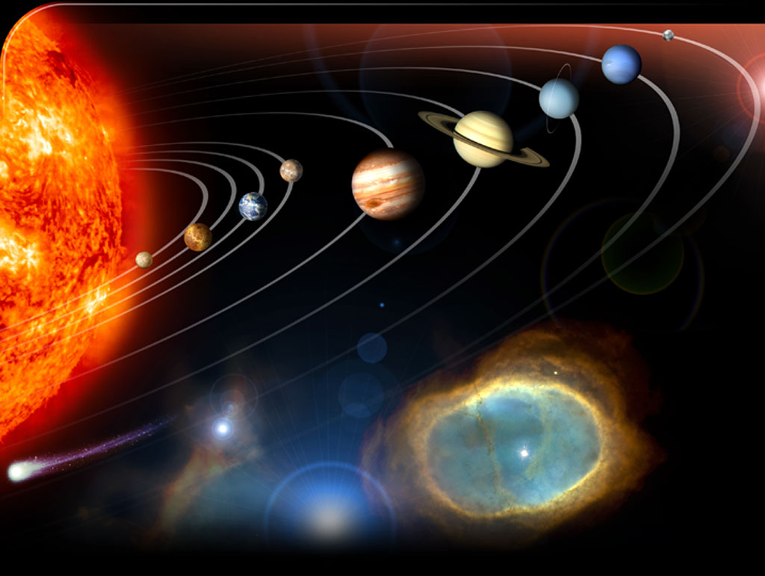
"When they discover the center of the universe, a lot of people will be disappointed to discover they are not it"
Bernard Bailey
Co-Creator of DC Comics
2

Slide 3
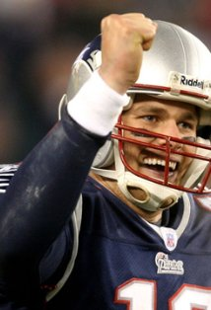
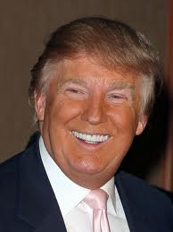
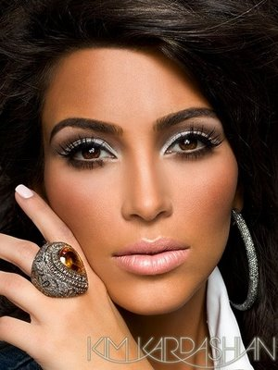
Center of the Universe
Can you think of someone who lives as though they are the center of the universe?
How would you describe his or her lifestyle?
What are the long-term effects of a self-centered worldview?
3

Slide 4
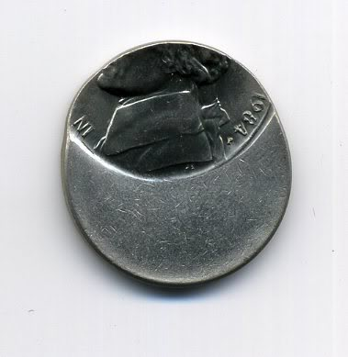
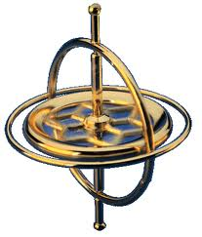
Off Center
When people don’t want to submit to a greater power, they come up with their own answers to life’s deepest questions.
These philosophies throw
people off center.
4

Slide 5
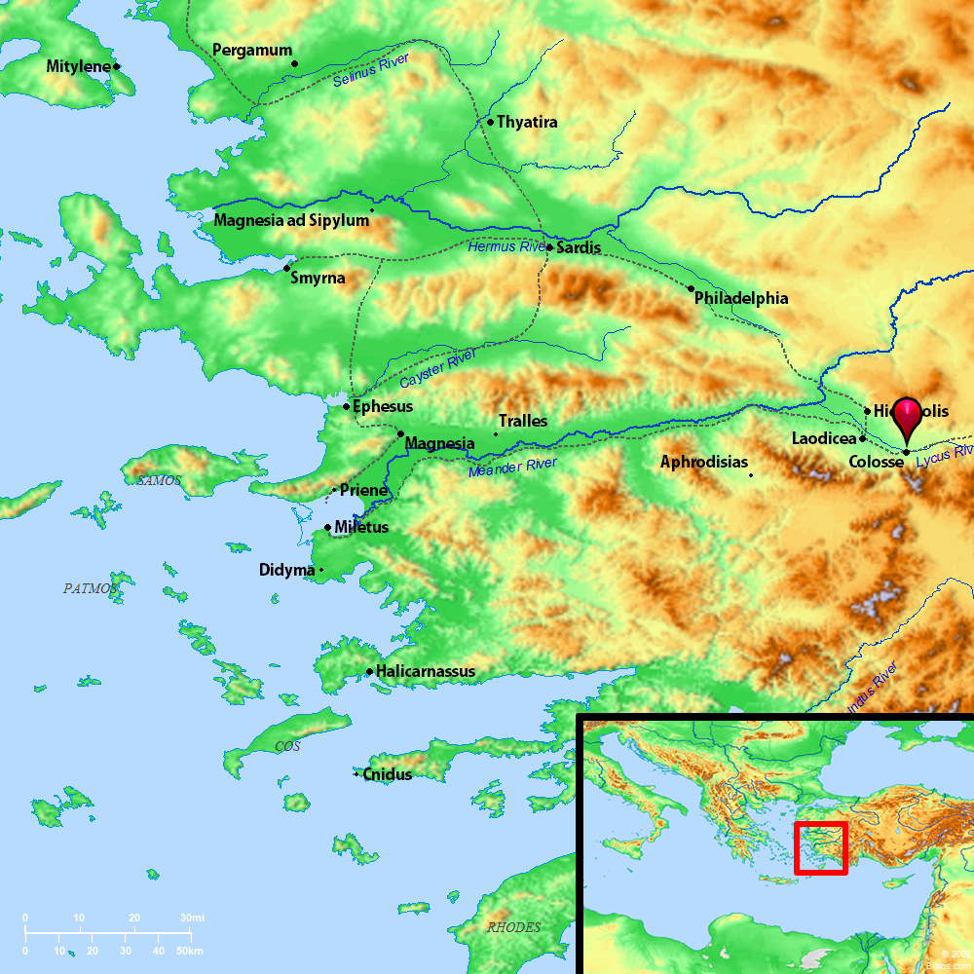
Colossians
Colossae (kuh-los'-ee)
was a declining center in the Roman province of Asia Minor.
Paul didn’t know the Colossian believers personally, but he was concerned about them.
5

Slide 6

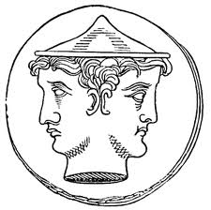
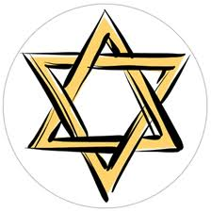
False Teaching
False teachers in Colossae were promoting a mixture of Jewish, Christian, and pagan practices, philosophies, and superstitions that undermined Christ’s supremacy.
Paul wrote the Letter to the Colossians to combat these false philosophies.
6

Slide 7
Why Beliefs Matter
Paul chose not to focus on the errors but on the truth because the truth answers every error.
What we believe matters, so Paul prayed believers in every century would have the right beliefs.
7

Slide 8
Colossians 1:9-12
⁹ For this reason also, since the day we heard this, we haven’t stopped praying for you. We are asking that you may be filled with the knowledge of His will in all wisdom and spiritual under-standing, ¹⁰ so that you may walk worthy of the Lord, fully pleasing to Him, bearing fruit in every good works and growing in the knowledge of God.
8

Slide 9
Colossians 1:9-12
¹¹ May you be strengthened with all power, according to His glorious might, for all endurance and patience, with joy ¹² giving thanks to the Father, who has enabled you to share in the saints’ inheritance in the light.
9

Slide 10
Paul’s 1st Petition
What was Paul’s first major request for the Colossian believers?
  That they would be filled with…
    Knowledge of God’s will
    Wisdom (information & insight)
    Spiritual understanding (application)
Spiritual points to the Holy Spirit
10

Slide 11
Paul’s Objective
Why did Paul pray for these things for the Colossian believers?
  So that they would…
    Walk worthy of the Lord
    Be fully pleasing to Him
    Bearing fruit in good works
    Growing in the knowledge of God
11

Slide 12
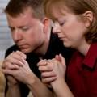
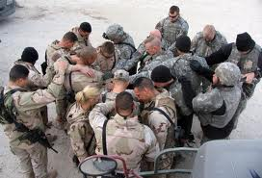

Praying with Poignancy
How do parent’s pray for their children away in college or serving in the military?
When you know you won’t be able to see someone for whom you are praying, how does it change the way you pray for them?
12

Slide 13
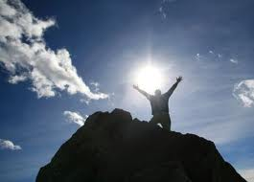
Paul’s 2nd Petition
What was Paul’s second major request for the Colossian believer’s (v. 11)?
Why did Paul pray for the Colossians to be strengthened with God’s power?
What will believers do when they choose to respond to life with unconditional endurance, patience, joy, and thankfulness?
13

Slide 14
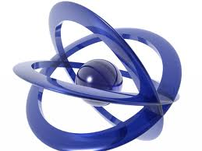
Staying Centered
Beliefs are the force that keeps us orbiting around the Center rather than flying off into destruction!
When the belief system deteriorates, so does the lifestyle and the life.
But it can’t be just any set of beliefs.
We must correctly believe who Christ is.
14

Slide 15
Who Christ Is
Everything in life revolves around how we answer the question – “Who is Jesus?”
Let’s see what Paul had to say to the Colossian believers about that.
15

Slide 16
Colossians 1:15-20
¹⁵ He is the image of the invisible God, the firstborn over all creation; ¹⁶ because by Him everything was created, in heaven and on earth, the visible and the invisible, whether thrones or dominions or rulers or authorities—all things have been created through Him and for Him.
16

Slide 17
Colossians 1:15-20
¹⁷ He is before all things, and by Him all things hold together. ¹⁸ He is also the head of the body, the church; He is the beginning, the firstborn from the dead, so that He might come to have first place in everything.
17

Slide 18
Colossians 1:15-20
¹⁹ For God was pleased to have all His fullness dwell in Him, ²⁰ and through Him to reconcile everything to Himself by making peace through the blood of His cross—whether things on earth or things in heaven.
18

Slide 19
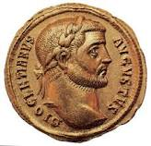
God in 3-D
We borrowed our word “icon” from the Greek word translated “image” in verse 15: eikon.
Paul’s use of image in this context means a complete representation.
Jesus is not a one-sided image of God stamped on a coin, He is a full three-dimensional view.
19

Slide 20
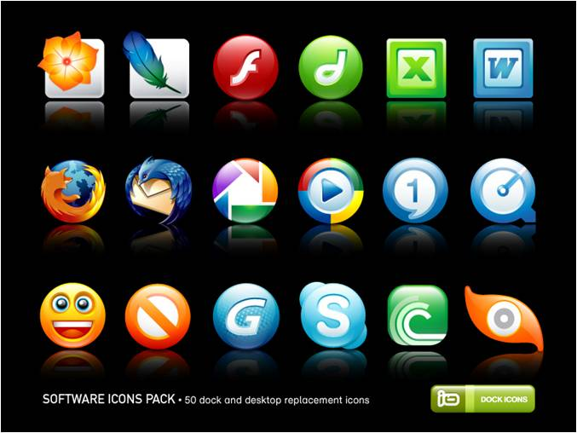
God in 3-D
Think about the icons you may have on the home screen of your computer; what do they represent?
How does an image help you visualize an invisible concept?
In similar fashion, how does Jesus
help you understand God?
20

Slide 21

Christ, First & Foremost
All Things
How would believing all this about Jesus give us confidence that the world isn’t totally spin-ning out of control?
What are some specific ways on any given day that we can see Christ first and foremost in our own lives?
CHRIST
Created Through (v. 16)
Come After
(v. 17)
Held Together
(v. 17)
Belong to
(v. 18)
21

Slide 22
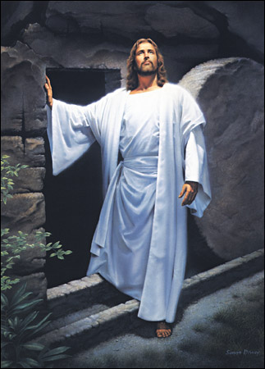
Who is Jesus to Me?
Many people don’t keep Christ as Lord and center because they have not settled the question of who He is.
In Matthew 16:15, Jesus asked His disciples, “Who do you say that
I am?”
Based on the verses we just read,
how would you answer Jesus?
22

Slide 23
What Christ Has Done
Who Jesus is, is amazing enough.
But, we cannot separate who Jesus is from what He has done.
We should be completely blown away when we consider what this Creator, Ruler, and Sustainer has done for us.
23

Slide 24
Colossians 1:13-14
¹³ He has rescued us from the domain of darkness and transferred us into the kingdom of the Son He loves, ¹⁴ in whom we have redemption, the forgiveness of sins.
24

Slide 25
Colossians 1:21-23
²¹ And you were once alienated and hostile in mind because of your evil actions. ²² But now He has reconciled you by His physical body through His death, to present you holy, faultless, and blameless before Him—²³ if indeed you
25

Slide 26
Colossians 1:21-23
remain grounded and steadfast in the faith, and are not shifted away from the hope of the gospel that you heard. This gospel has been proclaimed in all creation under heaven, and I, Paul, have become a minister of it.
26

Slide 27
What Christ Has Done
So, put it into your own words. What has Jesus done?
Could He have done any of this if He was not who Paul declared He was?
Why is “But now” in verse 22 such a hopeful statement in a world that seems to be spinning out of control?
What is the “once…but now” before and after statement of your life?
27

Slide 28
Without the Sun
If the sun were to disappear…all life on earth would die very shortly…Everything that orbits the sun would go off track and possibly collide without the gravitational pull from the sun.
What would life on earth be like without the SON?
28

Slide 29

You’re Grounded!
What did Paul mean by the statement in v. 23?
What are some “shocking” aspects of life in 2012? How does Christ keep us grounded?
How can an ever growing relationship with Christ keep you grounded and centered?
29

Slide 30
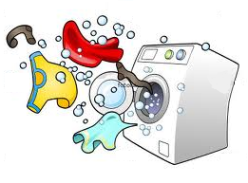
Unbalanced?
Losing the center is annoying in a washing machine, it’s devastating in life!
Lives that aren’t centered in Christ get thumped and tossed around by every situation and teaching.
We can only stay in balance when we find a reliable center.
Have you ever had a dancing washing machine?
You throw in a load of clothes and soon hear a wild thumping sound.
What causes that?
30

Slide 31
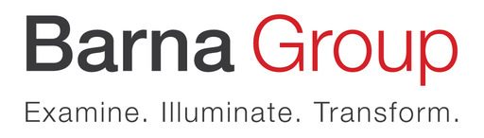
Biblical Worldview
The Barna Group surveyed adults to determine how many have a biblical worldview. They found that only 9% believe the following:
  There is absolute moral truth
  The Bible is totally accurate
  A person cannot earn their way into heaven
  Jesus lived a sinless life
  God is the all-knowing, all-powerful Creator who rules the universe
  Satan is real
31

Slide 32
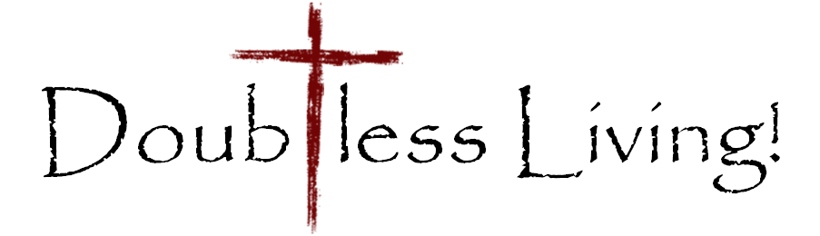
Seeing Christ for who He really is requires a biblical worldview.
Our worldview dramatically influences our choices and has a huge impact on behavior. And, worldview is primarily shaped and established by age 13.
Check out pages 88-89 in your quarterly for some great ideas for building and reinforcing a biblical worldview in your family.
32

Slide 33
Remember, seeing Christ for who He really is and then seeing everything else in light of that reality is the key to doubtless living.
To achieve that we need to understand who Christ is and what He has done, stand in awe of Him, and bow in submission to His authority.
33

Slide 34
Group Resources
  www.doubtlessliving.com
  www.youversion.com/groups/doubtlessliving
34

